Slide 1
Elements of a Computer System
Understanding Computers

Slide 2
Find a definition of a Computer and write it down

Slide 3
Learning Objectives
Distinguish between hardware and software
Identify Input, Output and Storage devices
Name at least five pieces of software
Suggest appropriate input and output devices for a given scenario

Slide 4
What is Hardware or Software?
What is Hardware? | What is Software?
Objects that you can touch, like a Music CD. For example: Disks, disk drives, display screens, keyboards, printers, boards, and chips. | You cannot ‘touch’ software. Software refers to the programs that run on a computer, rather like the music playing on a CD. Examples of software: Windows, MS Word, MS Excel, Kodu and Logo.

Slide 5
What are Input, Output & Storage Devices?
What is an output device? | What is an input device? | What is a Storage device?
An output device is a piece of computer hardware used display or output data which has been processed or stored in a computer. Printer, Speaker. | An input device is anything can be used to enter data into a computer. Keyboard, Mouse. | A storage device is used to permanently record or store data. CD, Hard Drive.

Slide 6
Activity 1
Open and complete Worksheet 1

Slide 7
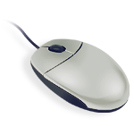
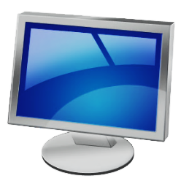
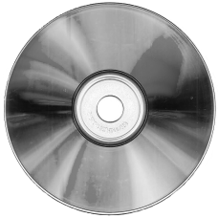
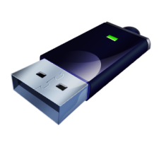
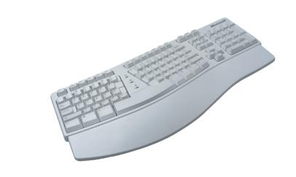
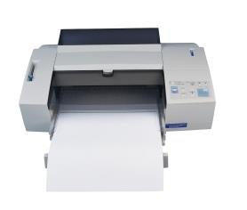
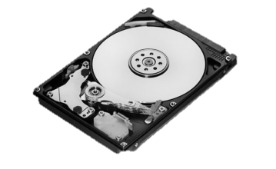
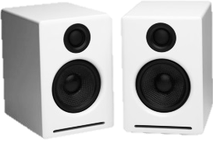
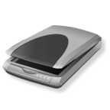
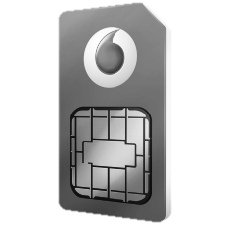

What do each of these images represent? Input, Output or Storage devices?

Slide 8
Input, Process, and Output
INPUT
Take in the number 5 and 4
Now Multiply them together
Tell me the answer
PROCESS
OUPUT

Slide 9
Input, Process, and Output
Sensors take in Data. Can you think of some sensors?
Heat Sensor, Light sensor, Movement Sensor, Noise Sensor

Slide 10
Using the terms Input, Process, and Output describe how the following work
Automatic door
Street Lights
Smart Phone (any example)
Paying for food in the canteen

Slide 11
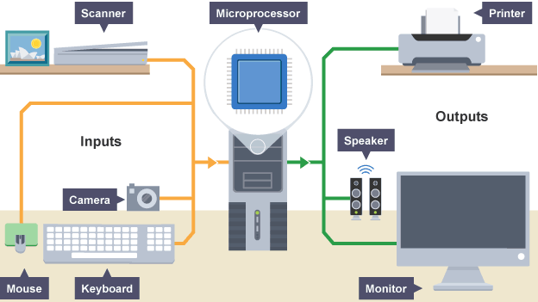
Input Process Output

Slide 12
Computer Systems
Save worksheet 2 in your folder and complete all the questions.
Print once you have finished
Determine the input, process and output in each case

Slide 13
Plenary
Write down the input, process and output of your own example of a computer in either school, home or outside

