Slide 1
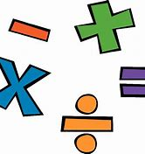
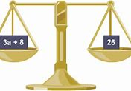
ALGEBRA
LO: To be able to understand the basics of algebra and certain rules and to be able to solve algebraic equations.
Rules:
Please make sure you have a pen and notebook with you and are making notes during the lesson.
Your MIC should be turned off
Please take part in the lesson when asked questions and only write in the chat box when asked
If you have any questions related to the lesson, please feel free to ask in the chat box and I will look at them during the lesson.

Slide 2


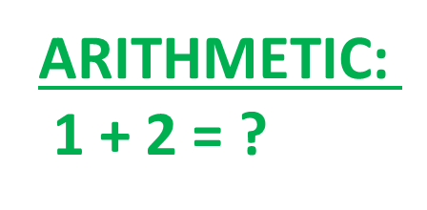
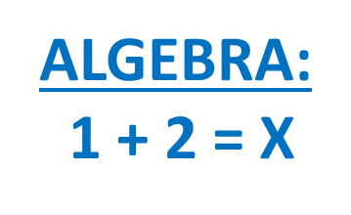
Algebra is a branch of mathematics that substitutes letters for numbers
a x 8 = 40
5 x 8 = 40
SYMBOLS:
A b c d e f g h I j k l m n o p q r s t u v w x y z
WHAT IS ALGEBRA?
OPERATIONS:
+ - x ÷
Algebra is about finding the unknown.

Slide 3






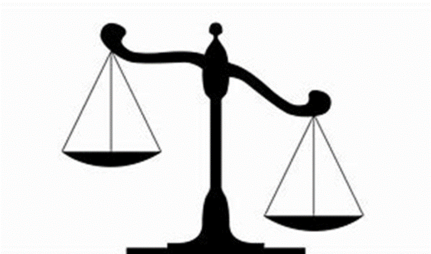


SOLVING BASIC EQUATIONS:
KEY STRATEGY:
GET THE UNKNOWN VALUE BY ITSELF IN AN EQUATION!
…Means figuring out the value of the unknown!
e.g. X Y Z
4 + X
3
= 5
X = 5 x 3 - 4
AN EQUATION IS LIKE A BALNCED SCALE
HOW?

Slide 4





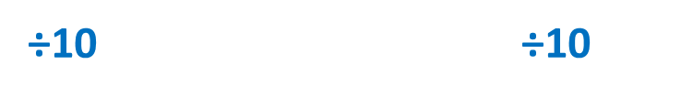

It’s the same for multiplication and division
1 + 2
3
x5 x5
SAME CHANGES!
Whatever we do to one side we must do to the other.
+4 +4
-3 -3

Slide 5
SOME EXAMPLES…
x + 3 = 8
x – 15 = 7
Subtraction does not have commutative property.
20 = x + 7
15 – x = 7

Slide 6

Y + 4 = 7
E + 9 = 24
X + 9 = 11
X + 5 = 11
D + 6 = 17
2 + Y = 21
Q – 5 = 2
28 + X = 42
T – 15 = 13
14 + B = 21
Y = 3
E = 15
X = 2
X = 6
D = 11
Y = 19
Q = 7
X = 14
T = 28
B = 7

Slide 7

SOLVING EQUATIONS THAT INVOLVE OPERATION OF X AND ÷ :
EXAMPLE:
3X = 15
÷ 3
÷ 3
X IS BEING MULTIPLIED BY 3 , SO TO GET X BY ITSELF WE MUST DIVIDE BY 3 AND WE MUST DO THE SAME TO THE OTHER SIDE!
X x 3
To undo that
DIVIDE
both sides
X ÷ 3
To undo that
MULTIPLY both sides
X = 5
CHECK:
REPLACE THE VALUE OF X WITH WHAT YOU FOUND , E.G. FOR THIS PROBLEM X = 5!
3 x 5 = 15

Slide 8

EXAMPLE:
DIVISION DOES NOT HAVE
COMMUTATIVE PROPERTY!
X ÷ 2 = 3
3 x 2 = 6
X
2
4
X
X
4
= 3​
X = 6
CHECK:
X IS BEING DIVIDED BY 2 SO THE INVERSE IS MULTIPICATION!
REPLACE THE VALUE OF X WITH WHAT YOU FOUND E.G. FOR THIS PROBLEM X = 6!
6 ÷ 2 = 3

Slide 10
3C = 12
8P = 24
3D = 30
10U = 20
3F = 27
G ÷ 5 = 2
X ÷ 7 = 6
S ÷ 3 = 16
T ÷ 4 = 50
M ÷ 6 = 5
2P + 1 = 9
3H – 7 = 14
C = 4
P = 3
D = 10
U = 2
F = 9
G = 10
X = 42
S = 48
T = 200
M = 30
P = 4
H = 7

Slide 11
BRACKETS
The thing OUTSIDE the brackets MULTIPLIES each separate TERM INSIDE the brackets.
When letters are MULTIPLIED together, they are just written next to each other , e.g. pq
Remember, R x R = R², and TY² means T x Y x Y, whilst (TY)² means T x T x Y x Y.
Remember, a minus outside the bracket REVERSES ALL THE SIGNS when you multiply.
EXAMPLE:
4p (3r - 2t)
-4 (3p² - 7q³)
3 (2x + 5)
= 6x + 15
= 12pr - 8pt
12p² + 28q³

Slide 12
2 (x - 2)
X (5 + x)
Y (y + x)
3y (2x - 6)
3 (p + 7)
5 (3y - 7)
6 (t + 4)
4 (7 - 2x)
4 (3g + 5h -1)
2x – 4
5x + x²
Y² + xy
6xy – 18y
3p + 21
15y – 35
6t + 24
28 – 8x
12g + 20h - 4

Slide 13


BRACKETS IN EQUATIONS:
Solve 3(x + 2) = 12
1) EXPNAD BRACKETS
2)GET THE UNKNOWN BY ITSELF AND SOLVE!!
3x + 6 = 12
-6 -6
3x = 12
÷ 3 ÷3
3 (x + 2)
= 3x + 6
X = 4

Slide 14
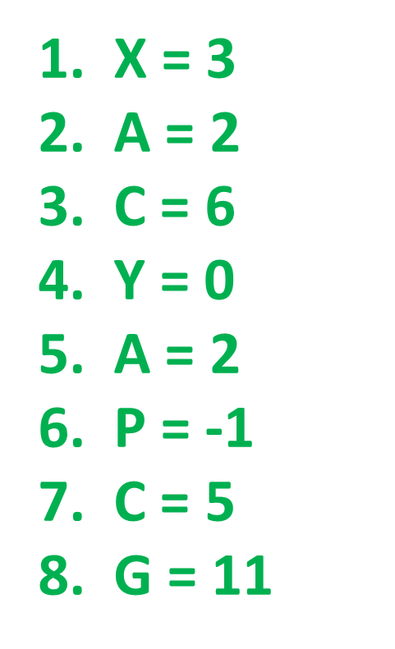


2 (x + 3) = 12
4 (a + 1) = 12
6 (c - 2) = 24
2 (y + 4 ) = 8
3 (a – 1 ) + 2 = 5
3 (p + 2 ) = 3
3 (e + 2 ) = 21
2 (g – 3 ) = 16

