Slide 1

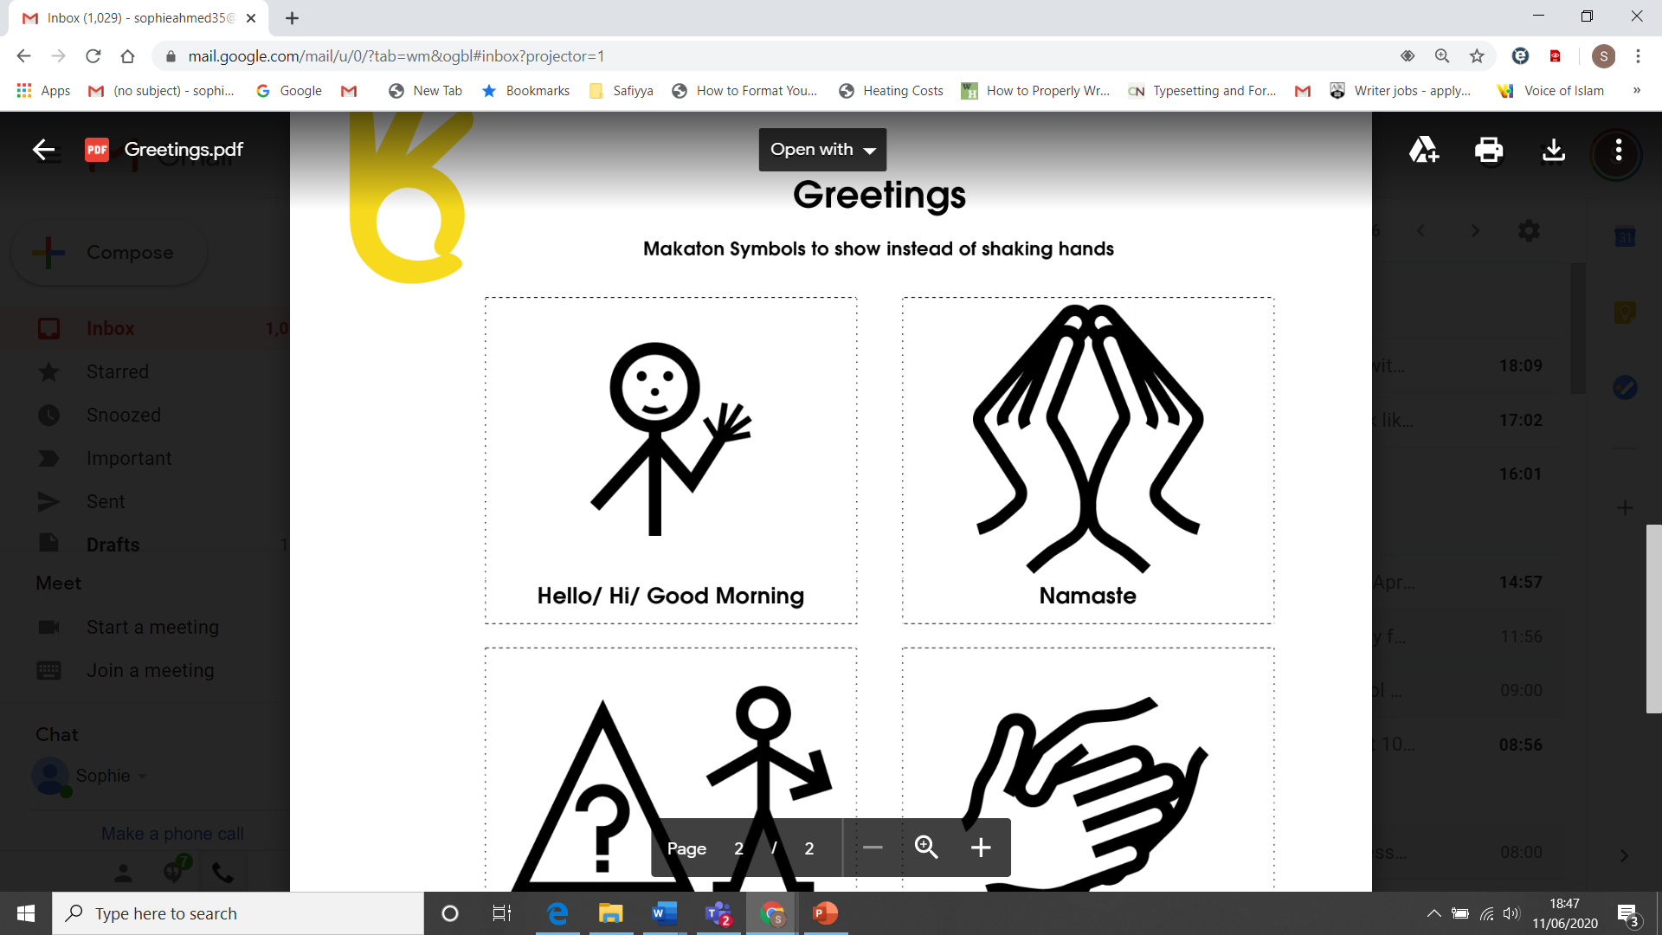

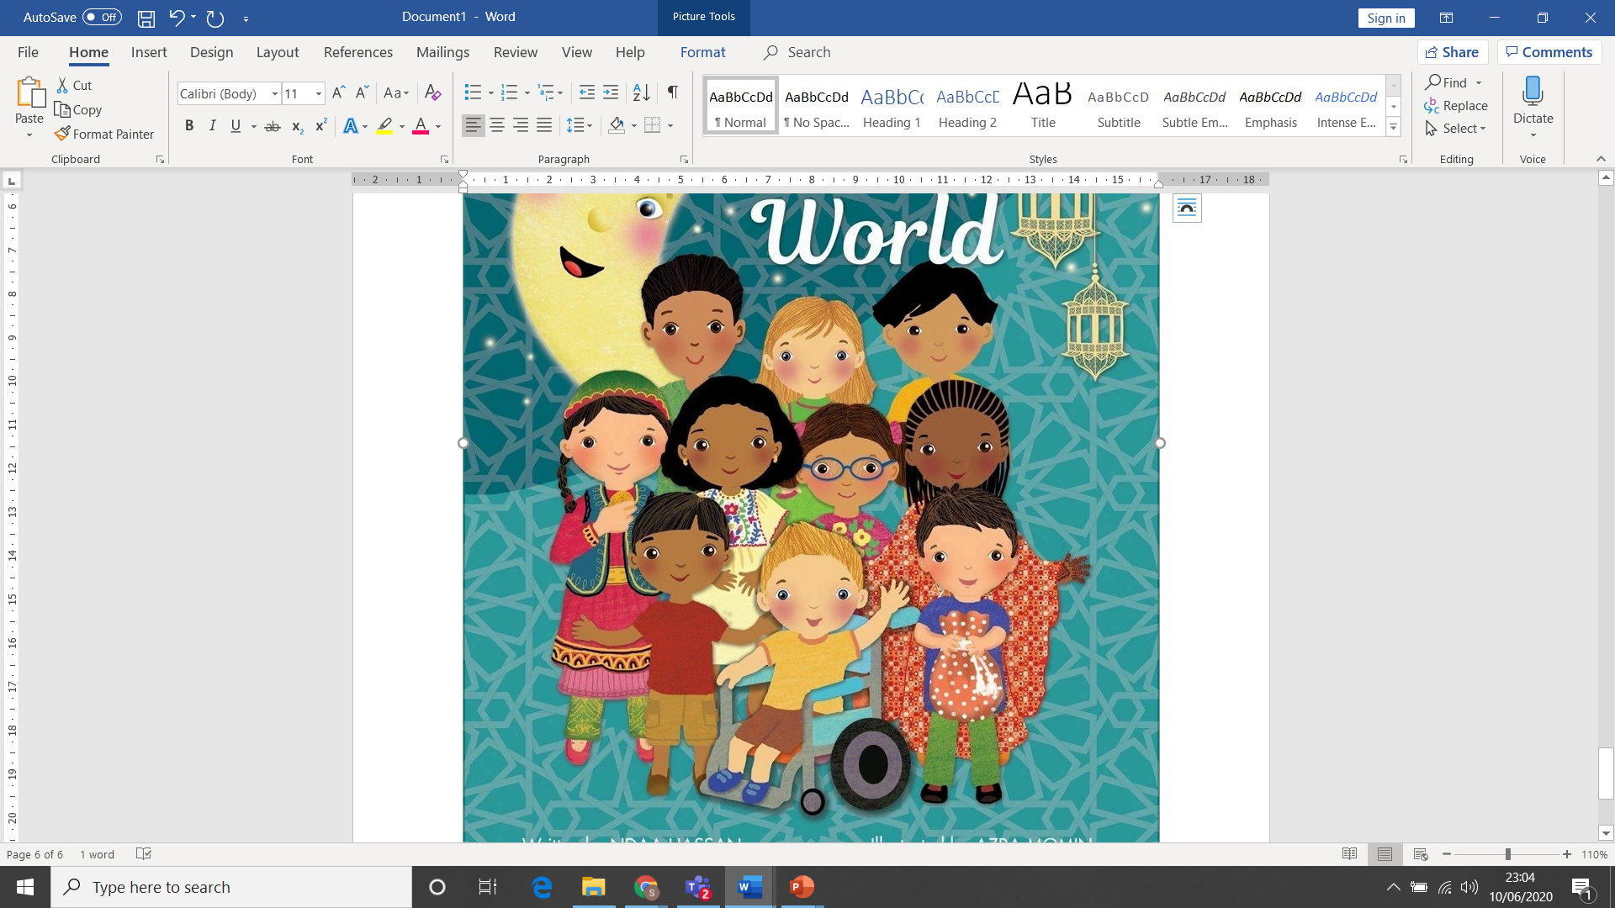

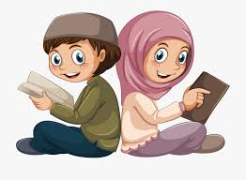
Asalamalaikum & Welcome
Your teacher is Sophia Ahmed

Slide 2
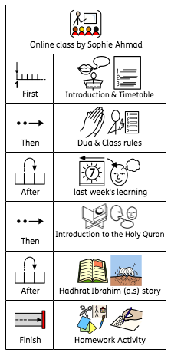
Timetable!

Slide 3



Some class rules….
Show good listening
Mics and camera switched off unless told
Don’t use chat room unless asked
Log on and off if problems

Slide 4
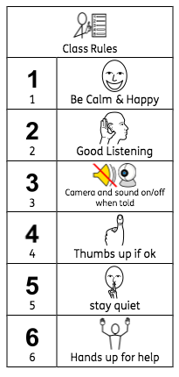

Slide 5
Look out for these signs….

Slide 6



TYPE IN CHAT
WRITE DOWN
DRAW YOUR ANSWER
SPEAK YOUR ANSWER

Slide 7

I’D LIKE TO ANSWER PLEASE!
This Photo by Unknown Author is licensed under CC BY-SA-NC

Slide 8
QUESTION…
Do you know what dua we start with when learning?
IF YOU’D LIKE TO SPEAK
SPEAK YOUR ANSWER

Slide 9
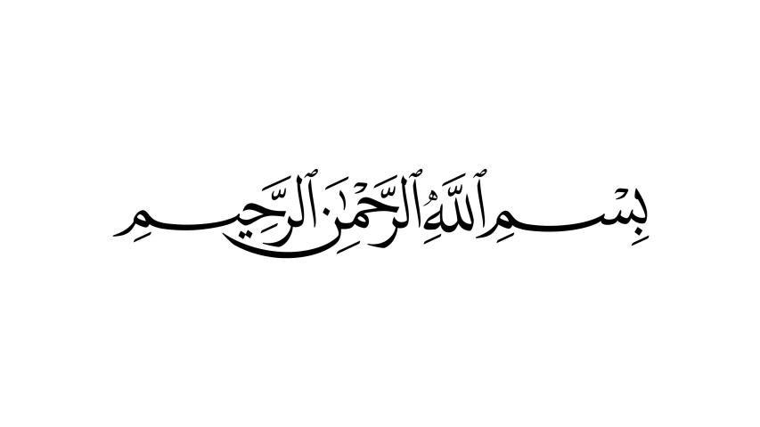
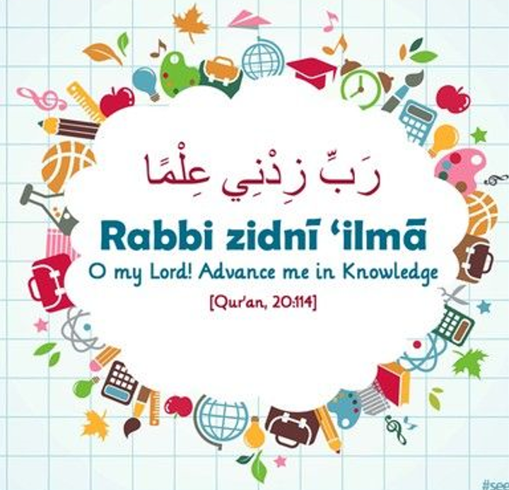

Slide 10
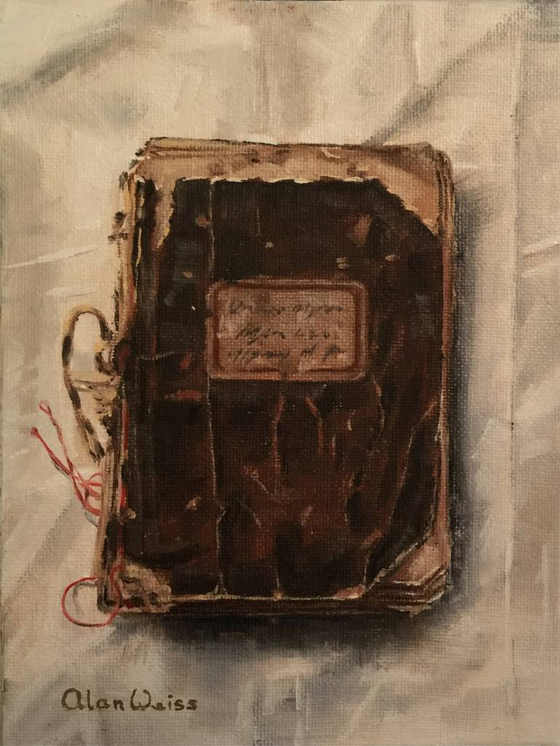

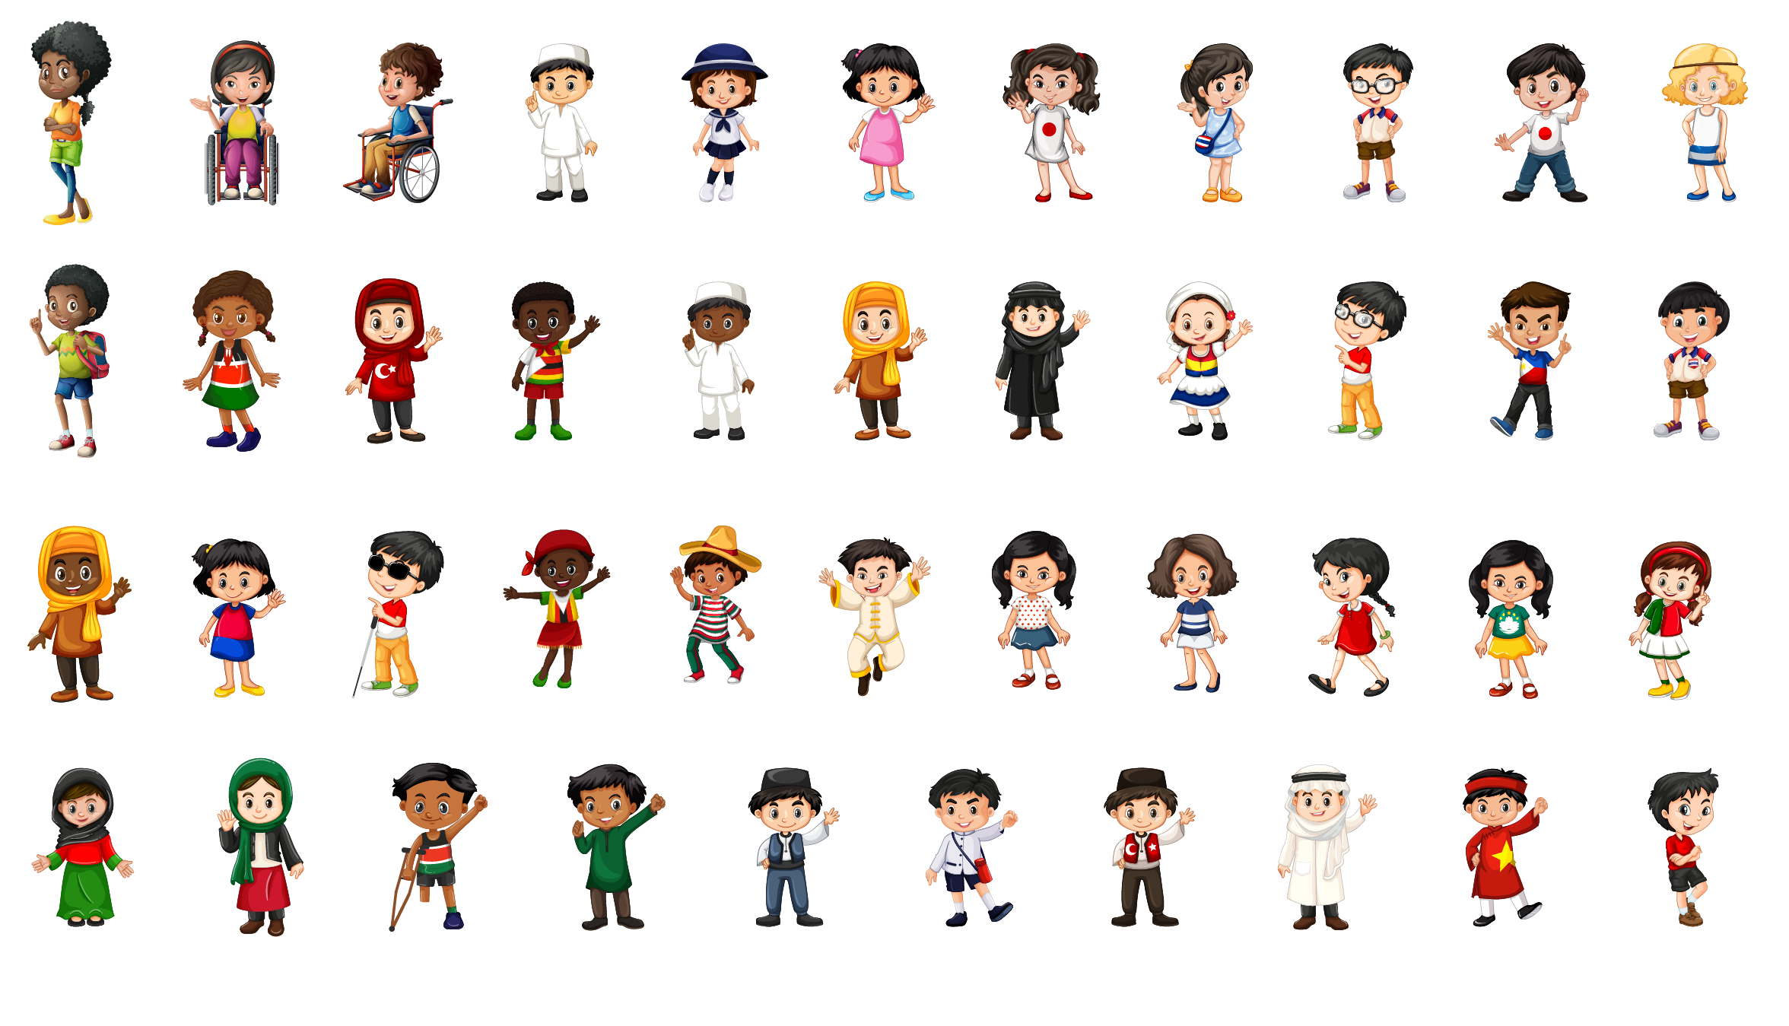
Never judge a book by its cover…

Slide 11
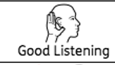


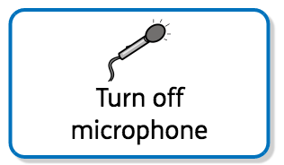
No chat in chat room
No cameras

Slide 12

Todays Learning Objectives…
I am able to recount the events of Hazrat Ibrahim’s (as) life and explain why he is so important to Muslims.
I can explain what the five pillars of Islam are and why they are so important.

Slide 13
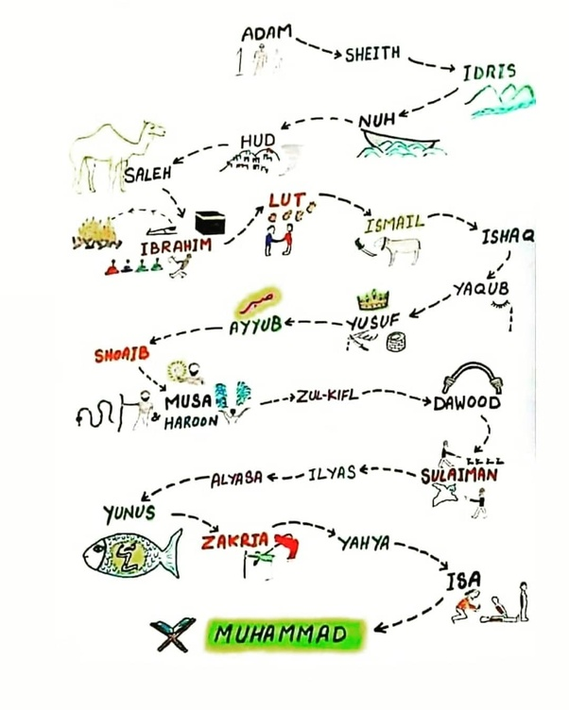
Hazrat Noah/Nuh (as)
Hazrat Abraham/Ibrahim (as)
Hazrat Muhammad (sa)
Hazrat Mirza Ghulam Ahmad (as)
(sa)
Hazrat Mirza Ghulam Ahmad (as)

Slide 14


Slide 15

Let’s review our previous learning!
Can you remember where we left the story of Hazrat Ibrahim (as)?

Slide 16


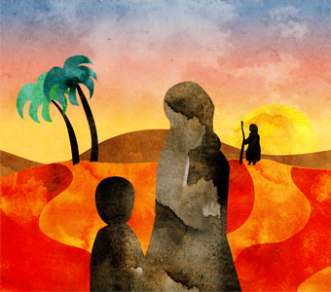


Slide 17
What is a pillar of Islam?
Can you remember which one we looked at?

Slide 18
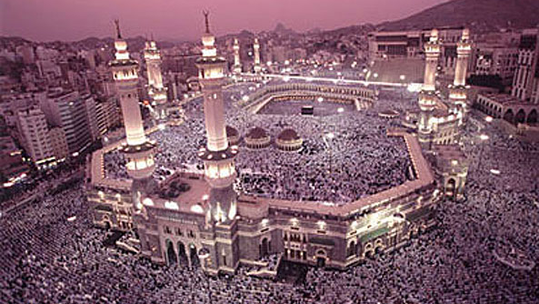
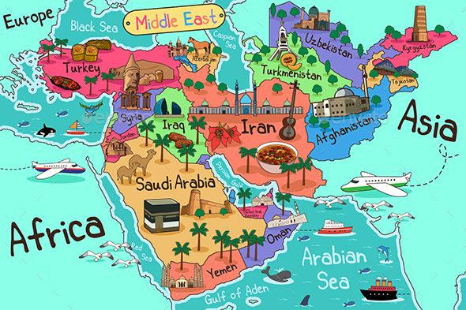

Slide 19
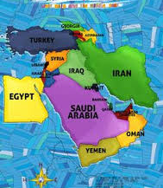
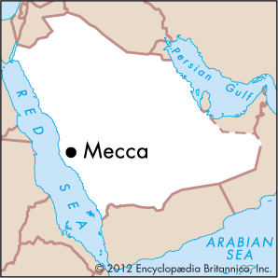
“My Lord, make this city a city of peace, and keep me and my children away from worshipping idols” (14:36)

Slide 20
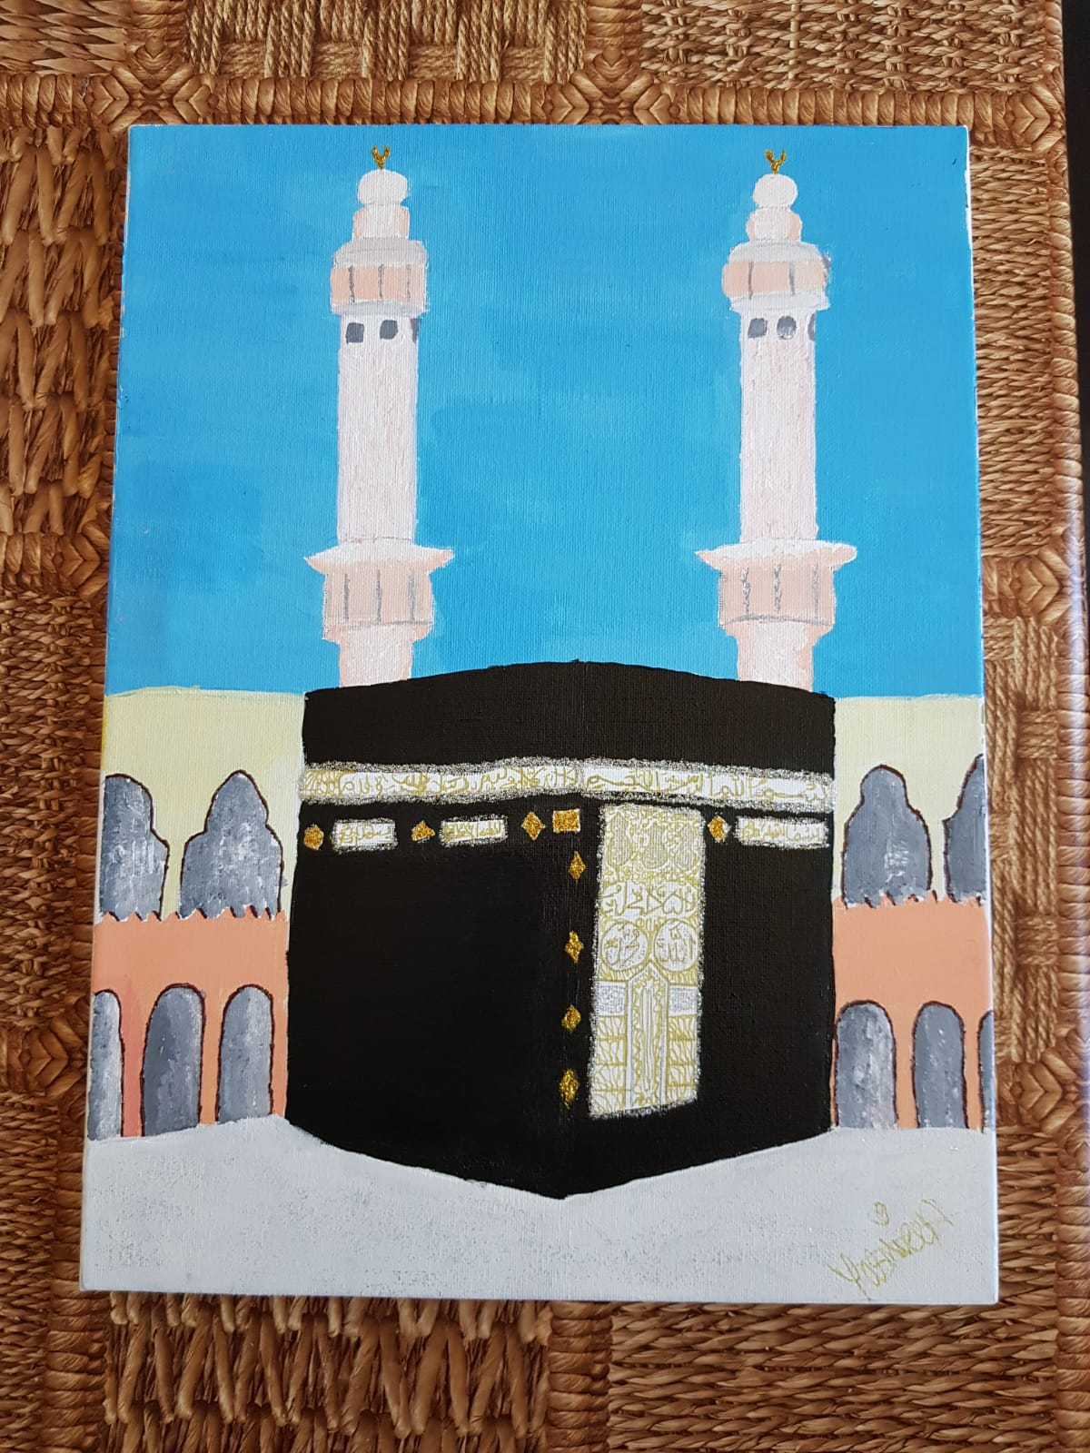


IZZA - CHEAM

Slide 21
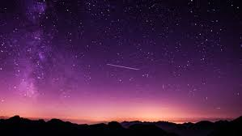
“O my son, I have seen in a dream that I offer thee in sacrifice, so consider what thou think of it!” He replied, “O my father, do as thou art commanded. Thou wilt find me, if Allah please, steadfast in my faith.” (37:103)

Slide 22

“O Abraham, thou hast indeed fulfilled the dream….” (37:105-106).

Slide 23
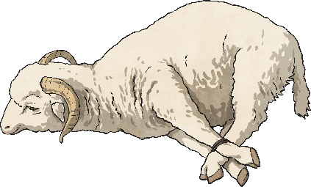

Slide 24
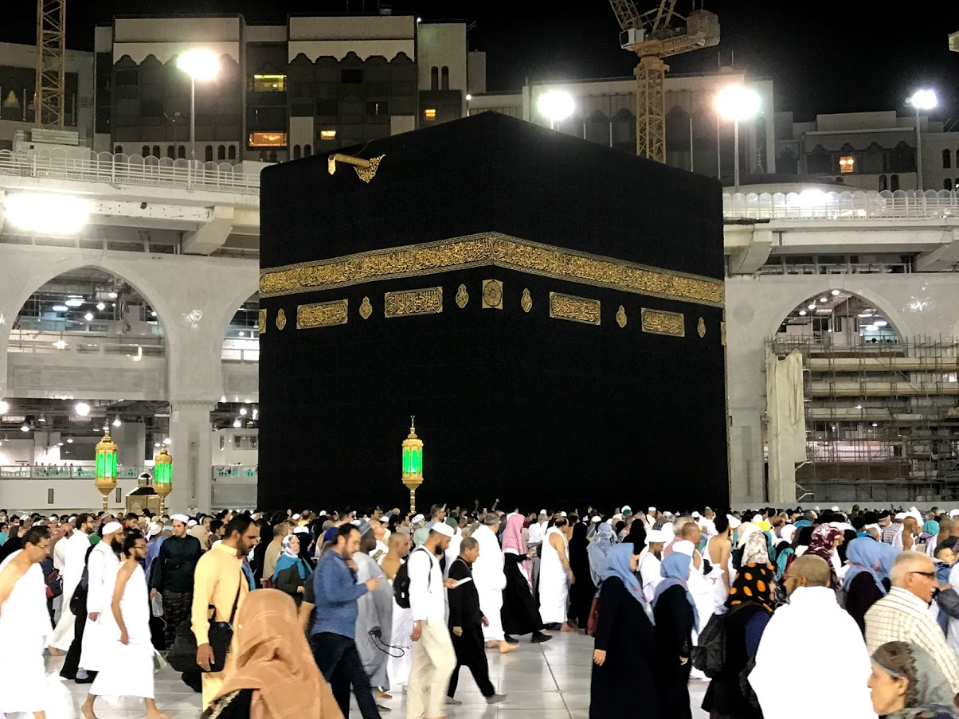

Slide 25
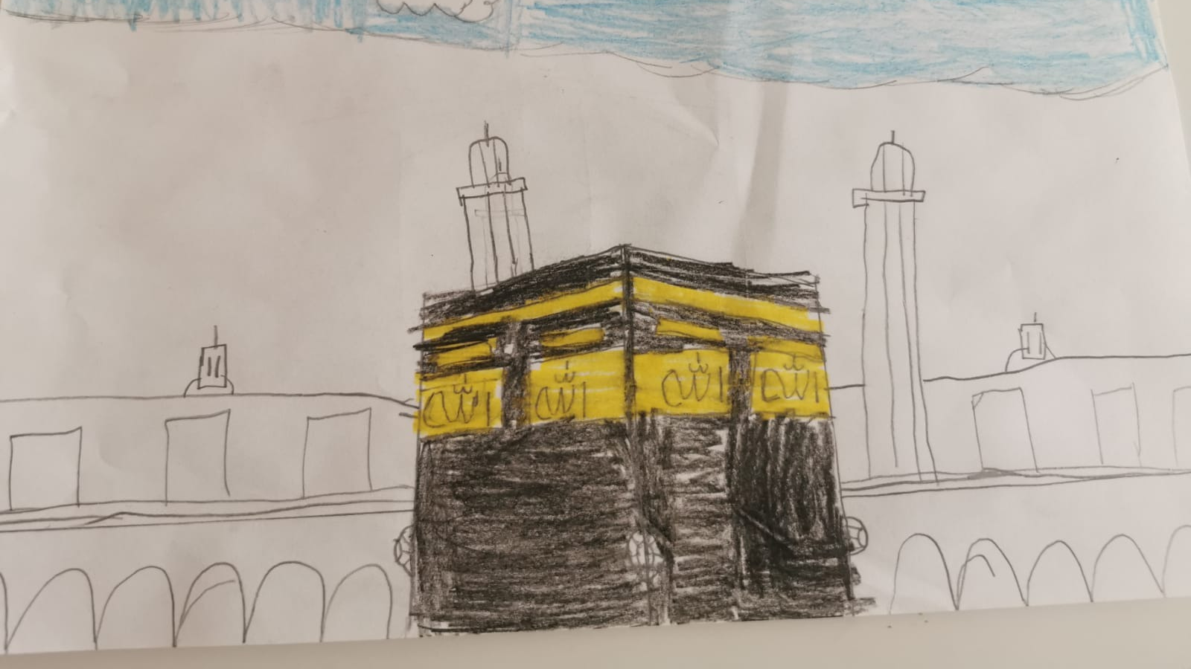
Ibrahim Ahmed, 10

Slide 26


“Our Lord, accept this from us; for thou art the all hearing, the all knowing.” (2:134) “Our Lord, make us submissive to Thee and make of our offspring a people submissive to thee. And show us our ways of worship, and turn to us with mercy; for thou art oft- returning with compassion and Merciful.”(2:135) “And, our Lord, raise up among them a messenger from among themselves, who may recite to them Thy Signs and teach them the Book and Wisdom and may purify them; surely, Thou art the Mighty, the Wise” (2:136)
This Photo by Unknown Author is licensed under CC BY-NC

Slide 27
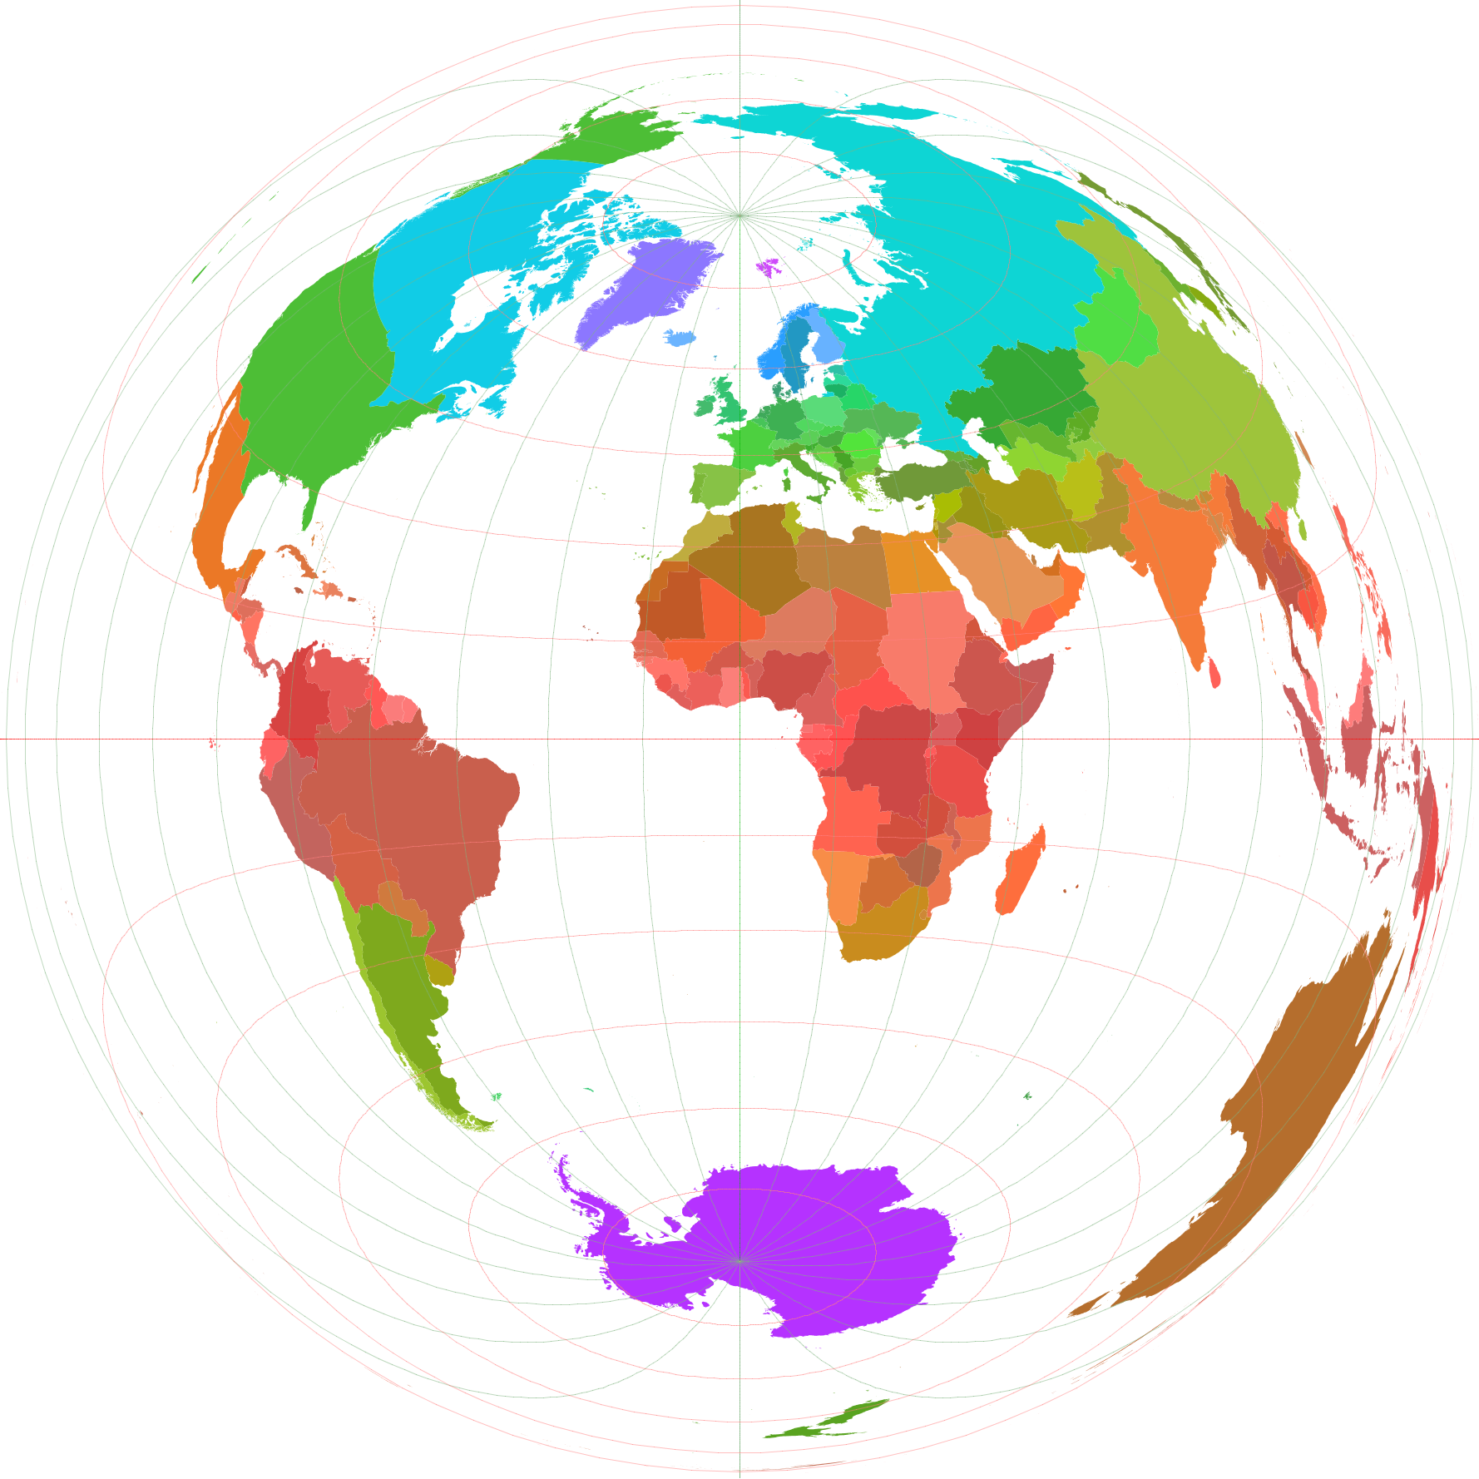
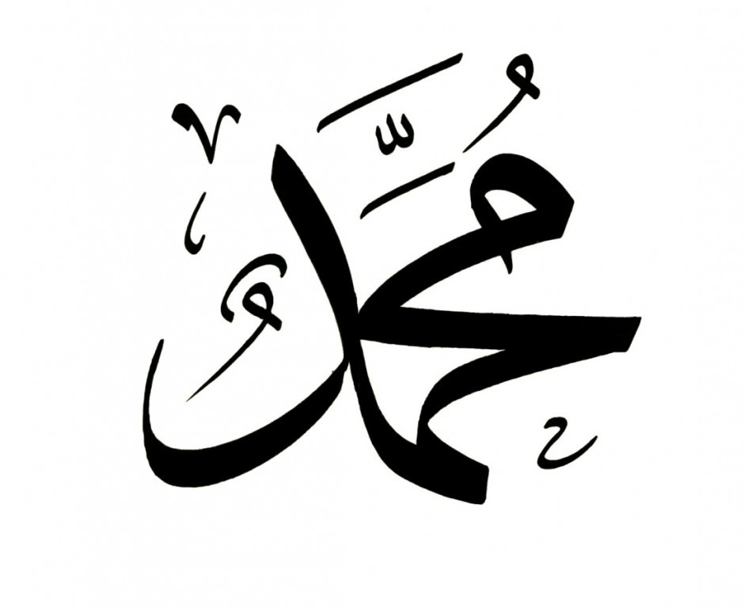

This Photo by Unknown Author is licensed under CC BY-SA

Slide 28
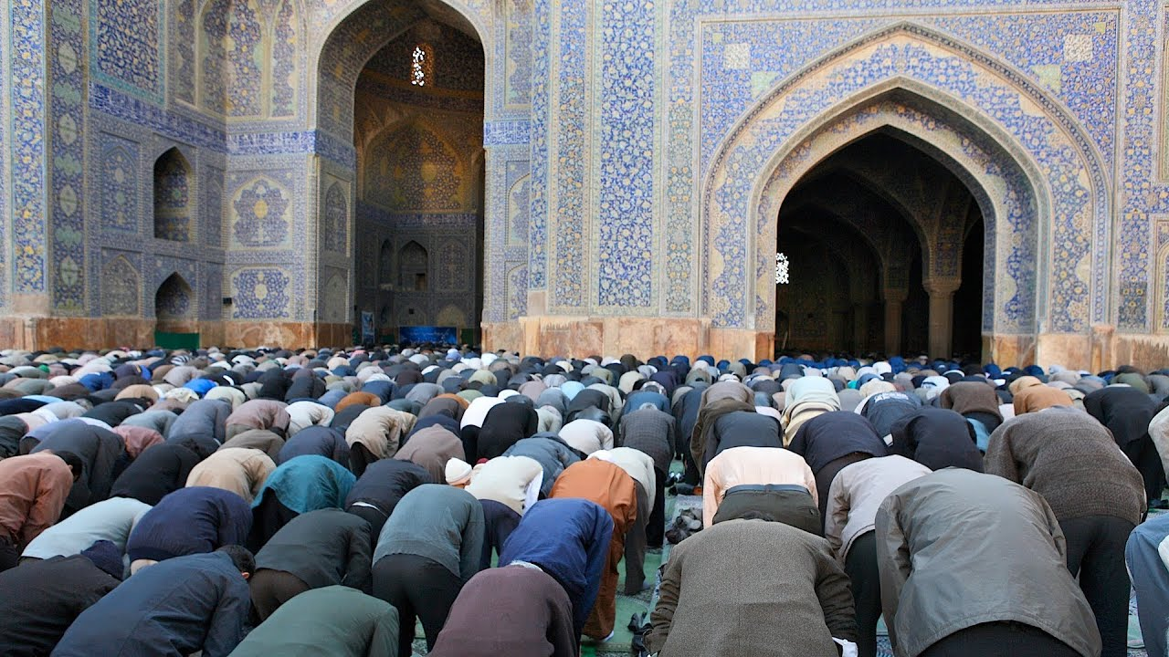
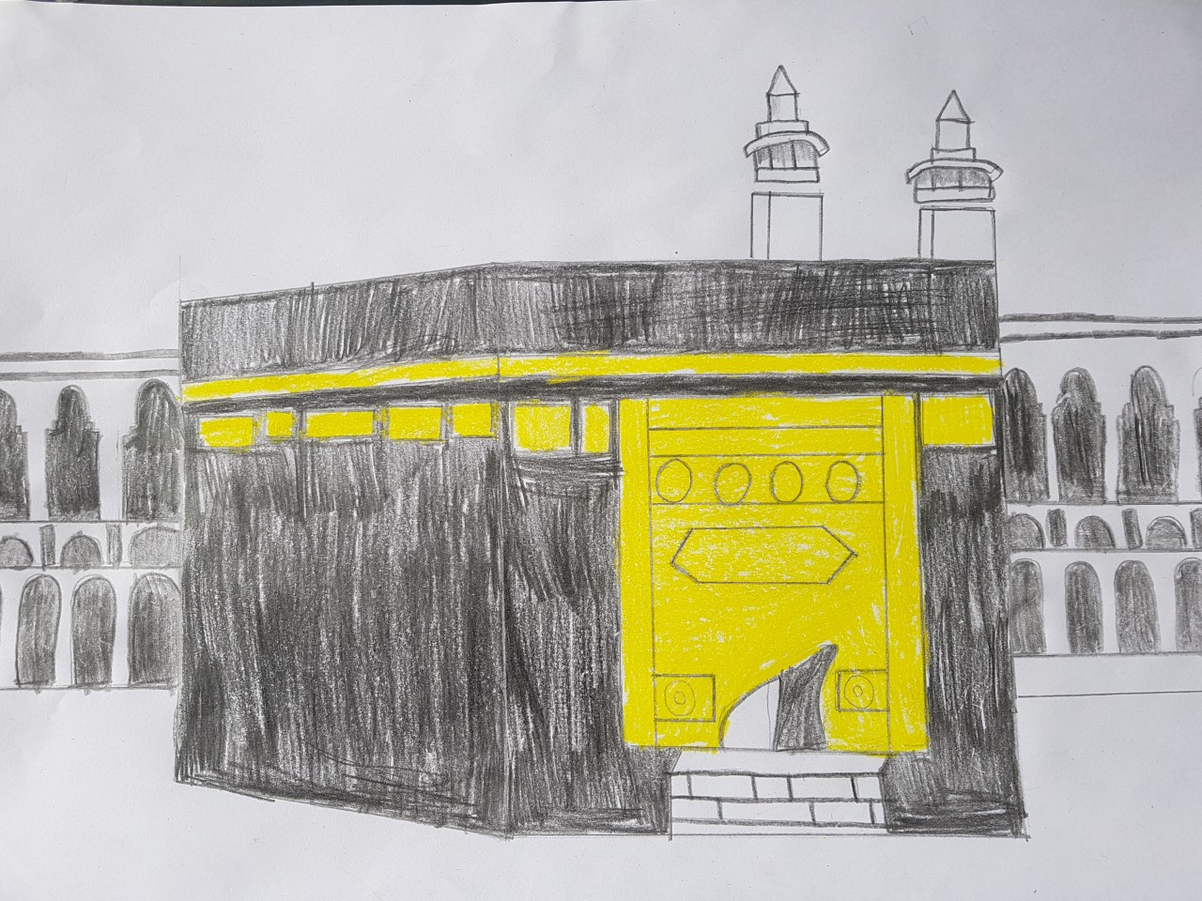
“And call to mind when We assigned to Abraham the site of the House and said associate not anything with Me, keep My house clean for those who perform circuits and those who bow and prostrate themselves in prayer”(22:27) “And proclaim unto man the pilgrimage. They will come to thee on foot and on every lean camel, coming by every distant deep track” (22:28)

Slide 29
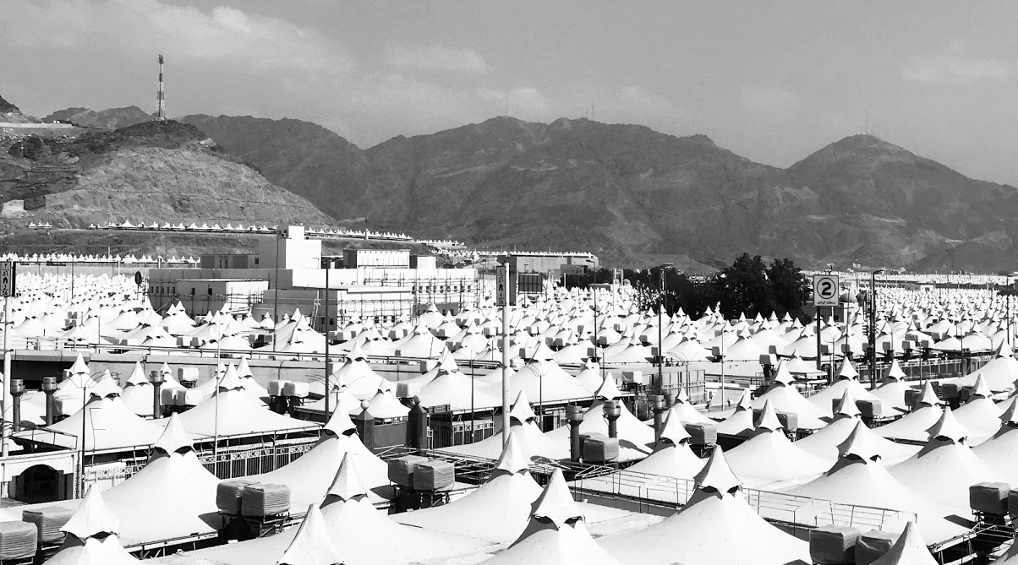
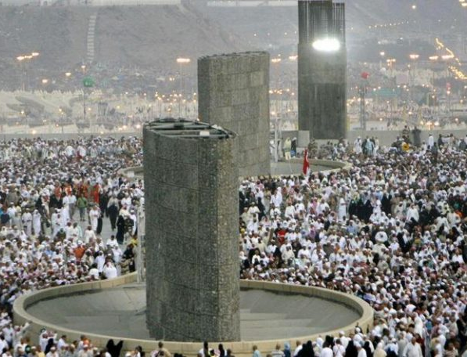

Slide 30
Hazrat Noah/Nuh (as)
Hazrat Abraham/Ibrahim (as)
Hazrat Muhammad (sa)
Hazrat Mirza Ghulam Ahmad (as)
(sa)
Hazrat Mirza Ghulam Ahmad (as)

Slide 31
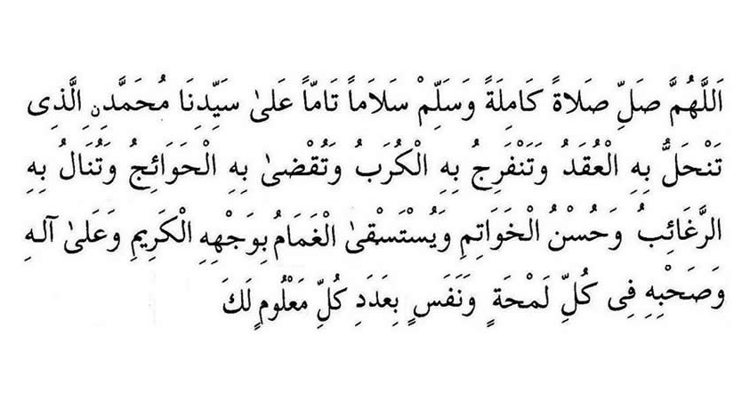

Slide 32
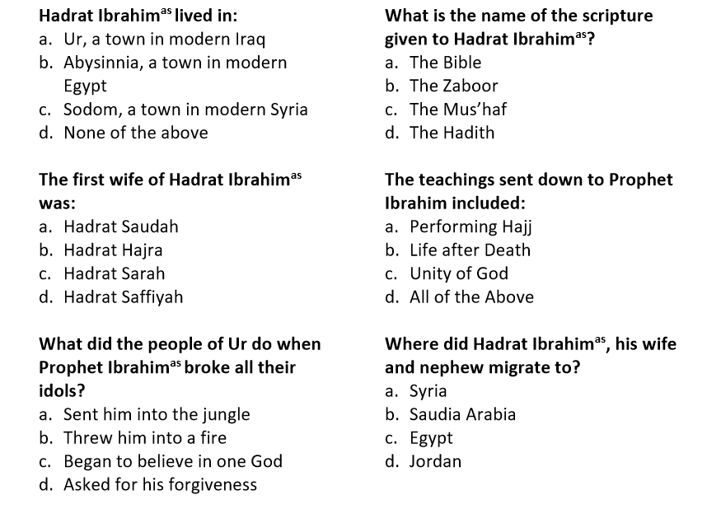

Slide 33
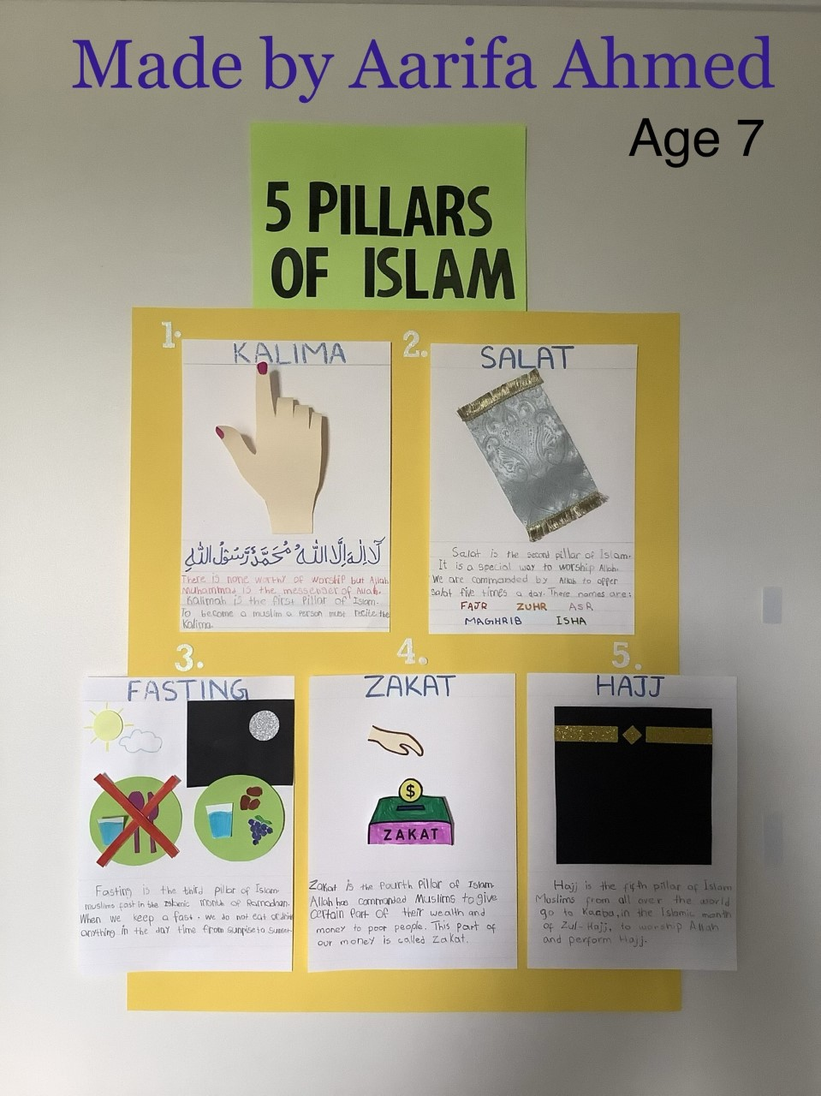
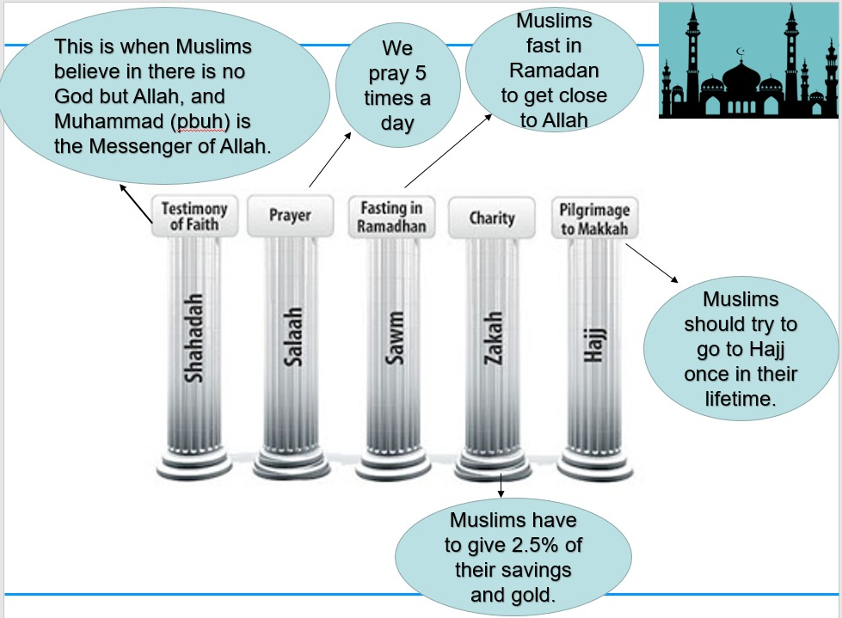
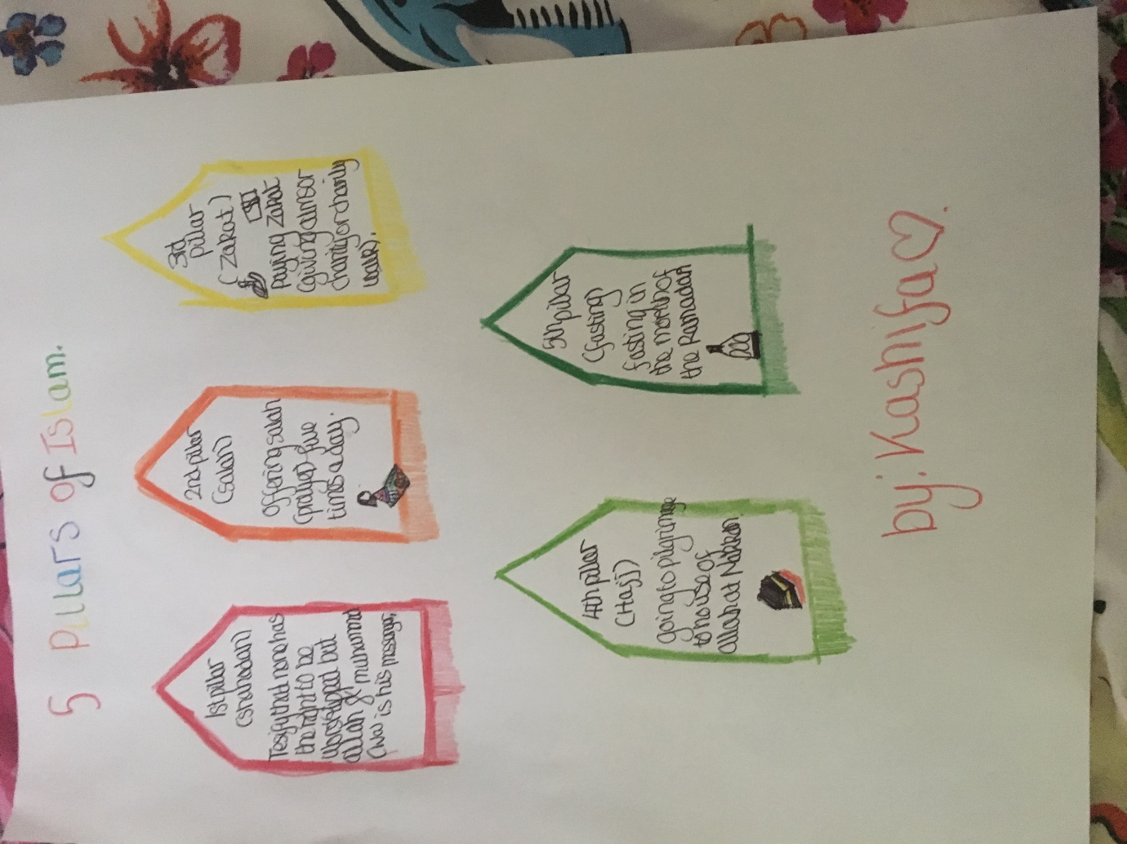
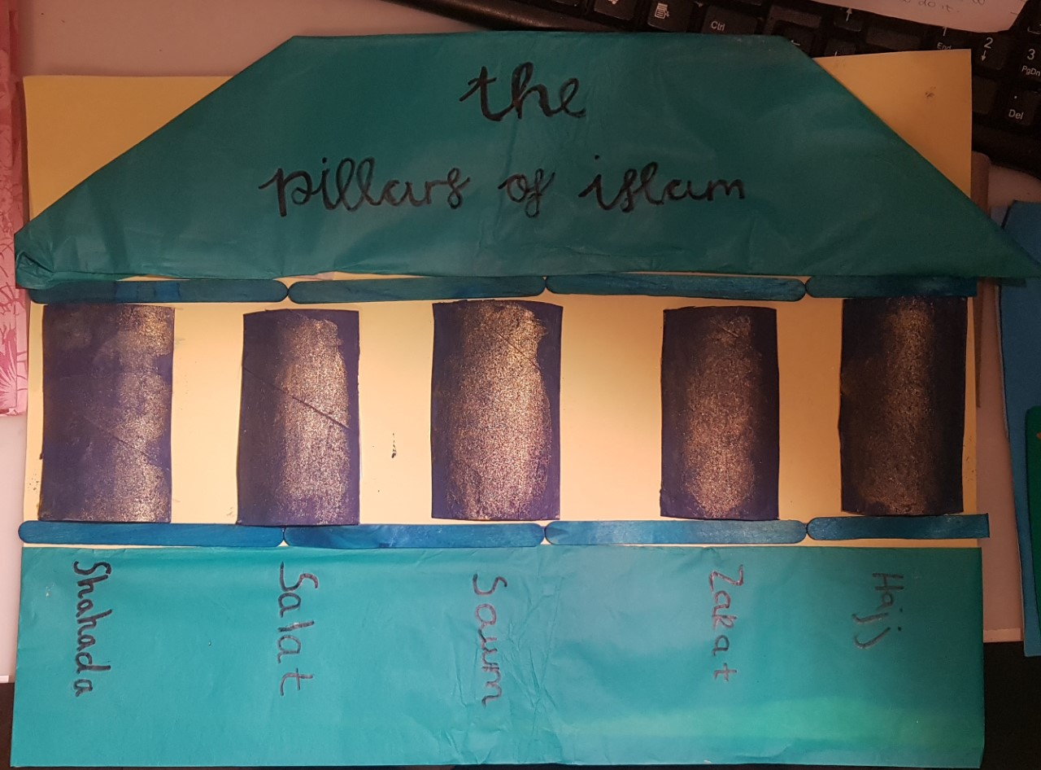
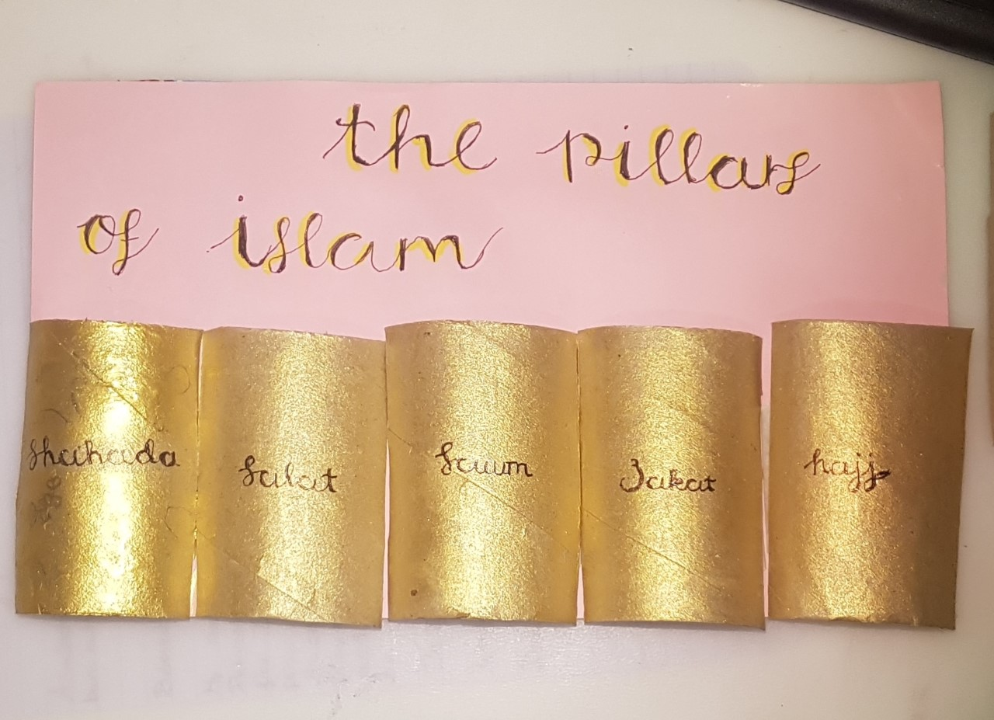
Mah-Noor 11
Dania 9
Malaika 12

Slide 34

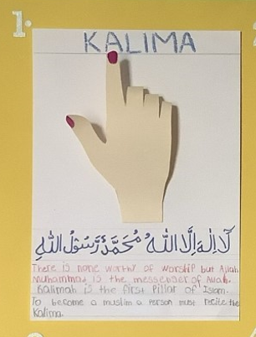
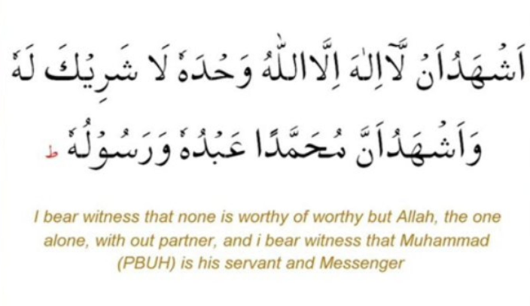
1.
Kalima Shahada
(Declaration of Faith)

Slide 35
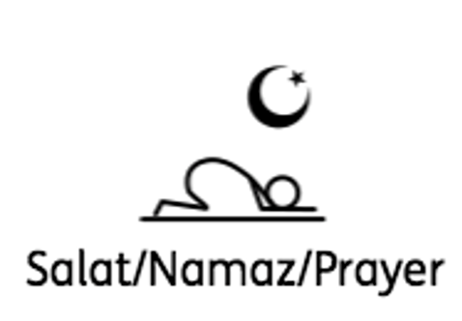
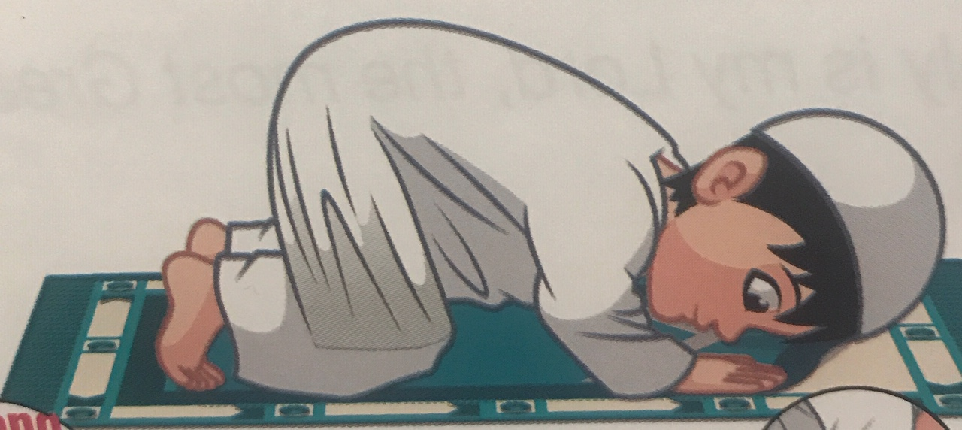
2.
Salat (Prayer)

Slide 36
Question…
Can someone tell me what the five daily prayers are?

Slide 37

FAJR

Slide 38

ZUHR

Slide 39

ASR

Slide 40

MAGHRIB

Slide 41
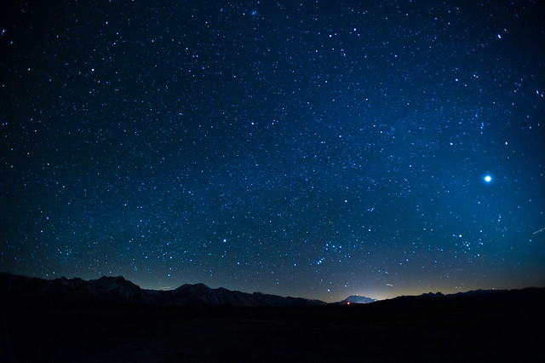
ISHA
This Photo by Unknown Author is licensed under CC BY-SA

Slide 42
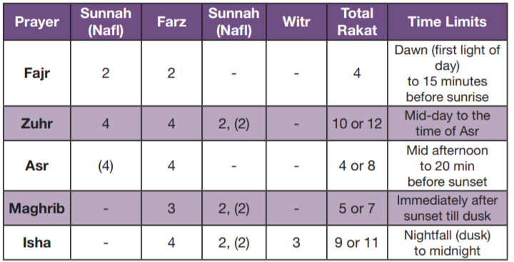

Slide 43

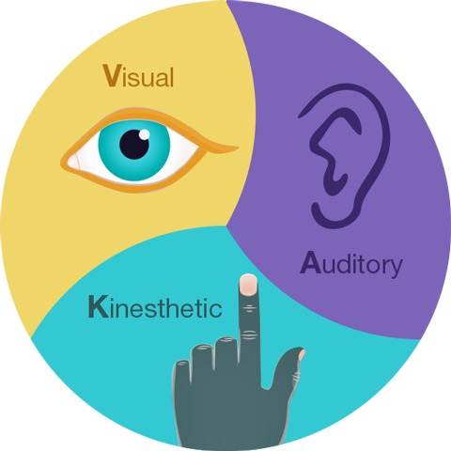


Slide 44
Never judge a book by its cover…

Slide 45

https://youtu.be/Ezv85LMFx2E

Slide 46
Do you know what we should do before we offer salat?

Slide 47
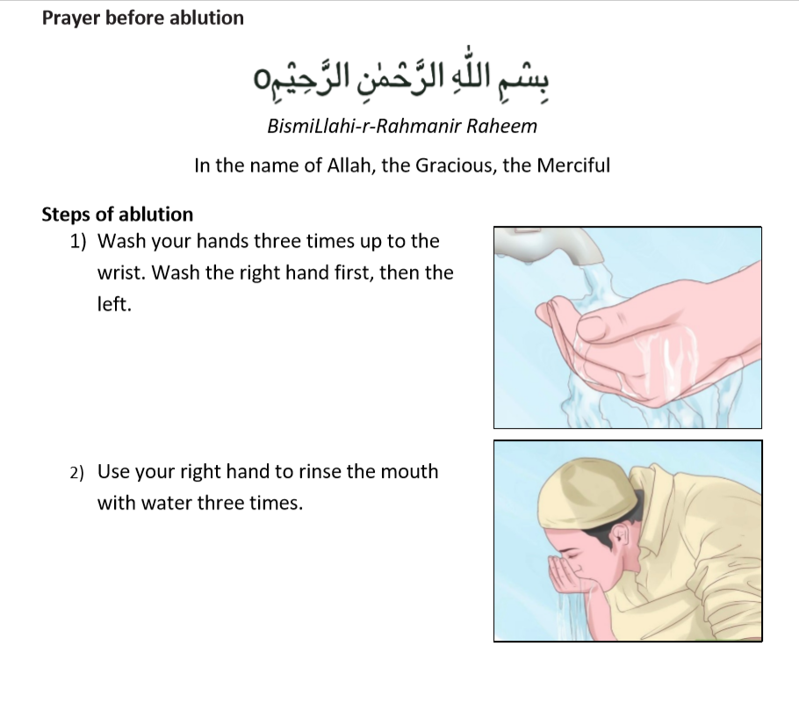
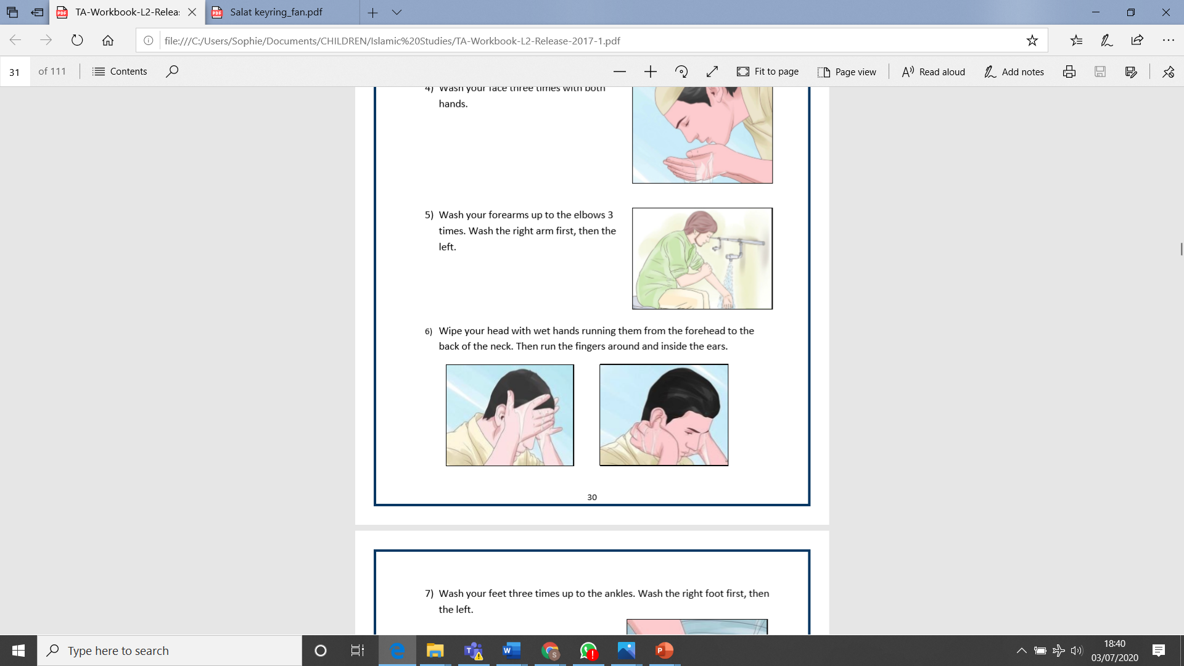
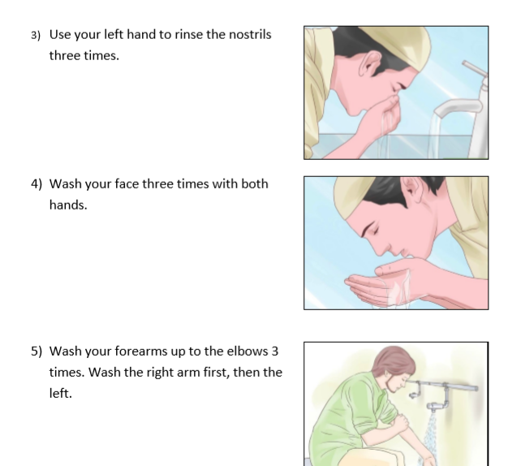
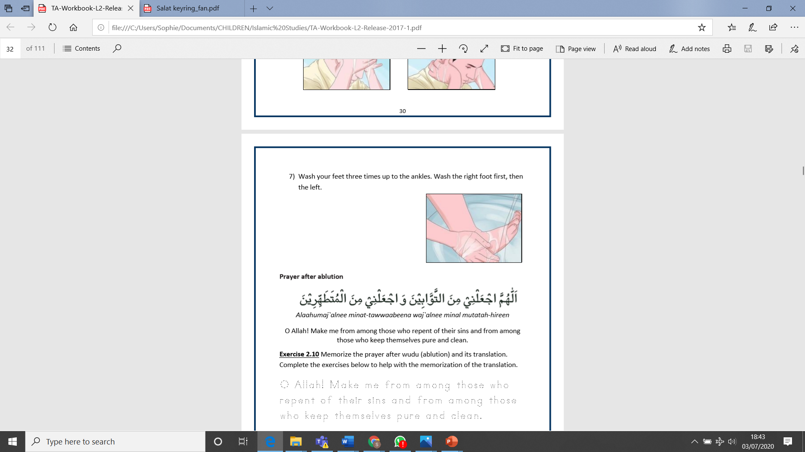

Slide 48
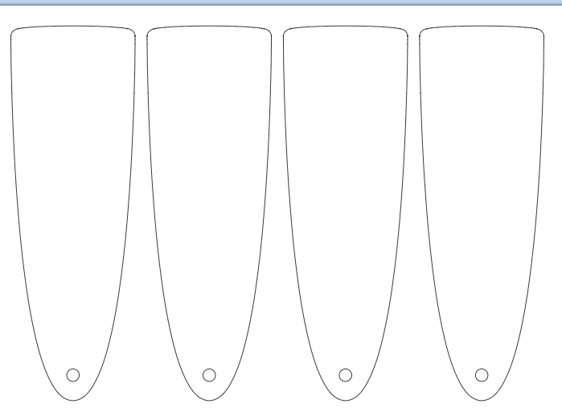
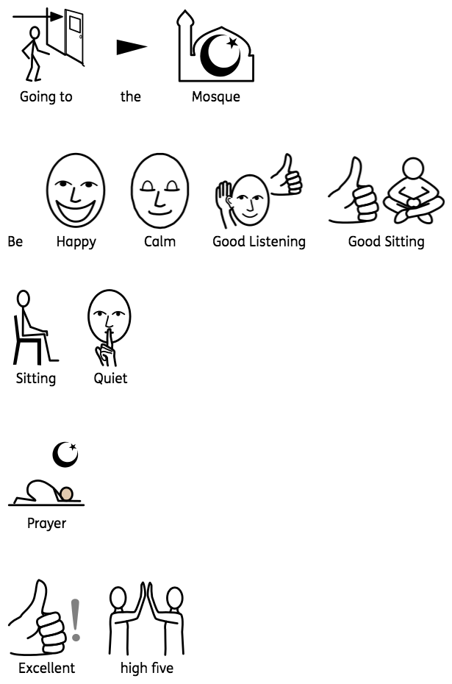

Salat/Prayer Positions, Routine & Behaviour Key Rings
These can be cut out, laminated and put on a key ring to use on various events at the Mosque

Slide 49
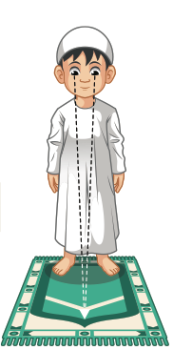
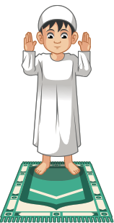


Ruku
Niyat
Takbeer-tehrima
Qiyam

Slide 50




Qa’dah
Sajdah
Qayyama
Jilsah.

Slide 51

The best way to learn salat
is to copy those who
know and practice….even if you haven’t
learnt all of the duas…offer all of your prayers…
Blessings!
This Photo by Unknown Author is licensed under CC BY-NC
This Photo by Unknown Author is licensed under CC BY-NC

Slide 52
Thank you so much!
Homework : Can you make a learning fan of either the namaz positions or the wudhu
Next week…Saturday at 3pm…don’t forget to go online to check the timetable on :
https://ahmadiyya.uk/talim/online-classes/
TalimTeacher2@ahmadiyyauk.org

