Slide 1
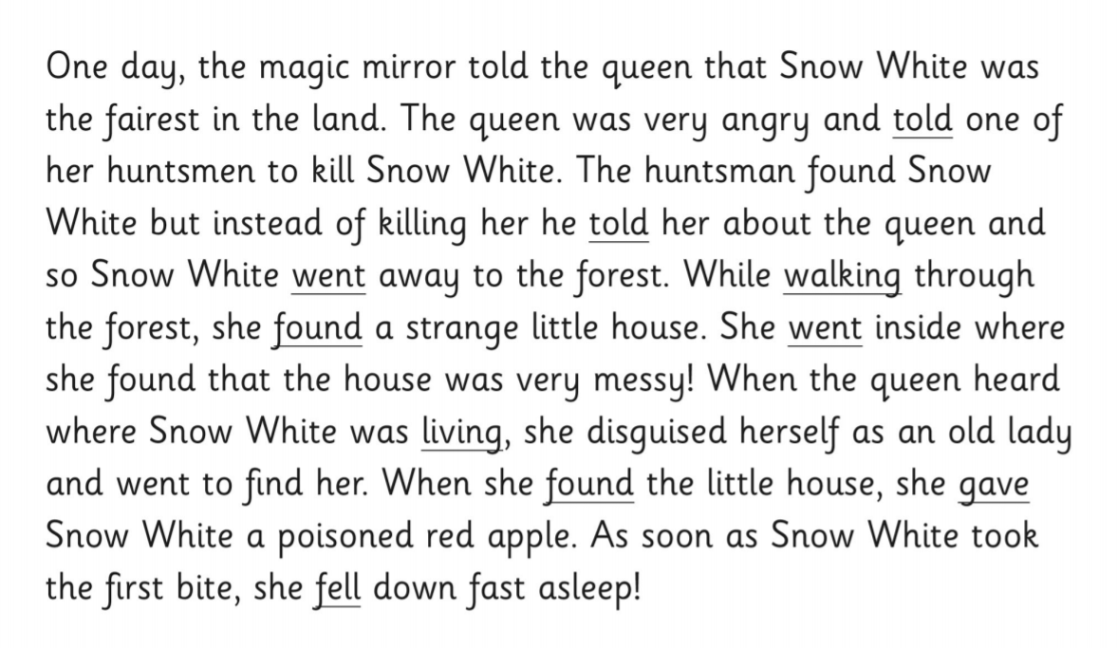
In the name of Allah, the Most Gracious, the Ever Merciful
Starter Activity:
Replace the underlined verbs with more powerful ones.

Slide 2
PARTS OF SPEECH
11 PLUS PREPARATION
By Nafeesa Rehana

Slide 3
Learning Objectives
To understand how different parts of speech form a sentence.
To identify nouns and pronouns and understand their correct use.
To apply knowledge in writing using these parts of speech correctly.

Slide 4
What is speech?
* The communication or expression of thoughts
* Conversation
The old,tired man was sitting under the tree and patiently waiting for someone to arrive.

Slide 5
EIGHT PARTS OF SPEECH
Pronouns
Adjectives
Verb
Adverbs
Interjections
Prepositions
Nouns
Conjunctions

Slide 6
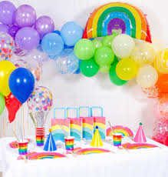
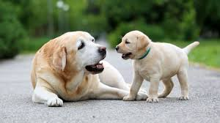
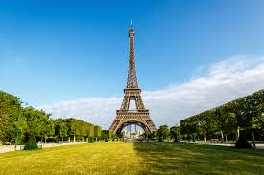
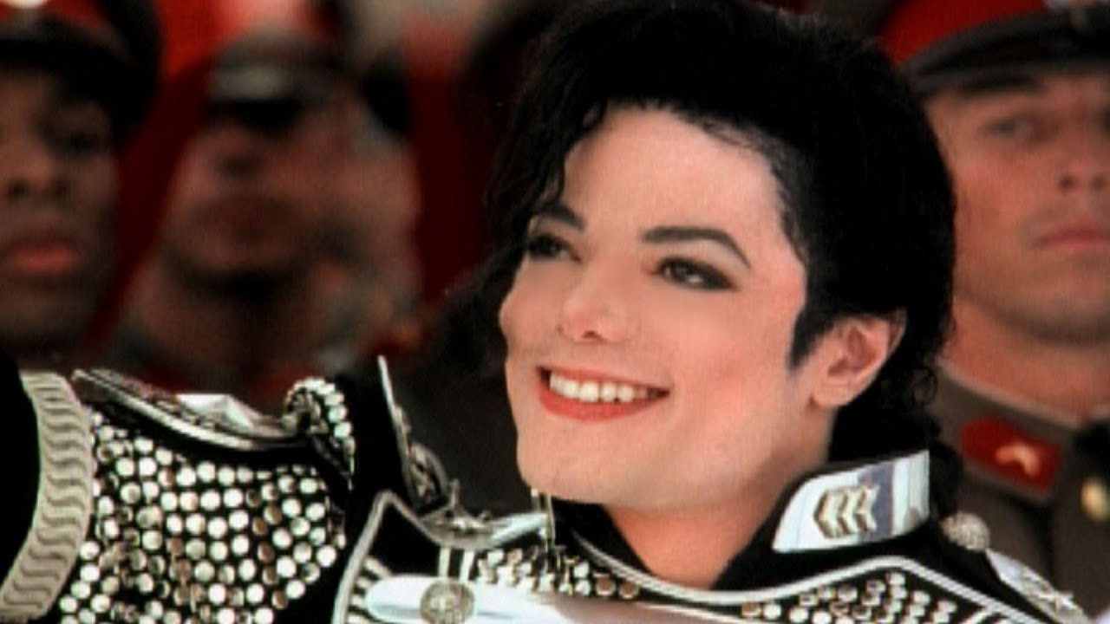
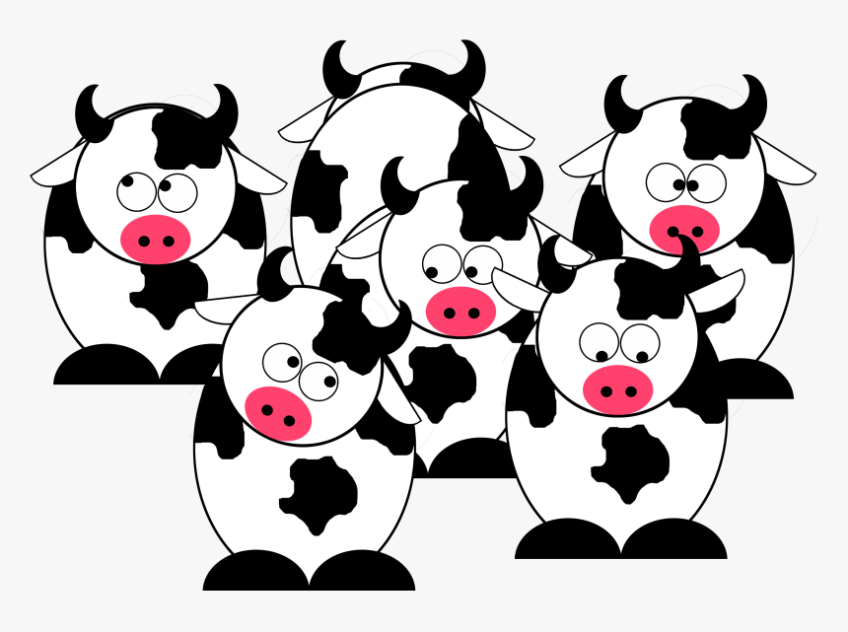


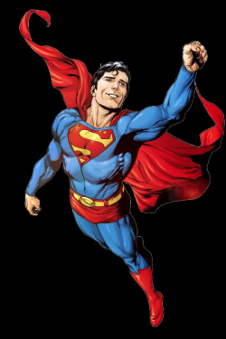
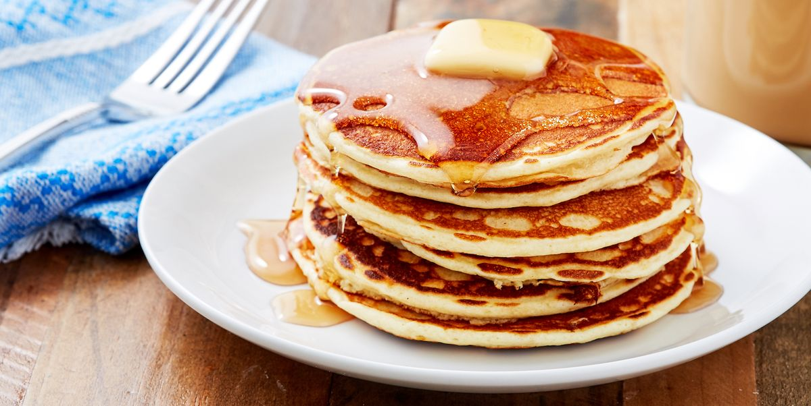
NOUN (Naming Word)
A noun is the name of a person, place, thing, or idea.
man... Bromley College... house... happiness
TYPES OF NOUNS
COMMON
PROPER
ABSTRACT
COLLECTIVE
COMPOUND
Nouns can fall under different catagories:
Common or Proper
Singular or Plural
Abstract or Concrete
Possessive
?
?

Slide 7
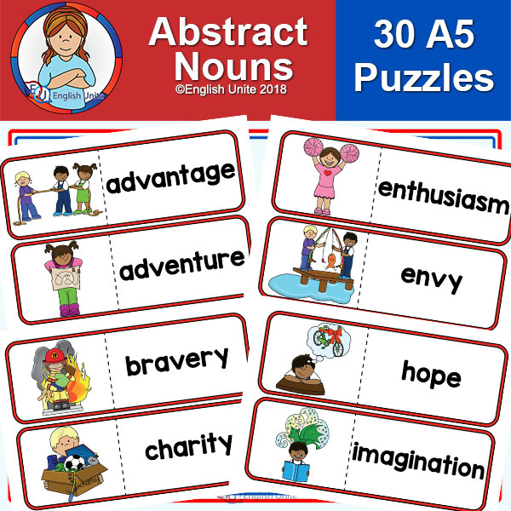
Some Abstract Nouns
Fill in the blanks using abstract nouns.
When people are honest with me, I feel happy that the ………………… is being told.
2. When I am bored of studying, I feel the …………………… in my brain.
3. When I am sad about something, I feel ………………….. in my heart.
4. When it’s Friday, the whole class feels the …………………… !
5. When a friend does something to help us, we know that there is …………………………..

Slide 8
Identifying Nouns
Circle each noun. There is more than one in each sentence
All good superheroes fight for truth, justice, and the right to wear spandex.
The Mule can carry ten times his own weight.
With just a little caffeine, John can study all night!
Birdman can talk to birds but the birds have been getting bored with his conversation recently.
Mister Invisible is awfully hard to find, unless there is snow on the ground.

Slide 9
Pronouns
A pronoun is a word used to replace a noun.
Examples of pronouns are: he, she, it, they. We use pronouns so that we don't need to keep repeating the same nouns.
Consider this sentence
John said that John’s mother was taking John in John’s mother’s car to visit John’s mother’s friends and see John’s mother’s friends’ goldfish.
Can you improve it by using pronouns?

Slide 10
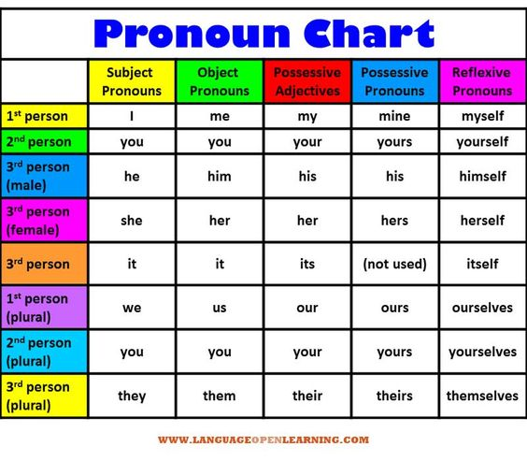
Types of pronouns

Slide 11
Relative pronouns For example: which, who, that
“Joe, who was dressed as a cowboy, was excited about his friend’s fancy dress party.”
Interrogative pronouns For example: which, who, whose
Who took the book?
Demonstrative pronouns. For example: this, that, these
These are my clothes.
Indefinite pronouns. For example: none, several, any
Sometimes, I just need someone to talk to.
  DO NOT CONFUSE PRONOUNS WITH DETERMINERS

Slide 12
Task: Use pronouns in the following sentences and make the sentences less repetitive.
1. Oscar drew a picture. Oscar was pleased about Oscar’s picture. Oscar’s parents hung his picture in his parent’s kitchen.
2. ‘I wonder if mum could make a cake?’ thought Jane. If Jane helps mum to make the cake then the cake will be baked much faster.
3. The dog and the cat were resting on the front porch when a loud bang of thunder roared above the dog and the cat. Quickly, the dog and the cat dashed inside away from the terrifying noise.

Slide 13
Identify the pronouns:
1. His hat is blue; it also has a small white logo on the front.
2. The hat, which is missing, was given to the boy when he was 6 years old.
3. The horse was magnificent. Its owner had trained it impeccably well!
4. There isn’t a day when I don’t feel happy.
5. Please have more food; it is yours.
6. No the mess isn’t mine. It is theirs.
7. Jess and I went to the cinema. We had lots of fun watching the new Aladdin movie!
8. They have got some tennis balls that you can play with.

Slide 14
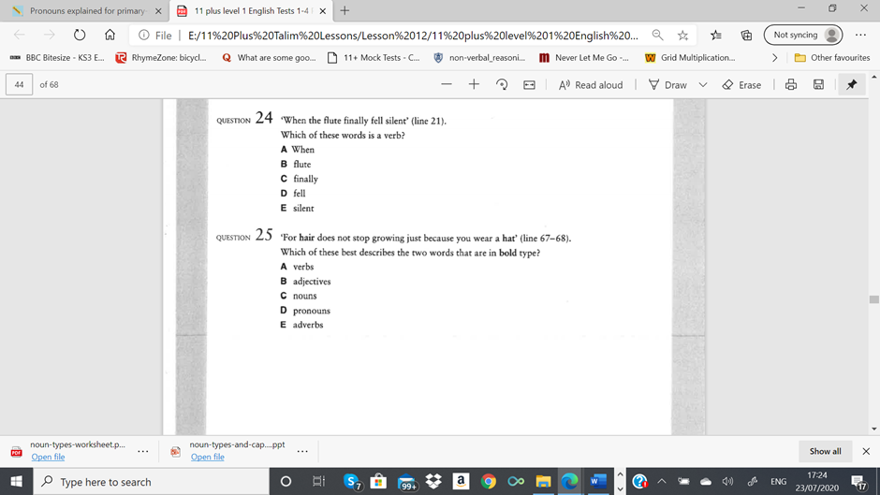
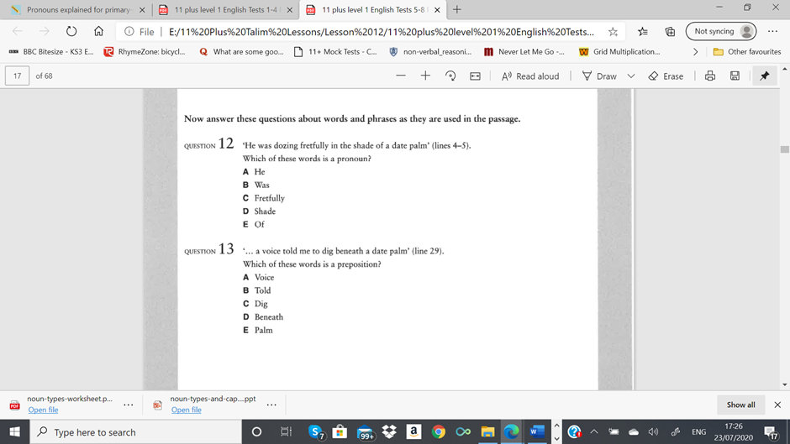
Sample questions

Slide 15
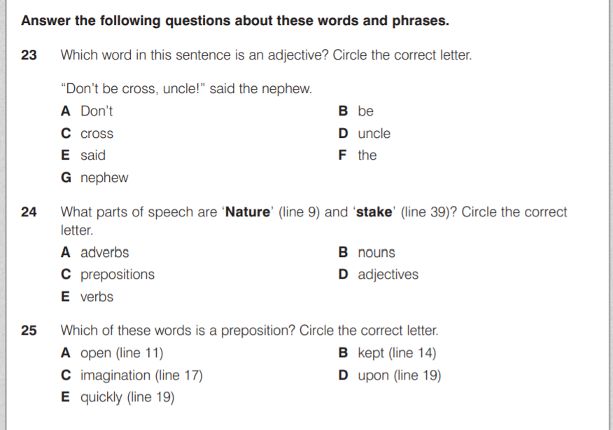

Slide 16
