Slide 1

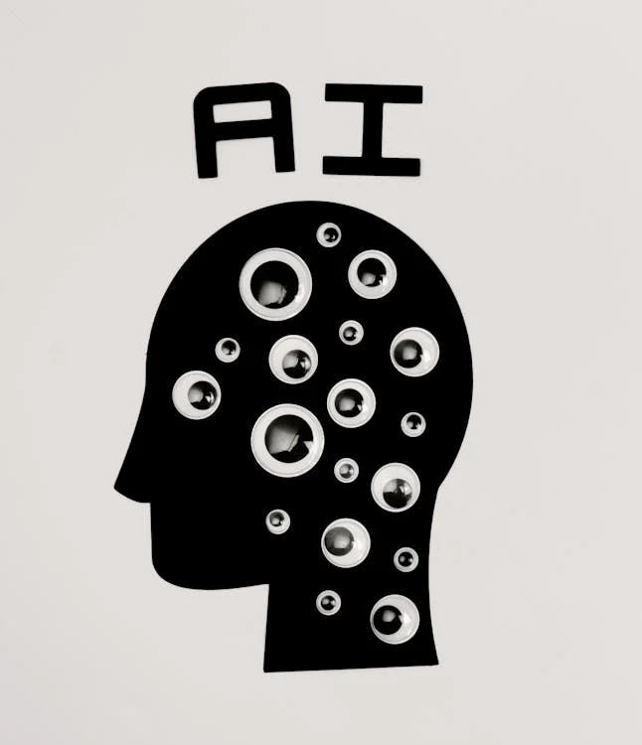
What is AI?
Shura Proposal 25/01 Artificial Intelligence

Slide 2
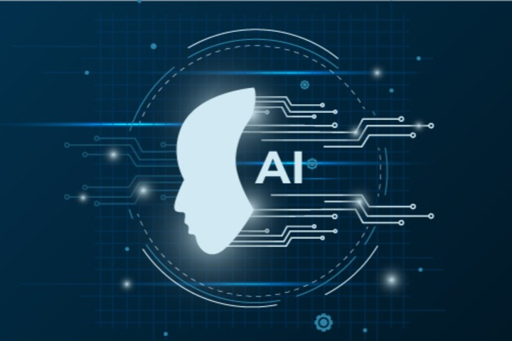
🤖 What is AI?
AI (Artificial Intelligence) is like a smart robot brain that lives inside computers, phones, and machines. It’s not alive, but it can learn, think, and solve problems
a bit like a human.
Shura Proposal 25/01 Artificial Intelligence

Slide 3
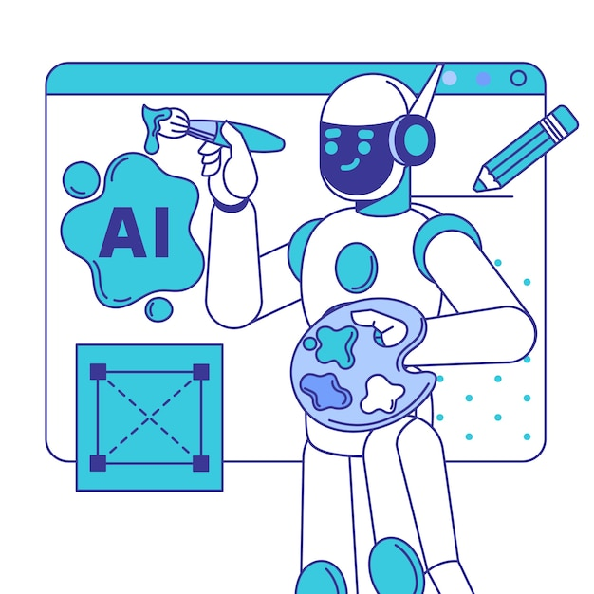
🤖 What is AI?
These tasks include:-
Understanding language
Recognising images
Solving problems
Making decisions
Learning from experience
Shura Proposal 25/01 Artificial Intelligence

Slide 4
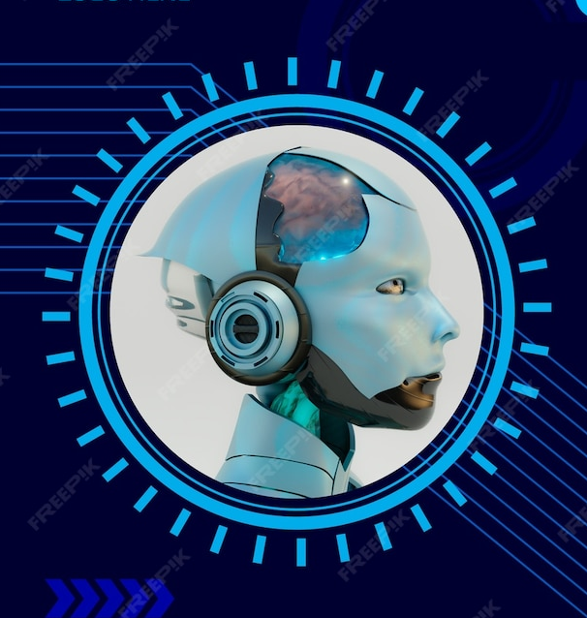
🤖 What is AI?
In simple words,
AI is when a machine can think or act in a smart way.
Shura Proposal 25/01 Artificial Intelligence

Slide 5
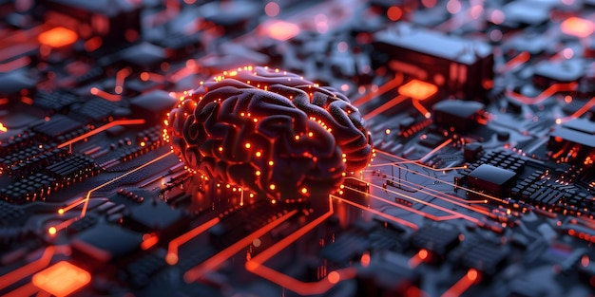
🧠 How does it work?
AI works by using data, algorithms, and learning techniques.
Here are the basics.
Shura Proposal 25/01 Artificial Intelligence

Slide 6
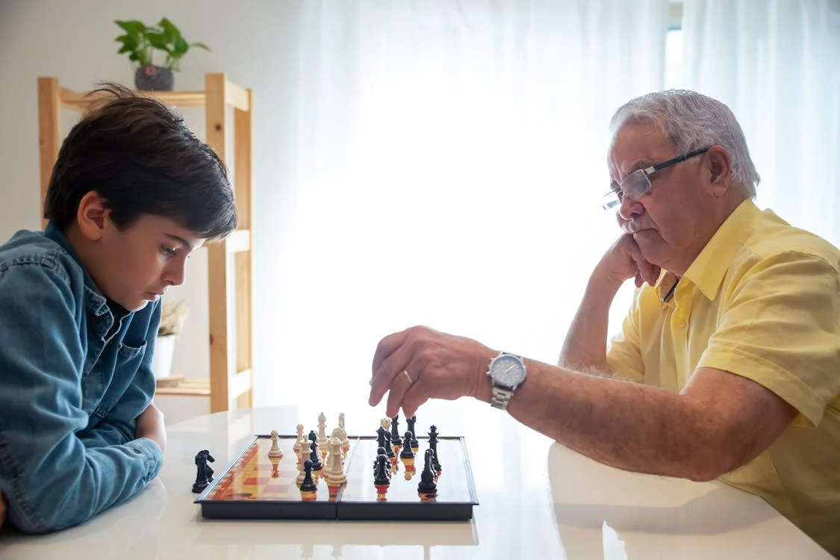
🧠 How does it work?
Data
Imagine you teach a friend how to play a game by showing them how you play.
AI l— by looking at lots and lots of examples.
Shura Proposal 25/01 Artificial Intelligence

Slide 7
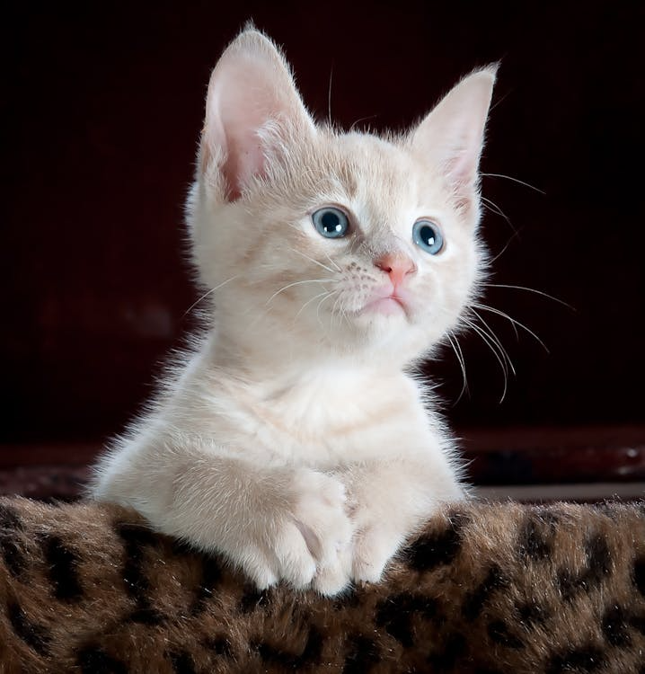
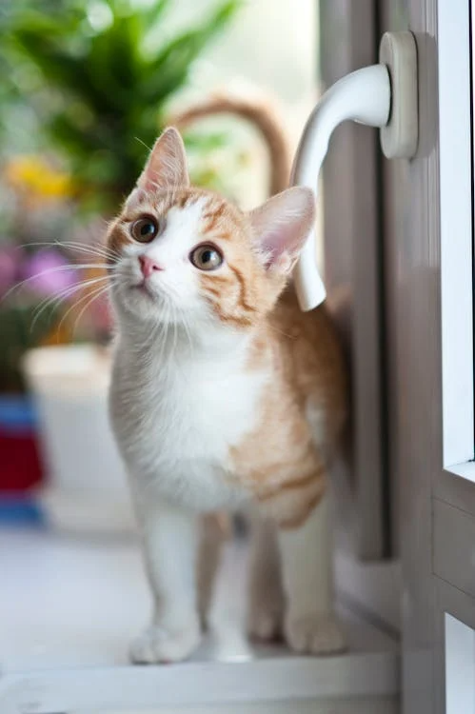

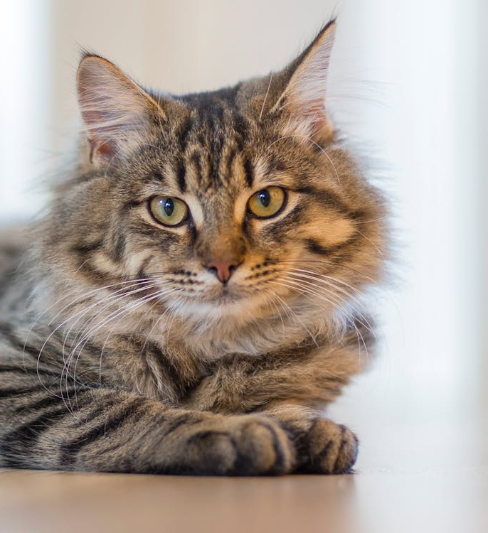
🧠 How does it work?
If you show an AI many pictures of cats,
it gets good at saying
“Oh! That’s a cat!”
If you show it many sentences, it learns how to talk.
Shura Proposal 25/01 Artificial Intelligence

Slide 8
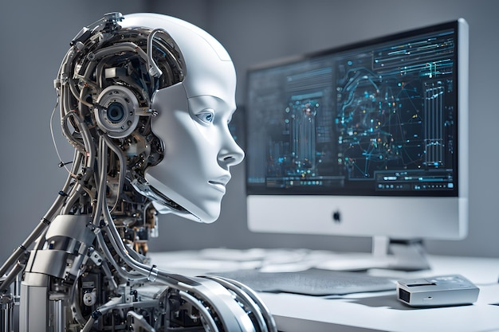
What is AI?
🧠 How does it work?
Algorithms
These are the rules or instructions that tell the computer how to learn from the data.
Different types of algorithms are used for different tasks.
Shura Proposal 25/01 Artificial Intelligence

Slide 9
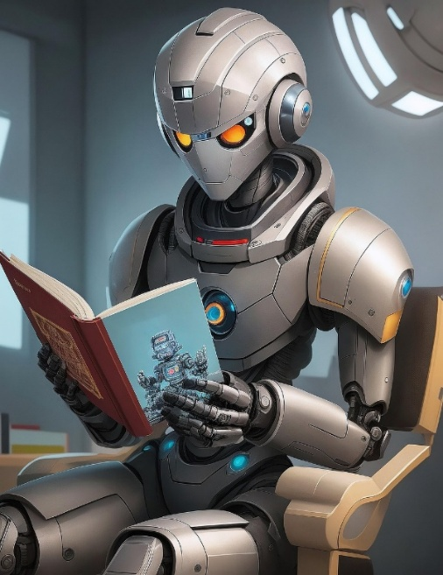
🧠 How does it work?
Machine Learning
This is the most common type of AI.
Machine Learning means the computer learns patterns from data instead of being programmed step by step.
Shura Proposal 25/01 Artificial Intelligence

Slide 10

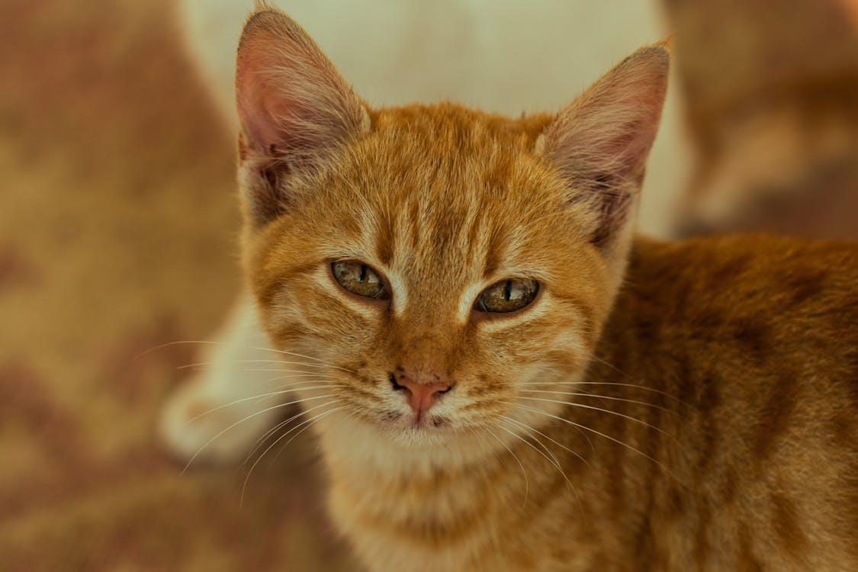
🧠 How does it work?
Machine Learning
Example:
You don’t tell the AI
“a cat has whiskers, ears, eyes”.
You simply show images
and it learns the patterns by itself.
Shura Proposal 25/01 Artificial Intelligence

Slide 11
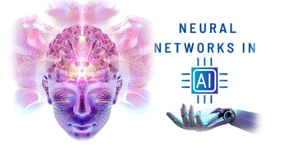
🧠 How does it work?
Neural Networks
These are special computer models inspired by the human brain.
They are made up of
layers of “neurons”,
which process data in
small steps and pass it forward.
Shura Proposal 25/01 Artificial Intelligence

Slide 12
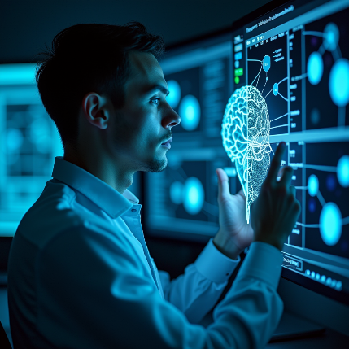
🧠 How does it work?
Neural Networks
Deep learning is when the network has many layers, allowing it to learn complex patterns like speech or faces.
Shura Proposal 25/01 Artificial Intelligence

Slide 13
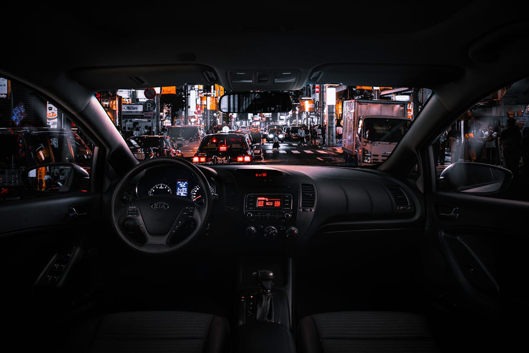
🧠 How does it work?
For instance:
Self-driving cars use deep learning with cameras to detect pedestrians, traffic signs and other vehicles to navigate safely.
Shura Proposal 25/01 Artificial Intelligence

Slide 14
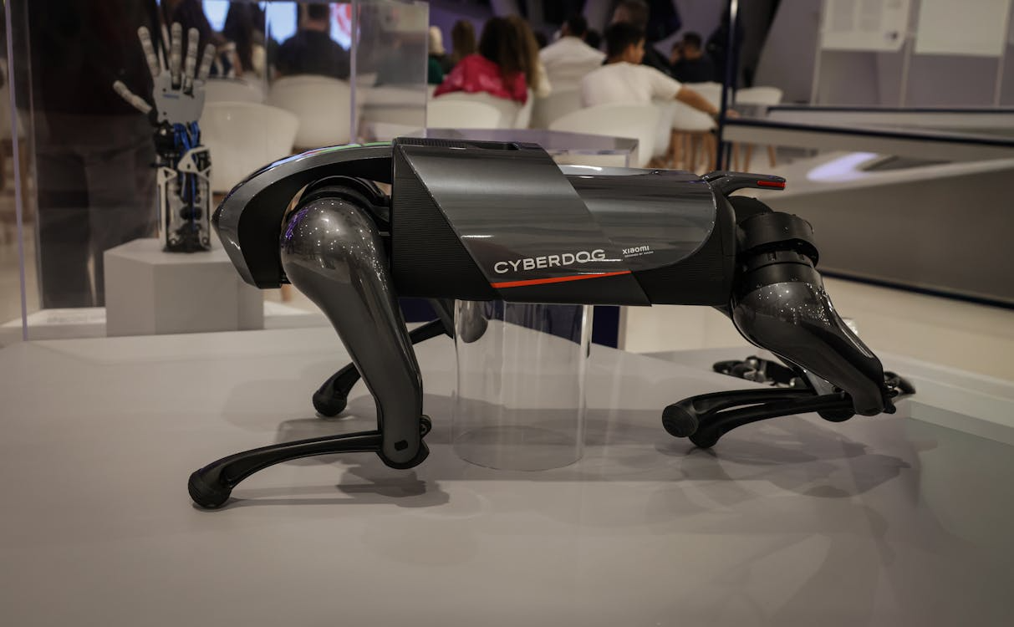
🧠 How does it work?
Training the Model
AI is “trained” by giving it lots of examples.
It adjusts itself until it gets the right answers.
This process is repeated many times until the AI becomes accurate.
Shura Proposal 25/01 Artificial Intelligence

Slide 15
🧠 How does it work?
6. Using the Model
Once trained, the AI can make predictions or decisions with new information.
For example:
You show a new picture and the AI says“this is a cat”.
Shura Proposal 25/01 Artificial Intelligence

Slide 16

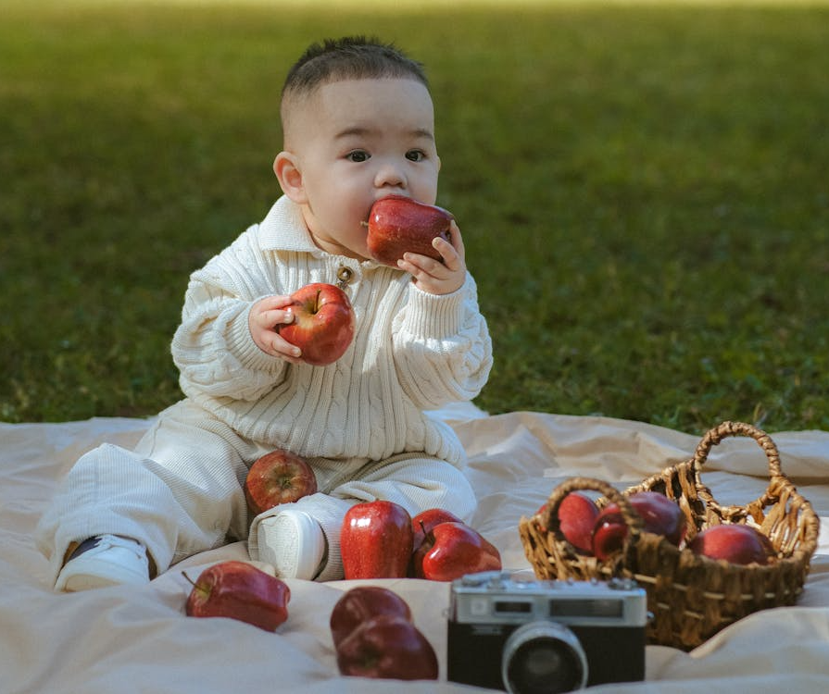
🧠 How does it work?
6. Using the Model
A Simple Example:
Teaching a child to recognise apples
You show many apples. The child notices the colour and shape. Eventually the child can recognise apples alone.
Shura Proposal 25/01 Artificial Intelligence

Slide 17
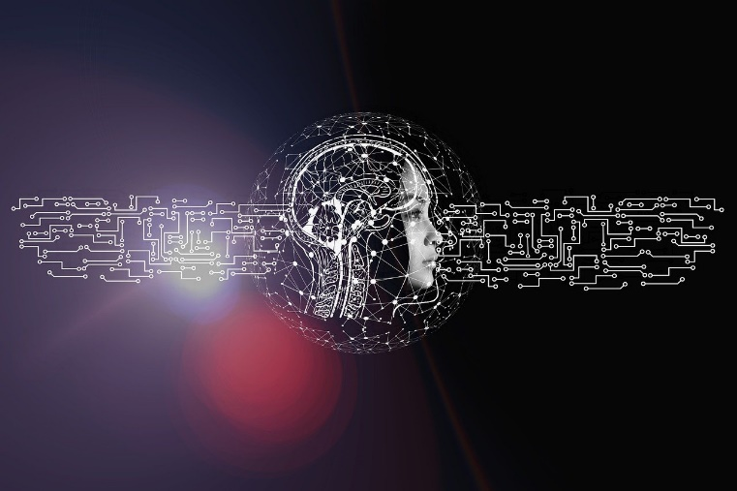
🧠 How does it work?
6. Using the Model
AI learns in a similar way but uses mathematics and data instead of human senses.
Shura Proposal 25/01 Artificial Intelligence

Slide 18


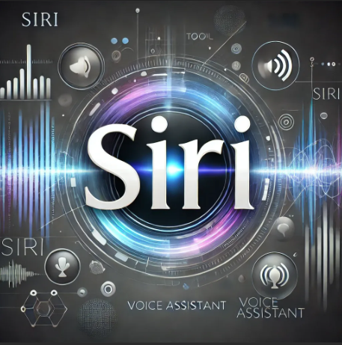
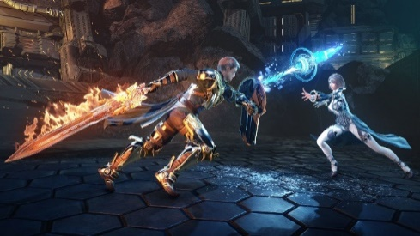
📱 Where do we use AI?
AI is already around you, even if you don’t notice:
YouTube recommending videos
Google Maps showing fastest routes
Voice assistants like Siri
Games where enemies learn how to beat you
Shura Proposal 25/01 Artificial Intelligence

Slide 19
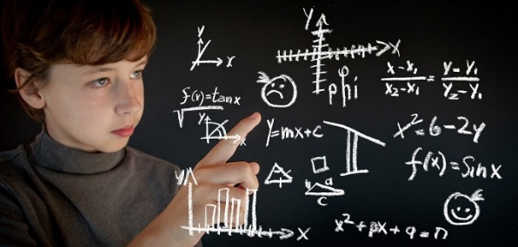

💡 Why do people make AI?
To help humans do things:
Make life easier
Solve big problems
Do tasks that are too hard or boring for people
Help doctors, scientists, drivers, and even gamers
Shura Proposal 25/01 Artificial Intelligence

Slide 20
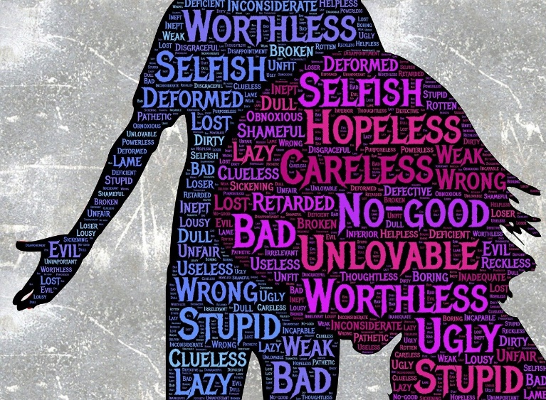
🛑 What AI can’t do
AI cannot feel emotions, doesn’t have a body, and can’t think exactly like a human.
It just follows patterns it learned.
Shura Proposal 25/01 Artificial Intelligence

Slide 21


Based on how it learns
Rule based AI
Humans give the computer a big list of rules
Example:
If the temperature is above 30, turn the fan on.
If a customer buys X, recommend Y.
It does not really learn-It just follows rules.
Shura Proposal 25/01 Artificial Intelligence

Slide 22
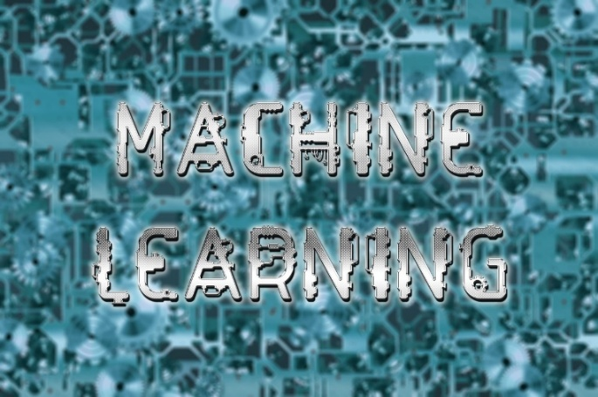
Based on how it learns
Machine Learning AI
The computer learns patterns from data instead of only rules
The system improves with experience
Most modern AI is machine learning
Shura Proposal 25/01 Artificial Intelligence

Slide 23
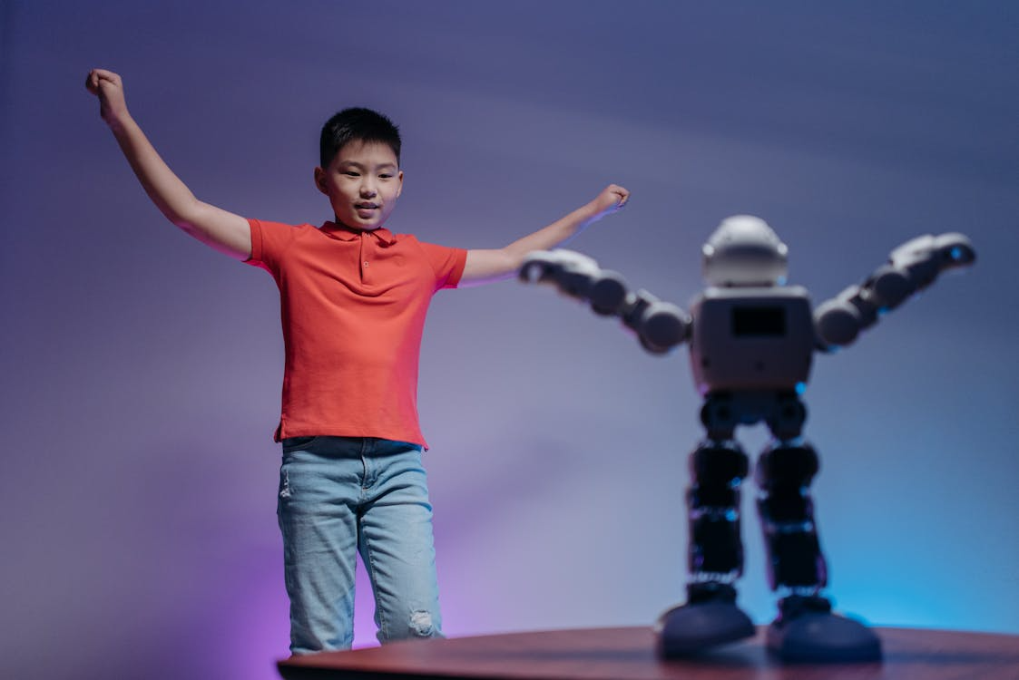
Based on how it learns
Inside machine learning, we have
three common styles.
Supervised learning
You give the AI examples
with correct answers
Images plus labels such as “cat” or “dog”
House data plus price
The AI learns to map input to output
Shura Proposal 25/01 Artificial Intelligence

Slide 24
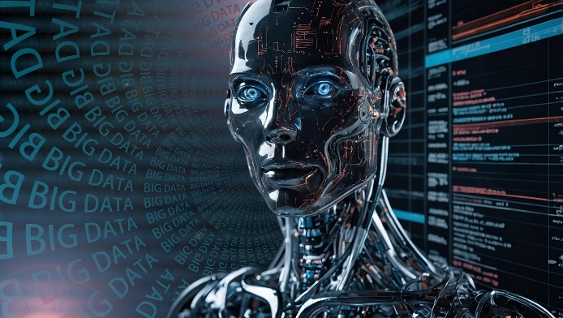
Based on how it learns
Unsupervised learning
You give the AI data - without answers
It tries to find groups or structure
Grouping individuals by behaviour
Clustering similar images together
Shura Proposal 25/01 Artificial Intelligence

Slide 25
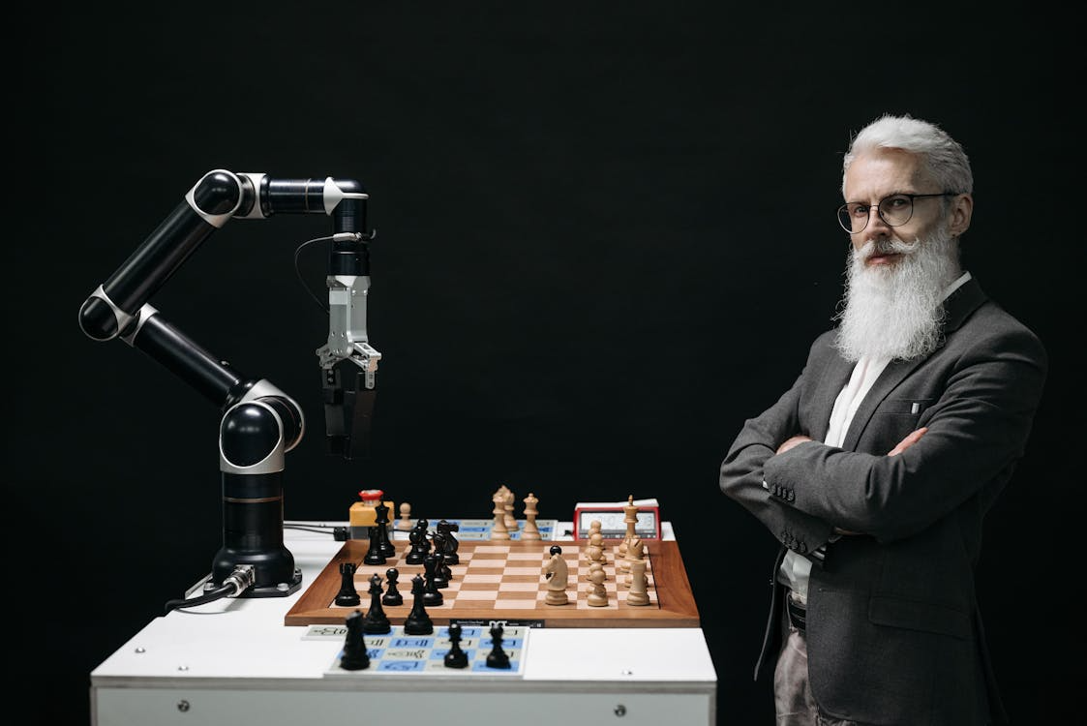
Based on how it learns
Reinforcement learning
The AI learns by trial and error
It gets rewards for good actions and penalties for bad ones
Playing games like chess or Go
Controlling robots
Shura Proposal 25/01 Artificial Intelligence

Slide 26


Key Takeaways
True / False Questions
AI is like a smart robot brain that lives inside computers
AI works by using data, algorithms, and learning techniques.
The most common type of AI is machine learning
Deep learning is when the network has many layers, allowing it to learn complex patterns like speech or faces.
Once trained, the AI can make predictions or decisions with new information.
Shura Proposal 25/01 Artificial Intelligence

