Slide 1

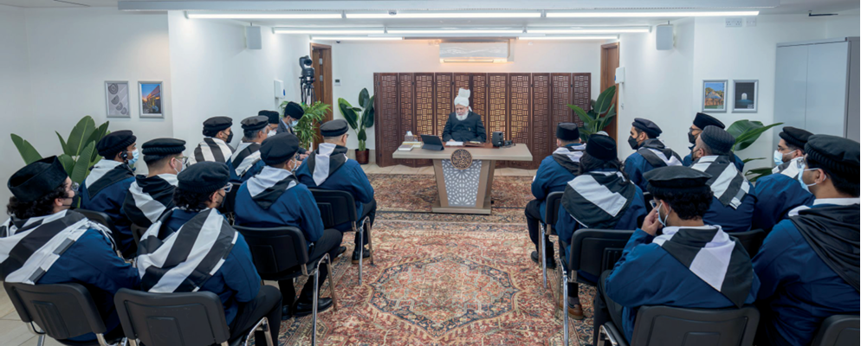
Huzoor’s (aba) Guidance on AI
Shura Proposal 25/01 Artificial Intelligence

Slide 2
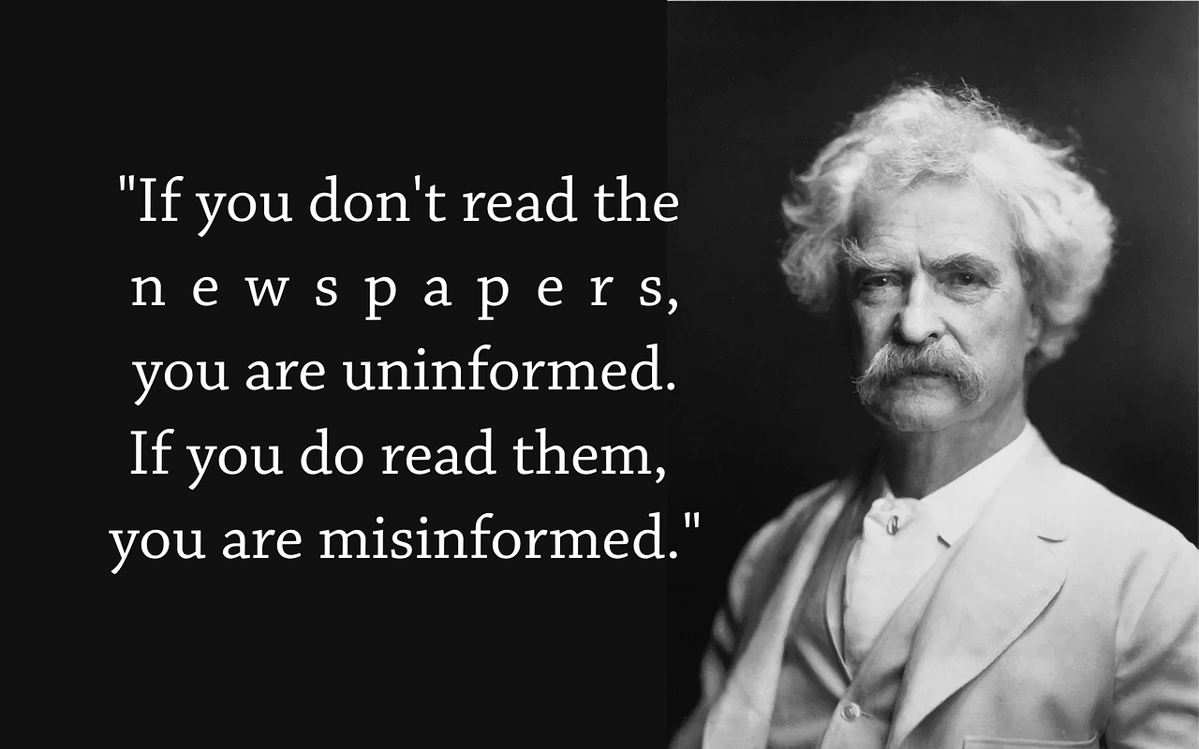
Question 1
“In the age of the internet AI how can we protect ourselves from wrong information and misinformation?”
This week with Huzoor – 21st November 2025
LINK: tinyurl.com/yu33wty4
Shura Proposal 25/01 Artificial Intelligence

Slide 3
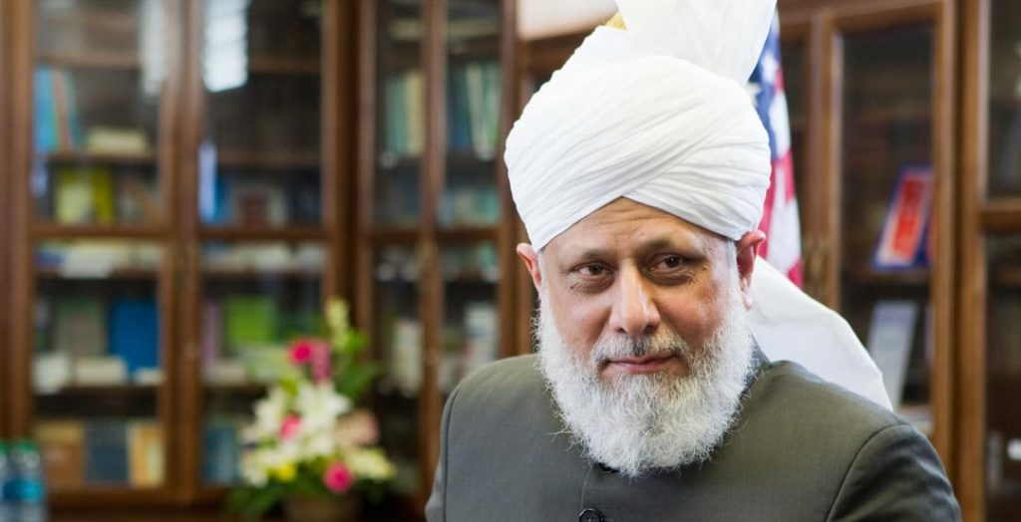
Question 1
Hazrat Mirza Masroor Ahmad, may Allah always be His helper, answered:
Allah has given you intellect, Mash’Allah. You know that this thing is wrong and this thing is right, this is wrong and this is right.
Shura Proposal 25/01 Artificial Intelligence

Slide 4
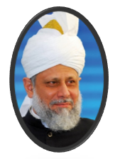
Question 1
(cont) When you are looking,
you need to judge everything yourself.
Allah the Almighty has already stated in the Holy Qur’an that Satan has said that ‘I will incite humans.’
Allah the Almighty created Adam (as) and told him that these things are right and these things are wrong.
Shura Proposal 25/01 Artificial Intelligence

Slide 5
Question 1
(cont) Satan approached him
in a very cunning way just as in today’s AI age or just as other different kinds of attractions and incentives are given, a person is drawn towards them.
So, Satan has said that I will say things like this and they will follow me.
Shura Proposal 25/01 Artificial Intelligence

Slide 6
Question 1
(cont) He said what he had to and he incited Adam (a.s.), saying:
“look, why did Allah the Almighty tell you not to do this work? “It is so that you will stay in Paradise”.
Adam made that mistake;
he committed that action.
Allah the Almighty then said:
“so be it, go and live on the earth”
Shura Proposal 25/01 Artificial Intelligence

Slide 7
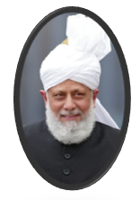
Question 1
(cont) The point was that Adam (as) was already on Earth, he wasn’t in the heavens, but the point was that now, living among the people of the world, you will have choices:
to do good deeds and to do bad deeds.
And if you follow the word of Satan and do bad deeds, you will be punished.
Shura Proposal 25/01 Artificial Intelligence

Slide 8
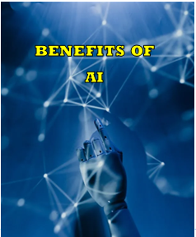
Question 1
(cont) And the good things of which I will continue to send you commands through the prophets or through the angels.
If you do take, you will receive a reward.
So, whether it is AI or anything else - there are benefits of AI as well.
Shura Proposal 25/01 Artificial Intelligence

Slide 9
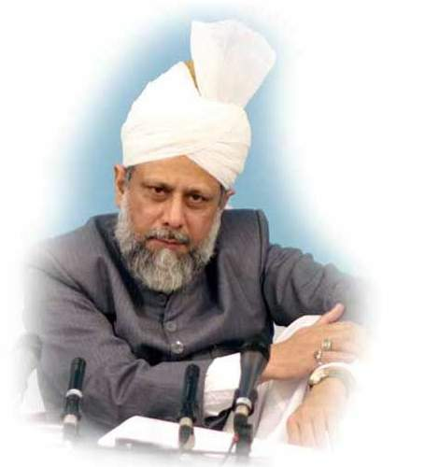

Question 1
(cont) Some people use it for translation. For example, people use AI to translate from English to Urdu or from Urdu to English, you benefit from it, right? You can take it; you can take information from there.
Now, everything in the world has become easily accessible.
Shura Proposal 25/01 Artificial Intelligence

Slide 10
Question 1
(cont) There are many applications
On the internet: there are many encyclopedias, Wikipedia and so on and so forth. So, you can look at them and take information from there. And then judge for yourself which is good, which is bad, which is beneficial for me, and which is not beneficial.
Shura Proposal 25/01 Artificial Intelligence

Slide 11
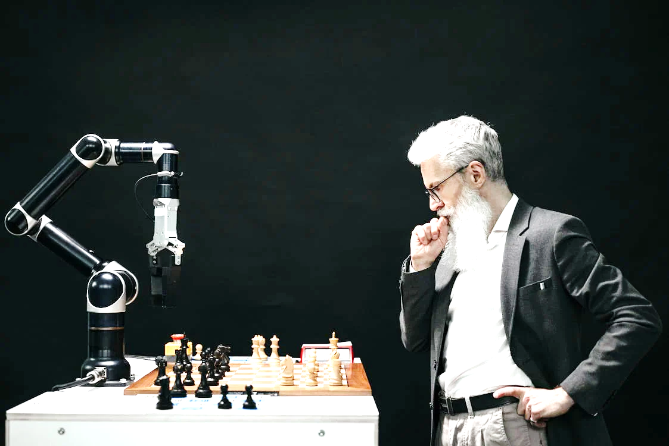
Question 1
(cont) Allah the Almighty says that I have given man intellect, and I have given him knowledge. Now use the intellect and the knowledge and then make better use of it. If you do that, then you will come close to Me.
Shura Proposal 25/01 Artificial Intelligence

Slide 12
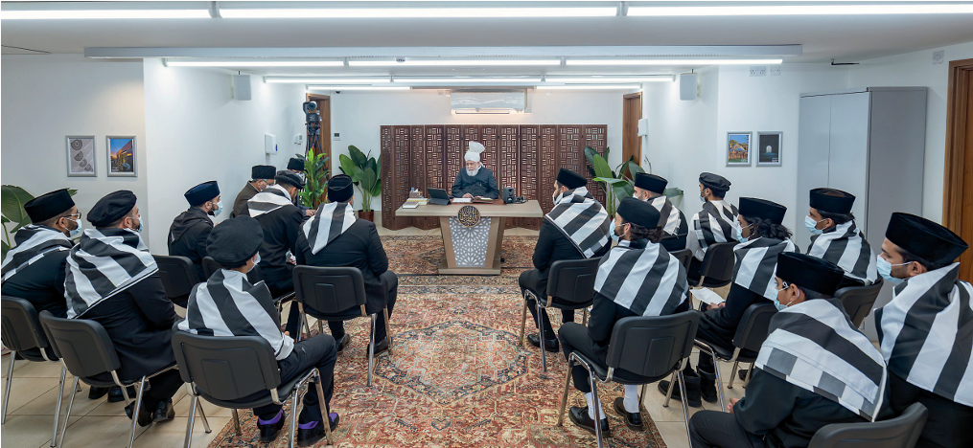
Huzoor’s Guidance on AI
Shura Proposal 25/01 Artificial Intelligence

Slide 13
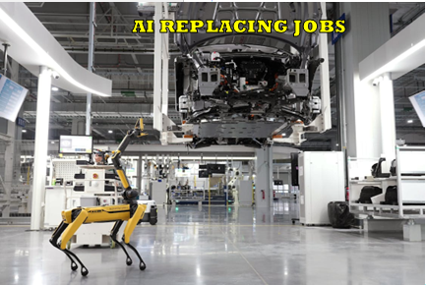
Question 2
The impact of AI on jobs and the future that Artificial Intelligence (AI) might replace many jobs in the next 5 to 10 years and asked for advice.”
This week with Huzoor – 14th November 2025
LINK: tinyurl.com/34ss73vd
Shura Proposal 25/01 Artificial Intelligence

Slide 14
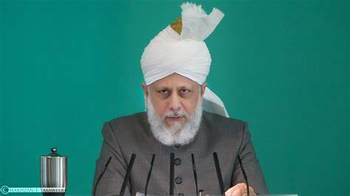
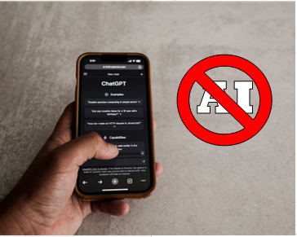
Question 2
Hazrat Mirza Masroor Ahmad, may Allah always be His helper, acknowledged that this is a widely discussed issue with concerns that governments may face economic collapse due to a lack of tax revenue from employment, potentially
leading to a backlash against AI.
Shura Proposal 25/01 Artificial Intelligence

Slide 15
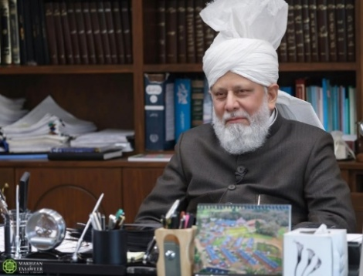
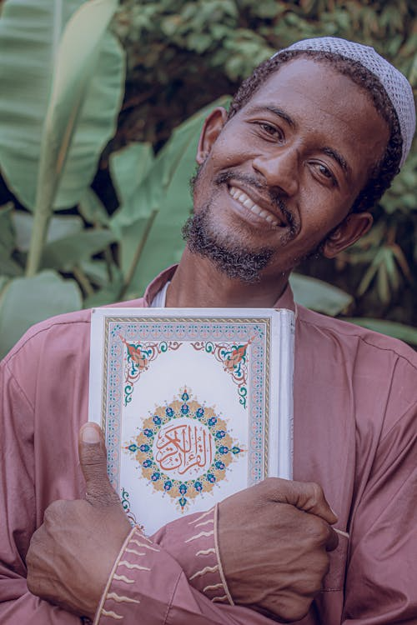
Question 2
When asked by the khadim which fields young people should pursue in this scenario?
Huzoor may Allah always be His helper, remarked that AI will likely permeate
every field. His advice was to
cultivate contentment or
qana‘at.
Shura Proposal 25/01 Artificial Intelligence

Slide 16

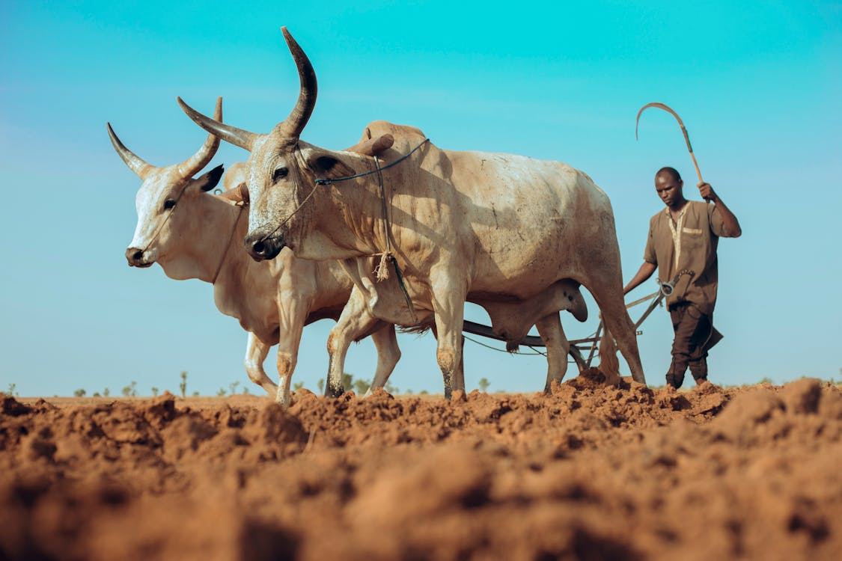
Question 2
With a gentle smile, he warned that if the current trend continues, humanity might be forced back to a primitive state of ploughing fields for survival, while a few wealthy individuals control everything until economies collapse.
Shura Proposal 25/01 Artificial Intelligence

Slide 17


Question 2
(cont) Behind his calm tone was
a clear warning:
this path leads to ruin
unless humanity turns to
Allah and recognises its
Creator.
Shura Proposal 25/01 Artificial Intelligence

Slide 18
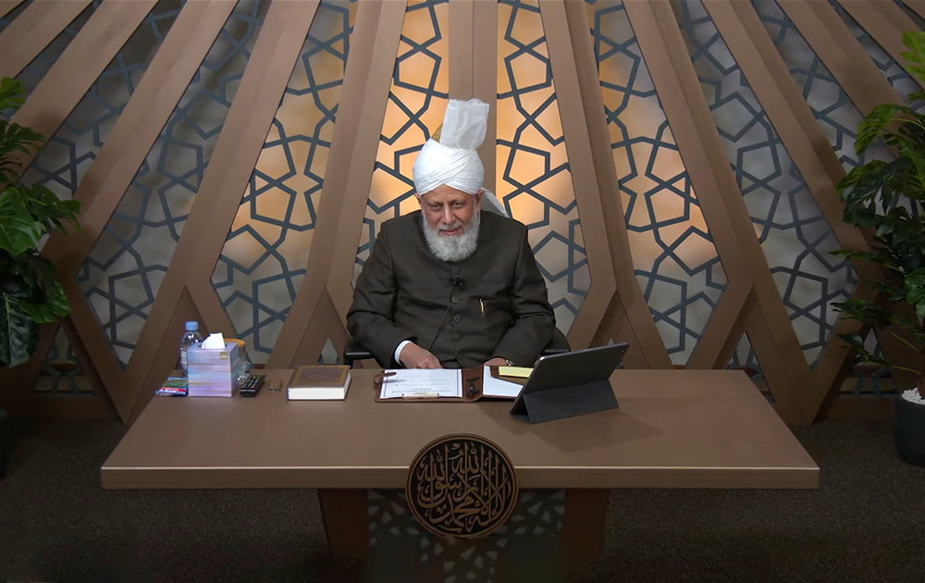
Huzoor’s Guidance on AI
Shura Proposal 25/01 Artificial Intelligence

Slide 19
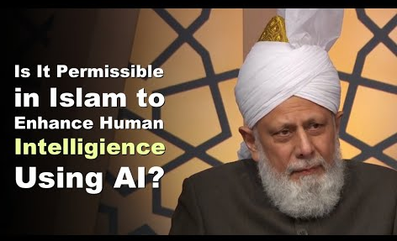
Question 3
“Is it permissible to enhance a person's intellect through AI?
This week with Huzoor – 21st February 2025
LINK:
https://www.amagallery.org.uk/this-week-ndash-feb-2025.html
Shura Proposal 25/01 Artificial Intelligence

Slide 20
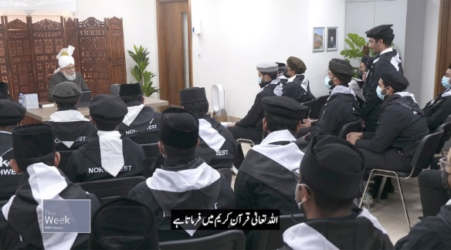

Question 3
Hazrat Mirza Masroor Ahmad, may Allah always be His helper, explained that using AI as an aid in work or intellectual pursuits is permissible, provided it does not lead one away from fundamental religious teachings.
Shura Proposal 25/01 Artificial Intelligence

Slide 21
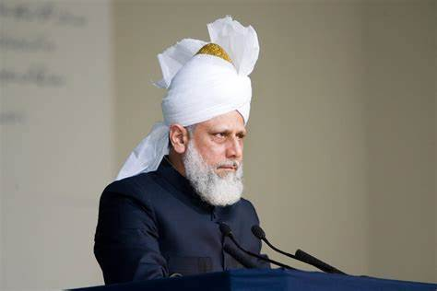
Question 3
AI can be beneficial, especially for those who require assistance in resolving complex matters, much like seeking help from another person.
However, Huzoor may Allah always be His helper, cautioned that AI is only as reliable as the information it has been programmed with.
Shura Proposal 25/01 Artificial Intelligence

Slide 22
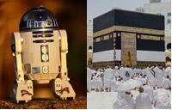
Question 3
(cont) Experts acknowledge that AI can sometimes provide incorrect answers, yet people may still accept them without question. If AI promotes ideas that detract from faith, then it should not be followed.
Shura Proposal 25/01 Artificial Intelligence

Slide 23
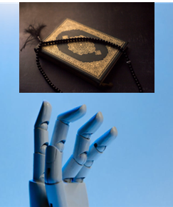
Question 3
(cont) Ultimately, if AI is used for the betterment of humanity and does not interfere with one’s religious
beliefs, then there is no harm
in utilising it.
Shura Proposal 25/01 Artificial Intelligence

Slide 24
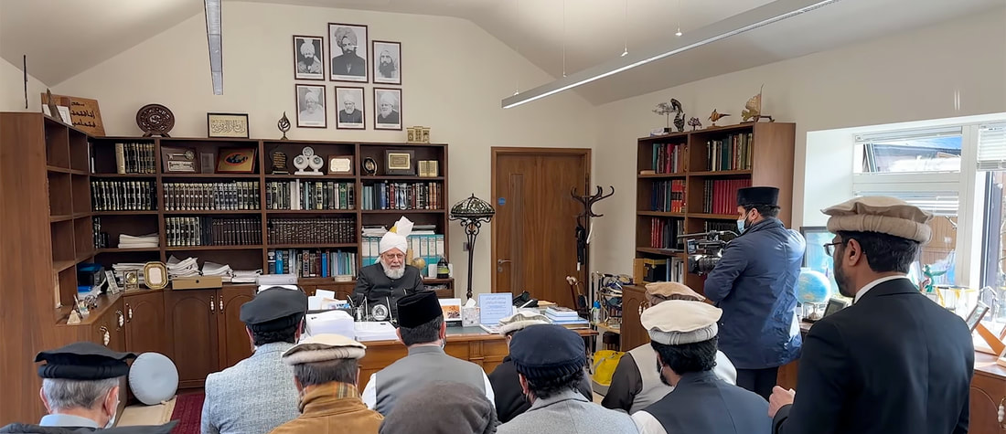
Huzoor’s Guidance on AI
Shura Proposal 25/01 Artificial Intelligence

Slide 25
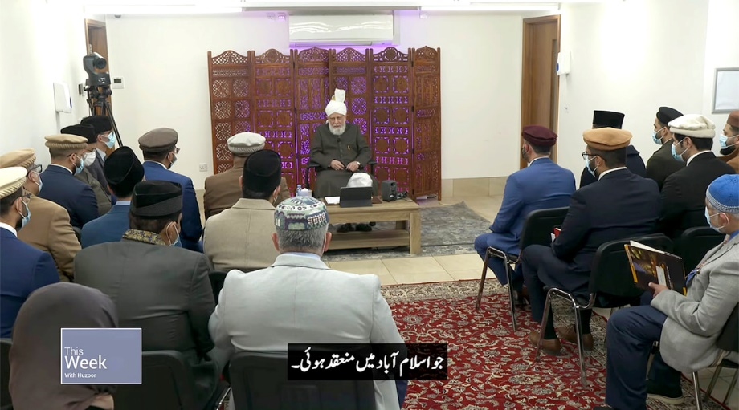
Question 4
“What is Huzoor's (aba) perspective on robotics and AI?
This week with Huzoor – 21st February 2025
LINK:
https://www.amagallery.org.uk/this-week-ndash-feb-2025.html
Shura Proposal 25/01 Artificial Intelligence

Slide 26
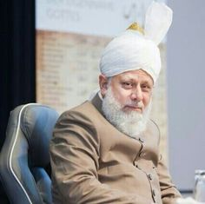
Question 4
Hazrat Mirza Masroor Ahmad, may Allah always be His helper, replied:
“Any technology which is beneficial for a human being is good, whether it is AI or robot. Even now, there are quite a number of doctors who are doing their operation with robots.
Shura Proposal 25/01 Artificial Intelligence

Slide 27
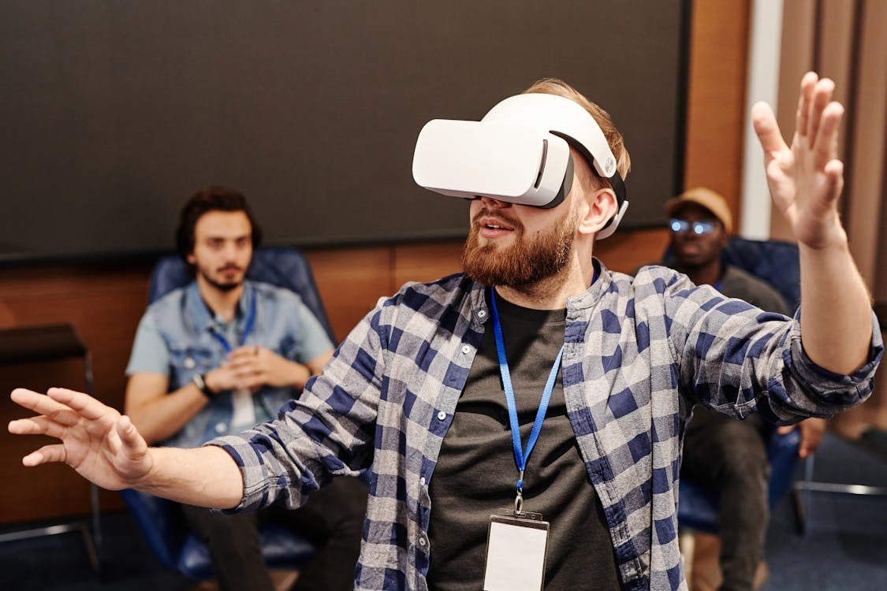
Question 4
I can see that although robots or AI is helping you, but it can also decrease the mental capability and capacity of your mind.
The level of intelligence can become low because you are relying on AI.
Shura Proposal 25/01 Artificial Intelligence

Slide 28
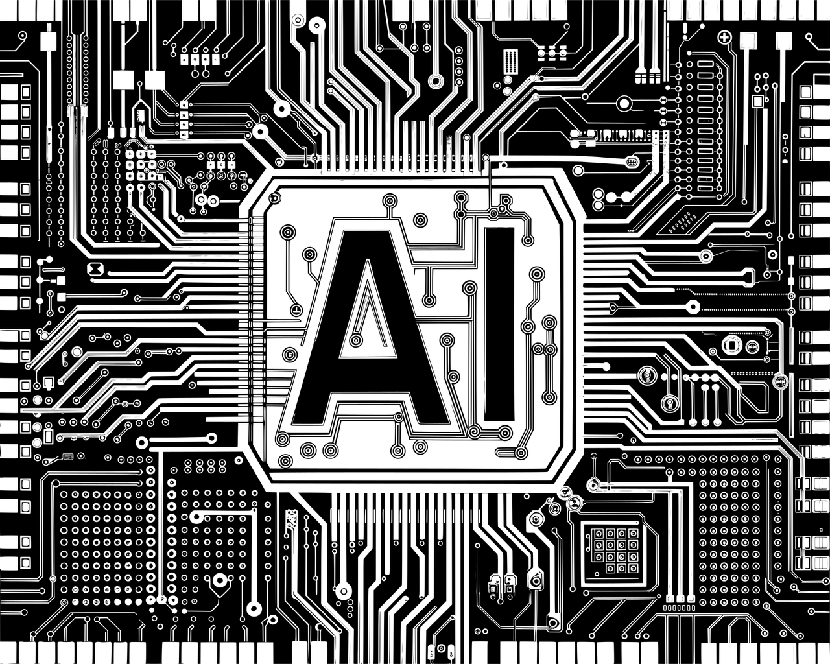
Question 4
(cont) You can take help from AI or robots, but do not completely rely on them.”
Shura Proposal 25/01 Artificial Intelligence

