Slide 1

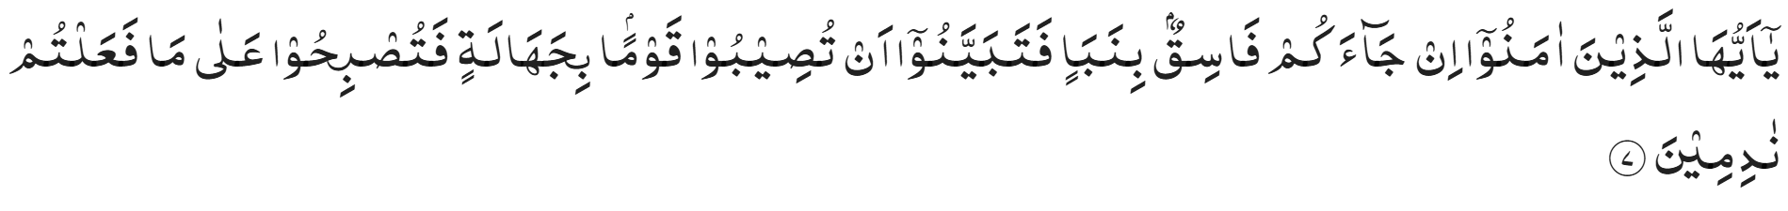
In the Name of Allah, the Most Gracious, Ever Merciful
Faith-First Digital Intelligence
Using Artificial Intelligence, Social Media and the Internet as an Ahmadi Muslim
Benefits, Risks and Responsible Practice
“O ye who believe! if an unrighteous person brings you any news, ascertain the correctness of the report fully, lest you harm a people in ignorance, and then become repentant for what you have done” (Al Hujuraat 49:7)
Shura Proposal 25/01 Artificial Intelligence

Slide 2
Programme Purpose
This scheme of work is designed to develop responsible, disciplined and faith-driven digital behaviour in line with Islamic teachings. It aims to equip pupils with the knowledge and understanding required to navigate Artificial Intelligence, social media and the wider digital world safely and responsibly.
Through a structured approach, pupils are guided to recognise both the benefits and risks of technology, whilst developing the ability to make informed, ethical decisions. Rooted in the principles of Islam Ahmadiyya, this scheme of work encourages pupils to uphold values such as honesty, modesty, accountability and self-control, ensuring that their online conduct reflects their faith and contributes positively to society.
Shura Proposal 25/01 Artificial Intelligence

Slide 3
Important Guidance for All Teaching Staff
*Please Read the Instructions Below Carefully*
All content within this scheme of work on AI, Social Media and Internet Usage as an Ahmadi Muslim is to be delivered based on pupils’ age and maturity.
All lessons titled ‘core content’ e.g. ‘Core Content | Lesson 1’ are to be taught to all pupils, regardless of age, totalling 8 lessons.
Lessons titled ‘mature content’ e.g. ‘Mature Content | 1’ are to be taught to all pupils aged 13 and over, in addition to the 8 core lessons, totalling 12 lessons.
Any mature content being taught should be discussed with pupils in a dignified and appropriate manner without trivialising breaches of Islamic
parameters. This is so that the gravity and seriousness of such topics can be underscored throughout the delivery of each lesson.
As Ahmadi Muslims, we must strive to cultivate within ourselves the qualities and standards expected of us by our beloved Khalifa (May Allah SWT strengthen his hand). May Allah enable us all to use the Internet, AI and Social Media in a manner that is beneficial for us and that serves Islam Ahmadiyya and may He protect us from using these tools in ways that incur his displeasure, Ameen.
Shura Proposal 25/01 Artificial Intelligence

Slide 4

Core Content | Lesson 1 | What is Artificial Intelligence/ AI?
Learning Objectives
To understand what Artificial Intelligence (AI) is and how it is used in daily life
To recognise the way AI works
To understand the benefits of AI, social media and internet usage
To recognise the risks and dangers associated with AI, social media and online platforms
To understand Islamic/Ahmadiyya principles regarding responsible and ethical online behaviour
Shura Proposal 25/01 Artificial Intelligence

Slide 5
Starter
“Who has heard of AI?”
“Where have you seen it?”
“What is it?”
*Talk to your partners*
Shura Proposal 25/01 Artificial Intelligence

Slide 6
What is AI and What are Some Examples?
  AI (Artificial Intelligence) refers to machines that can learn, think and give answers like humans
  They use prompts (instructions) to generate content, ideas and responses
  Some examples of AI include:
  Chatbots (answers questions)
  YouTube/TikTok recommendations
  Face recognition
  AI is not always correct and can at times produce information that is totally/ partially untrue (AI Hallucinations)
  It does not “know truth” like humans—it predicts answers using all the available information on the Internet
  What might AI also be used for?
  Do you think it is good or bad? Why do you think that?
  *Talk to your partners*
Shura Proposal 25/01 Artificial Intelligence

Slide 7
Islamic/ Ahmadi View
As Ahmadi Muslims we must always remember that:
Humans are given intellect (Aqal) and responsibility by Allah to make good use of the tools available
Technology is a tool and a trust (Amaanah), we must not use it for improper or haram purposes that can cause damage to us, those around us and society as a whole
We are accountable for how we use it (even online)
AI does not and cannot replace human judgement or truth
The Prophet Muhammad (sa) states that, “it is enough for a man to prove himself as a liar when he goes on narrating all that he hears” (Sahih Muslim), meaning we cannot just take content from AI and believe it to be true and share it with others without checking
Risks and Drawbacks of AI
Not everything AI produces is trustworthy or accurate, as mentioned earlier
We must verify all information produced by AI prior to believing it, sharing it or using it for any particular purpose such as assignments, homework or preparing an Islamic speech/ presentation
In Islam, “actions are judged by intentions”, as stated by Prophet Muhammad (sa) (Sahih Bukhari and Muslim)
Using AI dishonestly (e.g. cheating or deception) is a great misuse and breach of trust
Misuse of AI (e.g. false images, known as deepfakes) can damage one’s reputation as well as of those around them
AI can greatly reduce one’s ability to produce work of their own e.g. essays, assignments, solutions for homework and Islamic speeches or presentations for Ijtema's etc.
Advantages of AI
Fast access to information
Supports learning and revision
Simplifies complex topics (e.g. for schoolwork/ assignments/ projects)
Assists people (e.g. accessibility, translation and voice/ translation tools)
Provides definitions and synonyms/ antonyms for words that you wish to use in your work (assignments, homework, projects and Jama’at work)
Shura Proposal 25/01 Artificial Intelligence

Slide 8
Main Task – “Right or Wrong” | What do you think ?
Talk to your partners and discuss whether you think the following actions are acceptable and the right thing to do? I would like you all to prepare reasons for your answer
Discuss with your partners and then you will have the opportunity to share what you think:
Using AI to help explain homework
Copying AI answers and submitting as your own
Creating fake images of someone
Using AI to revise for exams
“Discuss each scenario with your partner: Is it right or wrong? Be prepared to justify your answer and explain the Islamic perspective.”
Shura Proposal 25/01 Artificial Intelligence

Slide 9
Feedback Time
Shura Proposal 25/01 Artificial Intelligence

Slide 10

Core Content | Lesson 2 | AI, Social Media & Their Influence On Behaviour
Learning Objectives
To understand how AI and social media influence behaviour
Recognise how content is pushed and controlled
Identify positive and negative influences
Reflect on their own usage and habits
Shura Proposal 25/01 Artificial Intelligence

Slide 11
Starter
Look at the question below and work with your partners to come up with an answer.
“Why does your feed always show what you like?”
Make sure you are prepared to explain why you think so, have some reasons ready to share with the class
*Talk to your partners*
Shura Proposal 25/01 Artificial Intelligence

Slide 12
Understanding AI and Social Media’s Influence On Behaviour
How do AI and Social Media know what to show you on your feed ?
AI is used in social media to decide what content you see. It works by tracking your behaviour—what you watch, what you like, how long you stay on a video, and what you interact with. Over time, it learns your interests and begins to show you more of the same type of content.
This means your feed is not random. It is carefully selected to keep your attention for as long as possible. The longer you stay on an app, the more successful the platform becomes, so content is designed to keep you engaged.
However, this can have an effect on your thoughts, habits, and behaviour. If someone is constantly exposed to certain types of content, it can shape what they think is normal, influence their decisions, and even affect their mood.
How can AI and Social Media influence your behaviour ?
AI is able to know what users are doing through data collection. Every action taken on a device—clicking, pausing, scrolling, searching, liking, or sharing—is recorded. Even how long someone looks at a post or video is tracked. This information is then analysed to build a detailed profile of the user’s interests, habits, and preferences.
Using this data, AI systems make predictions about what a person is most likely to engage with next. Content is then selected and prioritised based on what will keep the user watching for longer. This is often done through algorithms that constantly adjust and improve based on the user’s behaviour in real time.
Social media platforms are designed to maximise attention. Features such as endless scrolling, notifications, and personalised recommendations are used to keep users returning to the app. The more time spent on the platform, the more data is collected, and the more accurate the system becomes at influencing what the user sees.
Over time, this can shape behaviour. Repeated exposure to similar content can reinforce certain ideas, normalise behaviours, and influence attitudes. Users may begin to adopt trends, opinions, or lifestyles they see frequently, sometimes without realising it.
This is why it is important to remain aware and in control. While AI can be useful, it does not choose what is right or wrong—only what is most engaging. The responsibility remains with the individual to think critically and make conscious choices about what they watch and follow.
Shura Proposal 25/01 Artificial Intelligence

Slide 13
Islamic/ Ahmadi View
What guidance does Islam have to offer in this regard ?
From an Islamic perspective, this reminds us that we must be mindful of what we allow ourselves to watch and engage with. Not everything we see is beneficial, and we are responsible for how we use our time and what we expose ourselves to.
Islam also teaches the importance of guarding our eyes and hearts. What we repeatedly see and listen to can influence our thoughts and actions, so believers are encouraged to avoid content that may lead them towards harmful or immoral behaviour.
In Islam, time is a trust (Amanah) from Allah. Spending excessive time on content that has no benefit—or that distracts from responsibilities such as prayer, family, or learning—is something a Muslims should be mindful of and strive to control.
The concept of niyyah (intention) is also important. A person should ask themselves: Why am I using this platform? Is it for benefit, or just habit and distraction? Actions are judged by intentions, so using technology in a purposeful and beneficial way is encouraged.
Islam further emphasises self-control (discipline of the nafs). Even if something is easily accessible or widely accepted online, it does not mean it is right. A Muslim is expected to make conscious choices rather than follow trends blindly.
Finally, Islam teaches accountability. Every action—online or offline—is known to Allah. This means that how we behave, what we watch, and what we engage with matters, even if no one else sees it.
Let’s see what the Holy Qur’an and the Holy Prophet Muhammad (sa) have to say about consuming and believing content and choosing what to believe and transmit to others
“Tell the believing men to lower their gaze and guard their private areas” (Holy Qur’an 24:31)
“And do not pursue that of which you have no knowledge” (Holy Qur’an 17:37)
“A person’s feet will not move on the day of judgement until he is asked … about his life and how he spent it” (Jami'at-Tirmidhi)
“Deeds are judged by intentions” (Sahih Bukhari & Muslim)
Shura Proposal 25/01 Artificial Intelligence

Slide 14
Main Task – ‘Control vs Influence’ | A Personal Reflection PART A
Take a moment to reflect silently, what type of content do you see most coming up on your feed ?
Look at the following questions, do not share your thoughts with the class or anyone else but simply reflect for a moment, focus on how the content you see impacts you/ those around you:
What type of content do I see most often on my feed ?
How does this content make me feel afterwards
Would Allah be pleased to see me engaging with this content? ?
Does it benefit me in my studies, Islamic knowledge or becoming a better Ahmadi Muslim ?
Does the content promote Islamic values or does it go against my Ahmadi teachings ?
Would I be comfortable if others knew what I watched ?
If I kept watching this content or engaging with it what kind of person would I become – someone who contributes positively to society and Islam Ahmadiyya or someone who breaks the rules put in place by Allah and his Holy Prophet (sa) and Khulafaa (ra) ?
Now think about this question for a moment:
Am I in control of what I watch or are Social Media and the people around me in control of what I watch ?
Key Points:
The content you watch in private shapes who you become in public
Even if noone is watching you, Allah (SWT) sees everything
What you watch and consume does not just pass time, it shapes who you become
Shura Proposal 25/01 Artificial Intelligence

Slide 15
Main Task – ‘Control vs Influence’ | A Personal Reflection PART B
You are going to work in pairs and read each scenario carefully. Your task for today is to:
Identify what is happening in each scenario
Decide whether the person is in control of what they watch or are being influenced by their social media and how ?
Explain why (have reasons ready to share with the class)
Suggest what the person in each scenario could do instead
Make sure you are prepared to explain why you think so, have some reasons ready to share with the class
Someone sits down to do their homework but realises they have spent the past two hours scrolling on social media
Someone keeps viewing negative content and news until they feel sad and low in mood
Someone starts to dress and act like an influence they see on social media. The way the influencer dresses contradicts Islam and so do his habits
Someone uses their social media to learn about different healthy foods that they can tell their parents to try and cook for them
A student keeps their phone next to them when studying so that they do not miss any messages from their friends
A friend of yours begins to follow a trend in school. They do not really enjoy it but do it to make sure no one mocks or bullies them
Shura Proposal 25/01 Artificial Intelligence

Slide 16
Feedback Time
Shura Proposal 25/01 Artificial Intelligence

Slide 17

Core Content | Lesson 3 | Using AI, Social Media and the Internet to Increase our Religious Knowledge
Learning Objectives
To understand that not all Islamic content online is correct or trustworthy
To recognise the importance of learning Islam from authentic Ahmadiyya sources
To understand that AI and social media can give incorrect or mixed religious information
To understand that Ahmadi Muslims follow the teachings of the Promised Messiah (as) and Khilafat
To recognise that we do not follow or accept all interpretations found online
Shura Proposal 25/01 Artificial Intelligence

Slide 18
Starter
Where do people learn about Islam today?
Can you trust everything you see on TikTok, YouTube or AI?
Have you ever seen Islamic videos online? How do you know if they are correct?
*Talk to your partners*
Shura Proposal 25/01 Artificial Intelligence

Slide 19
Islamic/ Ahmadi View
Islam teaches us to seek true and authentic knowledge, not just easy or popular information
Not everyone online represents Islam correctly
There are many versions of events/ interpretations which deviate from the Holy Qur’an’s true teachings, that other sects may believe
The Promised Messiah (as) came to do away with these misconceptions and innovative interpretations/ practices
We believe in the Promised Messiah (as) as the true Imam of this age
We follow:
Khilafat for guidance
The Holy Qur’an
The Holy Prophet (sa) – Ahadith (his oral traditions) and Sunnah (practices)
The Promised Messiah (as), Khilafat and Jama’at literature
Why can’t we use AI for gaining Islamic Knowledge and Researching about Islam?
AI and social media can mix correct and incorrect beliefs and can also produce false information too (known as ‘AI hallucinations’) , as Ahmadis we must not rely on AI to source Ahadith, produce speeches for Ijtema's or even schoolwork for that matter.
Any content you obtain from AI must be fact-checked for accuracy.
Key Point:
We do not take our religion from random people online nor AI — we take it from trusted Ahmadi sources.
At times AI can produce extracts of Ahadith and Passages (extracts of the Promised Messiah (as)) that are totally untrue/ somewhat altered, therefore we cannot use AI for such things, unless we can fact check it by looking at the original texts
Shura Proposal 25/01 Artificial Intelligence

Slide 20
Main Task – “Who Would You Trust”
Your task for today is to look at the people below and
Decide who you would trust the most to learn about Islam and who you would trust the least.
Rank the sources from most trustworthy to least trustworthy
Work in pairs
Make sure you are prepared to explain why you think so, have some reasons ready to share with the class
A friend sharing a video they saw online
A local murabbi
A TikTok influencer
A non-Ahmadi scholar on Youtube
An AI Chatbot giving Islamic answers
Al Islam/ Al Hakam
A Friday sermon by our beloved Huzoor(aba)
The Imaam of a non-Ahmadi mosque
Shura Proposal 25/01 Artificial Intelligence

Slide 21
Feedback Time
Shura Proposal 25/01 Artificial Intelligence

Slide 22

Core Content | Lesson 4 | Online Safety & Personal Boundaries
Learning Objectives
To understand what personal information is and why it must be protected
To recognise unsafe situations online and how to respond to them
To understand the importance of setting boundaries when using the internet and social media
To understand Islamic/Ahmadiyya teachings on modesty, privacy and self-respect
To develop confidence in making safe and responsible choices online
Shura Proposal 25/01 Artificial Intelligence

Slide 23
Starter
What kind of information about yourself should you never share online?
Is it okay to talk to people online that you do not know in real life? Why or why not?
What would you do if someone online asked for your personal details?
What do you think about the statement, “it’s okay if the person seems nice”
Make sure you are prepared to explain why you think so, have some reasons ready to share with the class
*Talk to your partners*
Shura Proposal 25/01 Artificial Intelligence

Slide 24
Islamic/ Ahmadi View
Islam teaches us to protect our dignity, privacy and honour
Not everyone online has good intentions and people can pretend to be someone else
Islam teaches modesty (Hayaa’) and self-respect, so we must be careful about what we share online
We follow guidance from Khilafat to live safely and responsibly
We aim to avoid harmful situations and seek help from parents or trusted adults when needed
What can we share/ not share online ?
Personal information should never be shared with strangers
Anything shared online can be saved or misused and is difficult to remove
Do not share passwords, your location, your school name, personal photos and photos of family members
Not everyone online is who they claim to be
Private messages can be screenshotted and shared, be careful what you say online to others and the type of conversations you have
Sharing inappropriate content or saying harmful/ abusive things online can have serious consequences
What should we do if we find ourselves in a situation where we feel uncomfortable or unsafe?
Speak to a trusted adult (adult at home, parents, teacher etc.)
You can block people online in games and social media
Report abusive language/ people
Do not add friends who you do not know
Key point: Protect your privacy—what you share online matters.
Shura Proposal 25/01 Artificial Intelligence

Slide 25
Main Task – “Safe or Unsafe”
Your task for today is to look at the situations below and:
Decide whether each situation is safe or unsafe
What you would do to deal with the situation
What the dangers of each situation are
Who you would tell to help you
Work in pairs
Make sure you are prepared to explain why you think so, have some reasons ready to share with the class
Someone online asks for your name, school and address
Someone online in a game chat is saying rude and mean things to you
A person sends you a message that makes you feel scared, unsafe or worried and then they tell you, “do not tell anyone about this”
Someone online asks you to send a photo or video of yourself or a family member, but you do not know this person
Shura Proposal 25/01 Artificial Intelligence

Slide 26
Feedback Time
Shura Proposal 25/01 Artificial Intelligence

Slide 27

Core Content | Lesson 5 | Scams, Deception and Deepfakes
Learning Objectives
To understand what scams, deception and deepfakes are
To recognise common signs of scams and fake content
To understand how AI can be used to create misleading or false information
To understand Islamic teachings on honesty and avoiding deception
To develop awareness and caution when interacting online
Shura Proposal 25/01 Artificial Intelligence

Slide 28
Starter
Has anyone ever seen a message or video online that didn’t feel real?
What do you think a scam is?
Why would someone try to trick people online?
What do you think of the statement, “it looks real so it must be”?
Make sure you are prepared to explain why you think so, have some reasons ready to share with the class
*Talk to your partners*
Shura Proposal 25/01 Artificial Intelligence

Slide 29
Islamic/ Ahmadi View
Islam teaches honesty and truthfulness in all actions
Deceiving others, lying or tricking people is wrong
Not everything online is truthful — people can create false images, videos and messages
AI can be used to make things look real when they are not (deepfakes)
This can be extremely detrimental for one’s reputation and future marriage and professional/ personal life
Trickery, deception and false information is strictly condemned in Islam
As Muslims, we are taught to be truthful and careful in what we accept and share
We should not spread information unless we are sure it is correct
We must avoid being misled and avoid misleading others
How can we spot scams?
There are some telltale signs to look for:
Scammers try to create urgency, fear or excitement to trick people
Deepfakes can look very real but are fake
We must always pause and think before trusting or sharing
Key point:
Not everything that looks real is true—always think before you trust
The smart person is not the one who clicks fast but thinks first and then acts
Do not click unknown links/ share details with someone who is pushing you to do something urgently
Shura Proposal 25/01 Artificial Intelligence

Slide 30
Main Task – “Spot the Scam” | Can You Tell Which are Scams and Which are Real ?
Your task for today is to look at the situations below and:
Decide whether they are real or a scam
Explain how you know using the telltale signs we just learned about
Identify clues that show it is fake or suspicious
Work in pairs
Make sure you are prepared to explain why you think so, have some reasons ready to share with the class
A message saying, “click this link – you have won a prize!”
A post with shocking news that you cannot find on any other news channel or social media post
An email saying a parcel has been delivered to your doorstep and to pick it up
Your bank messages you saying your account is locked because of suspicious activity
A video of a famous person saying something that they normally would not/ strange
An email from school reading, “there will be significant snowfall this morning and so pupils are requested to stay home” with a signature at the bottom
Shura Proposal 25/01 Artificial Intelligence

Slide 31
Feedback Time
Shura Proposal 25/01 Artificial Intelligence

Slide 32
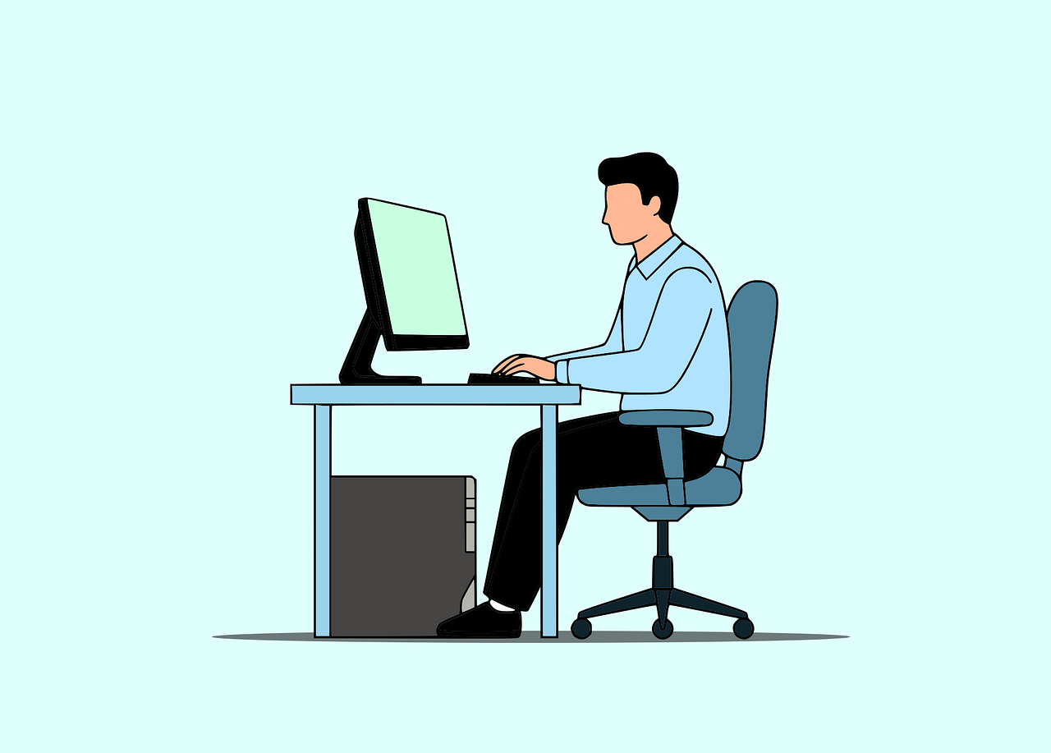
Core Content | Lesson 6 | Respectful Behaviour Online (Husn al Adab)
Learning Objectives
To understand what respectful behaviour (Husn al-Adab) means online
To recognise how words and actions online can affect others
To understand Islamic teachings on kindness, respect and self-control
To identify examples of respectful and disrespectful online behaviour
To develop the ability to communicate politely and responsibly online
Shura Proposal 25/01 Artificial Intelligence

Slide 33
Starter
What does it mean to have good manners (adab)?
Do the same rules of manners apply online?
How might someone feel if they are spoken to rudely online?
What do you think of the statement, “it is online so it does not matter, anyways noone knows who I am online so I can say what I want”?
Make sure you are prepared to explain why you think so, have some reasons ready to share with the class
*Talk to your partners*
Shura Proposal 25/01 Artificial Intelligence

Slide 34
Islamic/ Ahmadi View
What should an Ahmadi Muslim always keep in mind when online ?
We are taught to reflect good character in all situations, including online
We should speak with respect and avoid hurting others
We represent Islam and the Jama’at through our behaviour
You should always remember that:
Words online can hurt just like in real life
Messages can be misunderstood and spread quickly
We must think before we type or send anything
Before posting a comment or sending a message, ask yourself: Is it true, is it kind, is it necessary? Avoid responding in anger—pause and think before replying
Do not engage in arguments, insults, or public shaming
Respect others’ privacy—do not share messages or images without permission
Online behaviour reflects your character and values
What you say online can affect others’ feelings, reputation, and wellbeing
Showing patience and restraint is a sign of strength not hurling abuse at another person
The Holy Prophet (SAW) stated, “the person who is strong is one who controls himself when angry” (Al Adab Al Mufrad)
Key point:
Speak online the way you would speak face to face—with respect and dignity.
The Prophet Muhammad (SAW) stated that, “The Muslim is the one from whose tongue and hands others are safe” (An Nasaa’i 4995)
Shura Proposal 25/01 Artificial Intelligence

Slide 35
Main Task – “Say it Better” | Communication Challenge
Your task for today is to look at the examples of statements below and:
Work with your partner
Discuss what is good or bad about these messages and why
How you can change them/ rephrase them to make them polite and in line with how a Muslim should speak to others to show Husn al Adab?
Make sure you are prepared to explain why you think so, have some reasons ready to share with the class
“That is so wrong, you do not know anything”
“Why would you even post that picture of the sunset, it is so lame”
“Nobody cares about what you have to say”
“Just leave the lobby you are so bad at this game”
Shura Proposal 25/01 Artificial Intelligence

Slide 36
Feedback Time
Shura Proposal 25/01 Artificial Intelligence

Slide 37
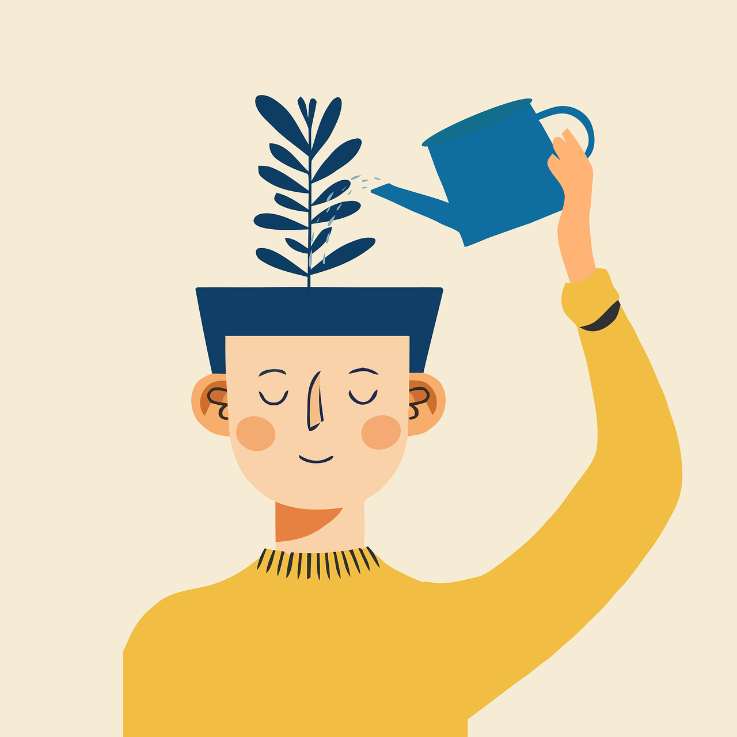
Core Content | Lesson 7 | Screen Time, Balance and Self-Control
Learning Objectives
To understand what screen time is
To recognise the importance of balance
To understand Islamic teachings on self-control
To identify healthy and unhealthy screen habits
To manage screen time responsibly
Shura Proposal 25/01 Artificial Intelligence

Slide 38
Starter
Think about and answer the questions below:
“How many hours do you spend on screens daily?”
“What do you use screens for?”
“Can too much screen time be harmful?”
What do you think about this statement, “I spend hours gaming and nothing happens to me, that must mean there is nothing wrong with it and I can stop whenever I want”
Make sure you are prepared to explain why you think so, have some reasons ready to share with the class
*Talk to your partners*
Shura Proposal 25/01 Artificial Intelligence

Slide 39
Islamic/ Ahmadi View
What does Islam tell us about the way we should spend our time ?
Islam teaches balance and self-control
Time is a gift from Allah and should not be wasted
Too much screen time can distract from Salah and responsibilities
Islam emphasises taking the ‘middle path’ i.e. being balanced in all things, nor being excessive in consumption of one thing (excess/ obsession) nor totally rejecting it rigidly (extremism)
There is nothing wrong with playing a video game or spending time watching a documentary, for example, but it does become a problem when we are constantly immersed in such activities
Not only can you begin to miss your Salah, sitting for prolonged hours is also detrimental to your physical and mental health
Not talking to your family members/ friends, going out to play sports and exercising can reduce your social abilities such as holding a conversation or developing meaningful bonds that can make you a better, productive and more considerate member of society – qualities that Islam promotes
What should we do instead then ?
We should prioritise prayer, study and family
We must control our usage, not be controlled by screens
Teacher to emphasise clearly:
Too much screen time leads to distraction and tiredness
It takes time away from important duties
Allah the Almighty states in the Holy Qur’an. “...He does not love those who exceed the bounds.” Al A’raf 7: 32
Key Point: Control your time—don’t let your screen control you.
Shura Proposal 25/01 Artificial Intelligence

Slide 40
Main Task – “My Day, My Balance” | Planning a Timetable Challenge
Your task for today is to work independently to think about what a balanced day might consist of in terms of the activities you engage in. Using your pen and paper and the list of activities below, produce a timetable:
School
Dinner
Homework
Screen time
Family time
Salah
Playing/ engaging in hobbies
Sleep
Make sure you are prepared to explain why you think so, have some reasons ready to share with the class
You are to work independently
Shura Proposal 25/01 Artificial Intelligence

Slide 41
Feedback Time
Shura Proposal 25/01 Artificial Intelligence

Slide 42

Core Content | Lesson 8 | Seeking Help and Speaking Up
Learning Objectives
To understand when and why it is important to seek help
To recognise situations that are unsafe, worrying or inappropriate
To know who trusted adults are and how they can help
To understand that speaking up is the right and safe choice
To develop confidence in asking for help
Shura Proposal 25/01 Artificial Intelligence

Slide 43
Starter
Look at the questions below and think silently for 1 minute:
When online, when might you ask for help?
Who are the trusted adults you can go to?
What might stop someone from speaking up?
What do you think of the statement, “it is better to stay quiet than to tell someone about what is happening”
Hands up, what do you guys think?
Shura Proposal 25/01 Artificial Intelligence

Slide 44
Islamic/ Ahmadi View
What does Islam teach us about harm and dangerous situations online ?
• Islam teaches us to protect ourselves and others from harm
• We should seek help when something is wrong
• It is not right to stay silent about harmful situations
• We are taught to be honest and responsible
• Speaking up helps protect ourselves and others
• Seeking help is a sign of strength, not weakness
What should we do if we encounter a problem or dangerous situation online ?
• If something feels wrong, unsafe, or worrying, tell a trusted adult
• Problems can grow when they are kept hidden
• Pupils will not get in trouble for asking for help
Key Point:
Speaking up keeps you safe; staying silent can allow harm to continue
If something that happened/ is happening online is making you feel uneasy then you should tell a trusted adult
If they continue to cause you distress, you can block them/ remove them as a friend
Shura Proposal 25/01 Artificial Intelligence

Slide 45
Main Task – “Speak Up Scenario Cards” | What Would You Do?
Your task for today is to read through the scenarios below and you must decide what to do in each situation and who to tell/ seek help from
Work in pairs
Read each scenario carefully
What is wrong in each scenario?
Why it is unsafe or worrying?
Who would you speak to/ seek help from?
Make sure you are prepared to explain why you think so, have some reasons ready to share with the class
*Talk to your partners*
Shura Proposal 25/01 Artificial Intelligence

Slide 46
Feedback Time
Shura Proposal 25/01 Artificial Intelligence

Slide 47
The Core Content (for pupils aged 12 and under) Ends Here
Shura Proposal 25/01 Artificial Intelligence

Slide 48
“O ye who believe! if an unrighteous person brings you any news, ascertain the correctness of the report fully, lest you harm a people in ignorance, and then become repentant for what you have done” (Al Hujuraat 49:7)
Shura Proposal 25/01 Artificial Intelligence

