Slide 1

All Content Past This Point is for Pupils Aged 13 and Above Only
**Before Proceeding Please Ensure You Have Read the Guidance on Slide 2**
Shura Proposal 25/01 Artificial Intelligence

Slide 2

Mature Content | Lesson 1 | Digital Safety, Dignity and Self-Protection
Learning Objectives
To understand the importance of protecting their dignity online
To recognise risks related to inappropriate and harmful digital content
To explain how to respond safely to uncomfortable or unsafe situations online
To identify trusted sources of help and support
Class Rules
Before we begin, it is important to establish clear expectations to ensure this lesson is conducted with respect, maturity, and professionalism:
Listen respectfully to the ideas and responses of your peers
Mocking one another for a response is not allowed
No personal experiences are to be shared at any time, even if you intend to share them so that others may learn something
Respect opinions that differ from your own
What is discussed is to remain within the classroom (where appropriate)
Maintain focus and take the lessons seriously
Ask questions about anything you are unsure of
Vulgar, immature and disrespectful remarks will not be tolerated
Please Note: anyone who breaches these rules and acts in an unacceptable manner will be given a warning, if they continue to fail to follow the rules they will be removed from the discussion
Shura Proposal 25/01 Artificial Intelligence

Slide 3
Starter
Look at the three statements below, numbered 1-5
I will read out the number (e.g. Statement 1) and you will show me thumbs up or thumbs down to tell me whether you think you agree (thumbs up) or disagree (thumbs down)
After each one, I will ask some of you to share your thoughts with the class and why you put your thumbs up or down
“Everything online is private and noone knows who I am therefore I can say what I want and send any pictures or videos to anyone online”
“If something feels wrong online, ignore it and move on, it is not your problem, let the person being targeted deal with it”
“You are a coward if you ask someone for help just because someone is always making jokes about you online”
“Someone insults a friend of mine and regularly mocks the way they talk, I go and inform my parents who then inform my friend’s parents
“All my friends swear and shout on the mic when playing videogames, I politely desist from playing with them and tell them that as an Ahmadi, I do not swear or shout at others in an intimidating manner”
“I made a deepfake image of my friend at school and share it in various group chats as a joke, he does not know but it is fine, we are friends”
Make sure you are prepared to explain why you think so, have some reasons ready to share with the class
*Talk to your partners*
Shura Proposal 25/01 Artificial Intelligence

Slide 4
Islamic/ Ahmadi View
What does Islam teach us about harm and dangerous situations online ?
• Islam teaches us to protect ourselves and others from harm
• We should seek help when something is wrong
• It is not right to stay silent about harmful situations
• We are taught to be honest and responsible
• Speaking up helps protect ourselves and others
• Seeking help is a sign of strength, not weakness
What should we do if we encounter a problem or dangerous situation online ?
• If something feels wrong, unsafe, or worrying, tell a trusted adult
• Problems can grow when they are kept hidden
• Pupils will not get in trouble for asking for help
Key Point:
Speaking up keeps you safe; staying silent can allow harm to continue
If something that happened/ is happening online is making you feel uneasy then you should tell a trusted adult
If they continue to cause you distress, you can block them/ remove them as a friend
Shura Proposal 25/01 Artificial Intelligence

Slide 5
Main Task – “Speak Up Scenario Cards” | What Would You Do?
Your task for today is to read through the scenarios below and you must decide what to do in each situation and who to tell/ seek help from. You are to:
Work in pairs
Read each scenario carefully
Identify what is wrong in each scenario?
Think about why it is unsafe or worrying?
Think about who you could speak to/ seek help from?
What damage could the behaviour in each scenario cause on a societal level?
Make sure you are prepared to explain why you think so, have some reasons ready to share with the class
*Talk to your partners*
A friend of yours has received an explicit photo from someone in school and forwards it to you
Someone has made a fake account with someone else’s name. They are posting edited and distorted pictures of the person and people you know are leaving rude comments under it
People at school have found an app that can paste a person’s face into any video, they ask you to join in
You have been talking to a girl in your class and have added her on social media, you talk regularly even though you know it goes against your values
A friend of yours is being bullied online on a game that you and a lot of friends at school play
A friend of yours has received an explicit photo from someone in school and forwards it to you
Shura Proposal 25/01 Artificial Intelligence

Slide 6
Feedback Time
Shura Proposal 25/01 Artificial Intelligence

Slide 7
Mature Content | Lesson 2 | Online Relationships, Dignity and Data Trails
Learning Objectives
To understand risks within online relationships
To recognise how data and images can be stored, shared, and misused
To explain how digital actions can impact reputation and future opportunities
To identify safe and appropriate online behaviour
To identify how zina can destroy the moral fabric of society and incur Allah’s displeasure
Class Rules
Before we begin, it is important to establish clear expectations to ensure this lesson is conducted with respect, maturity, and professionalism:
Listen respectfully to the ideas and responses of your peers
Mocking one another for a response is not allowed
No personal experiences are to be shared at any time, even if you intend to share them so that others may learn something
Respect opinions that differ from your own
What is discussed is to remain within the classroom (where appropriate)
Maintain focus and take the lessons seriously
Ask questions about anything you are unsure of
Vulgar, immature and disrespectful remarks will not be tolerated
Please Note: anyone who breaches these rules and acts in an unacceptable manner will be given a warning, if they continue to fail to follow the rules they will be removed from the discussion
Shura Proposal 25/01 Artificial Intelligence

Slide 8
Starter
Who can tell me what the following terms mean?
Data trails
Zina
Look at the three statements below, numbered 1- 3
“If someone feels real online, they can be trusted”
“Once you delete something, it’s gone for good”
“Sending private images stays between two people”
I will read out the number (e.g. Statement 1) and you will show me thumbs up or thumbs down to tell me whether you think you agree (thumbs up) or disagree (thumbs down)
After each one, I will ask some of you to share your thoughts with the class and why you put your thumbs up or down
Make sure you are prepared to explain why you think so, have some reasons ready to share with the class
*Talk to your partners*
Shura Proposal 25/01 Artificial Intelligence

Slide 9
Islamic/ Ahmadi View
What does Islam teach us about relationships outside of wedlock ?
Islam teaches modesty, dignity, and clear boundaries between non-mahram males and females
Unnecessary private communication, flirting, or emotional attachment outside of halal boundaries is not permitted
Online spaces do not remove these rules—haram remains haram, whether in person or digital
Be mindful of your tone of voice and your topic of conversation when speaking to members of the opposite gender
A believer protects their honour by avoiding inappropriate relationships and conversations
Emotional closeness can develop quickly online and lead to poor decisions
Guarding one’s modesty includes what we say, share, and engage with digitally
It is important to know that Zina is not only physically engaging in impermissible acts with the opposite gender, rather, the Prophet (SAW) stated, ““The two eyes commit adultery, the two hands commit adultery, the two legs commit adultery, and the genitals commit adultery”. (Musnad Aḥmad)
Always remember:
Online relationships can feel real but often lack accountability and truth
Private messaging, sharing images, or “talking stages” can lead to pressure, exposure, and regret
Once boundaries are crossed, it becomes harder to step back
Key Point:
What begins as a message can lead to harm—protect your dignity by keeping within halal boundaries
Islam teaches that prevention is better than cure – rather than allowing yourself to cross the boundaries you are to stay within, nip the haram discussions in the bud to prevent displeasing Allah, falling into Zina and damaging your reputation and of those around you
Shura Proposal 25/01 Artificial Intelligence

Slide 10
Main Task – “Nip It in the Bud” | What Should You Do?
Your task for today is to read through the scenarios below and you must think about and decide what you should do to avoid haram, what steps could you take to and who to tell/ seek help from. Recall the key point from the previous slide, “prevention is better than cure”, how can you prevent falling into sin? You are to:
Work in pairs
Read each scenario carefully
Identify which actions can lead to temptation to fall into the haram
What could you do to keep your mind off wanting to engage in haram actions and speech?
What damage could the behaviour in each scenario cause on a societal level?
Make sure you are prepared to explain why you think so, have some reasons ready to share with the class
*Talk to your partners*
Regularly messaging someone of the opposite gender in private and becoming dependent on them to be happy
A girl at your workplace regularly makes you a coffee in the morning and you begin to joke and flirt with her every morning before your shift starts
Your friend mocks you and calls you names for not having a girlfriend all the time. They try to pressure you into speaking to a girl.
You and a group of your male friends study in the library two weeks before your final exams, one of your friends brings his girlfriends and she brings some of her friends.
Shura Proposal 25/01 Artificial Intelligence

Slide 11
Feedback Time
Shura Proposal 25/01 Artificial Intelligence

Slide 12

Mature Content | Lesson 3 | X-Rated Content and Its Consequences
Learning Objectives
To understand the harms of engaging with inappropriate digital content
To recognise the impact on mental, emotional, and spiritual well-being
To explain the consequences of sharing or accessing such material
To identify strategies to avoid and respond to exposure
Class Rules
Before we begin, it is important to establish clear expectations to ensure this lesson is conducted with respect, maturity, and professionalism:
Listen respectfully to the ideas and responses of your peers
Mocking one another for a response is not allowed
No personal experiences are to be shared at any time, even if you intend to share them so that others may learn something
Respect opinions that differ from your own
What is discussed is to remain within the classroom (where appropriate)
Maintain focus and take the lessons seriously
Ask questions about anything you are unsure of
Vulgar, immature and disrespectful remarks will not be tolerated
Please Note: anyone who breaches these rules and acts in an unacceptable manner will be given a warning, if they continue to fail to follow the rules they will be removed from the discussion
Shura Proposal 25/01 Artificial Intelligence

Slide 13
Starter
Look at the three statements below and talk to your partners about whether you agree or disagree and why
“What you watch online has no real impact on you”
“Private viewing is harmless if no one else knows”
“I am not physically engaging in any haram action with anyone else so it is fine”
“Exposure to inappropriate content can affect behaviour and thinking”
What do you think about the statement, “It is natural to watch such content”
After each one, I will ask some of you to share your thoughts with the class and why you put your thumbs up or down
Make sure you are prepared to explain why you think so, have some reasons ready to share with the class
*Talk to your partners*
Shura Proposal 25/01 Artificial Intelligence

Slide 14
Islamic/ Ahmadi View
What does Islam teach us about dealing with such content ?
Islam teaches modesty, purity, and guarding one’s eyes and thoughts
Viewing inappropriate content weakens self-control and harms character
What we consume influences our heart, actions, and behaviour
Can damage future marriage and can become an addiction that ruins the relationship between spouses
One who seeks pleasure in such actions cannot then experience/ show love to their spouse in the halal and Islamic manner
Loss of respect/ dignity/ failing to act as a role model for one’s children
A believer strives for purity in both public and private life
True discipline is shown when resisting temptation, even when alone
Protecting oneself from harmful content is an act of strength and faith
What are the consequences of watching such content ?
Such content creates unrealistic expectations and distorts relationships
It can lead to addiction, secrecy, and loss of self-respect
One may begin to view women as objects and start viewing them as merely a source of pleasure rather than human beings with dignity and respect
The effects are gradual but damaging over time
Key Point:
Islam promotes the lowering of the gaze (Ghadd al Basr)
By doing so, the trigger to giving into carnal desires and engaging in impermissible actions is done away with
Shura Proposal 25/01 Artificial Intelligence

Slide 15
Main Task – “Impact Mapping: Mind, Society and Soul” | What is the damage?
Your task for today is to work in pairs to produce a mindmap. You will use everything we have just learned about to list all the different ways that watching such content can damage you.
Damage can be mental, spiritual, social and also, on a larger level, societal, how might this look, write up your ideas on your pieces of paper.
Work in pairs
What damage could the behaviour in each scenario cause at each level level (mental, spiritual, social and societal?
Make sure you are prepared to explain why you think so, have some reasons ready to share with the class
*Talk to your partners*
Shura Proposal 25/01 Artificial Intelligence

Slide 16
Feedback Time
Shura Proposal 25/01 Artificial Intelligence

Slide 17
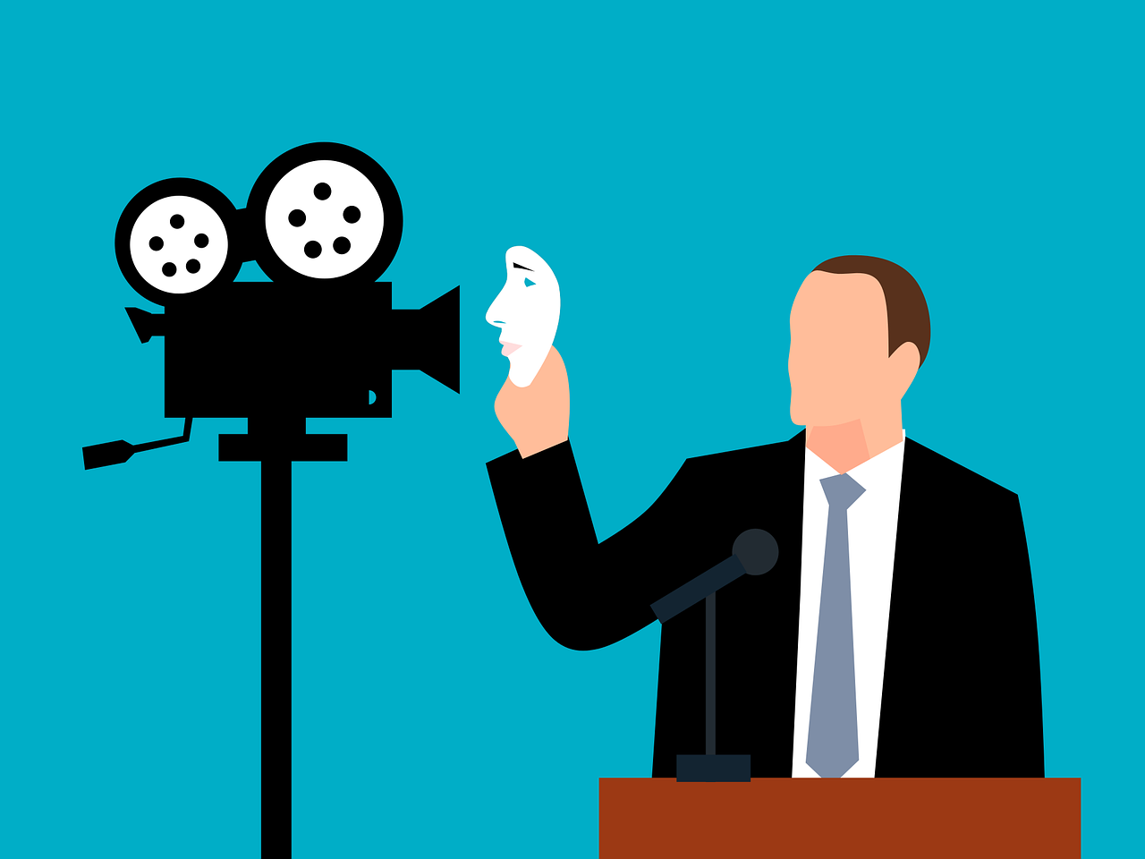
Mature Content | Lesson 4 | Personal Photos, Deepfakes and Their Risks
Learning Objectives
To understand the risks of sharing personal images online
To recognise how images can be manipulated or misused (including deepfakes)
To explain the potential personal, social, and reputational consequences
To identify safe behaviours to protect personal identity and dignity
Class Rules
Before we begin, it is important to establish clear expectations to ensure this lesson is conducted with respect, maturity, and professionalism:
Listen respectfully to the ideas and responses of your peers
Mocking one another for a response is not allowed
No personal experiences are to be shared at any time, even if you intend to share them so that others may learn something
Respect opinions that differ from your own
What is discussed is to remain within the classroom (where appropriate)
Maintain focus and take the lessons seriously
Ask questions about anything you are unsure of
Vulgar, immature and disrespectful remarks will not be tolerated
Please Note: anyone who breaches these rules and acts in an unacceptable manner will be given a warning, if they continue to fail to follow the rules they will be removed from the discussion
Shura Proposal 25/01 Artificial Intelligence

Slide 18
Starter
Who here has heard of the term ‘deepfakes’ ?
What are deepfakes
What are their associated dangers?
What do you think about the statement, “I created a deepfake of my friend, it is just a joke”?
Make sure you are prepared to share your ideas, have some points ready to share with the class
*Talk to your partners*
Shura Proposal 25/01 Artificial Intelligence

Slide 19
Islamic/ Ahmadi View
What guidance does Islam have to offer us in this regard ?
Islam teaches protection of honour, privacy, and dignity
Personal images are an amanah (trust) and must be safeguarded
Causing harm to oneself or others—through sharing or misuse—is not permitted
A believer protects their identity and avoids situations that risk exposure or misuse
Altering or sharing images without consent is a breach of trust and responsibility
Actions, even in private, carry accountability
What are the dangers and consequences of sharing personal photos online or producing deepfakes of someone ?
Images can be edited, reused, or turned into harmful content without consent
Deepfakes can falsely represent individuals and damage reputations
There can be serious legal consequences for sharing, possessing, or distributing harmful or explicit images
Once shared, control is often lost permanently and anyone who sees such content can redistribute it or make illegal/ inappropriate use of it, for which you are now responsible
Key Point:
Once an image is shared, control is lost—protect your dignity and the dignity of others and think before you click send
Shura Proposal 25/01 Artificial Intelligence

Slide 20
Main Task – “Think Before You Share” | What is the damage?
Your task for today is to work in pairs and to:
Read each scenario carefully
Identify what is happening?
What are the risks?
How could the image be misused or manipulated?
What are the consequences in each scenario (personal, social, Islamic and reputation wise)?
What should the person do instead?
Make sure you are prepared to explain why you think so, have some reasons ready to share with the class
*Talk to your partners*
A pupil posts a group photo online without asking everyone in the picture if they are comfortable with it
A pupil uses an app to change their appearance in a photo and posts it as if it were real
A person’s image is taken from their social media and used to create a fake profile pretending to be them
Someone receives an image from a friend and forwards it without thinking
Someone screenshots a private disappearing message from a friend and saves it without the sender knowing
A person sees an explicit image of someone online and they share it and repost it without knowing if it is even real
Shura Proposal 25/01 Artificial Intelligence

Slide 21
Feedback Time
Shura Proposal 25/01 Artificial Intelligence

Slide 22
Analyse, Reflect and Act
If you find yourself in a situation involving a deepfake or an inappropriate image shared, what can you do ?
Talk to your partner and be prepared to share you reasoning
Shura Proposal 25/01 Artificial Intelligence

Slide 23
Feedback Time
Shura Proposal 25/01 Artificial Intelligence

Slide 24
Key Takeaways for Today
Do not share, forward or engage with the content
Block and report the account or source immediately
Inform a trusted adult (teacher, parent, safeguarding lead)
Remove yourself from the group in which it is being shared
Do not attempt to handle it alone
Do not comment under such a post
Shura Proposal 25/01 Artificial Intelligence

Slide 25
Scheme of Work Concluded
Shura Proposal 25/01 Artificial Intelligence
Please Note: All Images Sourced From Pixabay (Free-use Licence)

Slide 26
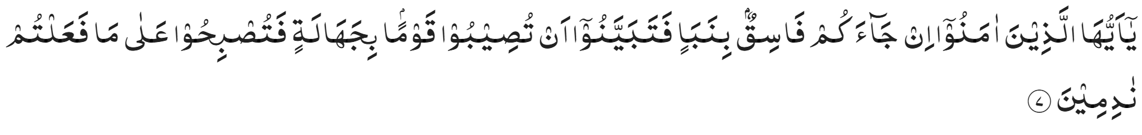
“O ye who believe! if an unrighteous person brings you any news, ascertain the correctness of the report fully, lest you harm a people in ignorance, and then become repentant for what you have done” (Al Hujuraat 49:7)

