Slide 1


In the Name of Allah, the Most Gracious, Ever Merciful
Faith-First Digital Intelligence
Using Artificial Intelligence, Social Media and the Internet as an Ahmadi Muslim
Benefits, Risks and Responsible Practice
“O ye who believe! if an unrighteous person brings you any news, ascertain the correctness of the report fully, lest you harm a people in ignorance, and then become repentant for what you have done” (Al Hujuraat 49:7)

Slide 2
Programme Purpose
This programme is designed to support parents and adults in understanding the digital world and their responsibility within it
The content will address real risks and challenges associated with AI, social media and internet usage
Some topics may be sensitive in nature, including harmful content, online behaviour and safeguarding concerns
All discussions will be approached with respect, dignity and professionalism in line with Islamic teachings
Parents are encouraged to reflect honestly on their own usage and household practices
The aim is not to criticise, but to equip and empower families to make better, informed decisions
Please maintain a serious and attentive approach throughout — these issues directly impact our children and future generations
Where appropriate, discussions should remain confidential and respectful

Slide 3
Important Guidance for All Teaching Staff
*Please Read the Guidance Below Carefully*
This programme is not only to be understood, but implemented within the home environment through consistent action and guidance
Parents must take an active role in shaping their children’s digital habits, rather than assuming children will manage themselves
Discussions around AI, social media and online behaviour should be ongoing within the household, not limited to a single session
Parents should strive to lead by example, ensuring their own use of technology reflects discipline, modesty and purpose
It is essential to establish clear household rules and boundaries regarding screen time, content and device usage
Parents should create an environment where children feel safe to speak openly, ask questions and seek guidance without fear
Monitoring and supervision should be carried out with wisdom and balance, ensuring protection without creating secrecy or rebellion
Islamic teachings, guidance from Khilafat, and Jama’at resources should be used as the primary reference point when addressing digital challenges
The objective is to raise individuals who are not only aware of risks, but who demonstrate self-control (Taqwa), responsibility and strong moral character in all aspects of their digital and personal lives
As Ahmadi Muslims, we must strive to cultivate within ourselves the qualities and standards expected of us by our beloved Khalifa (May Allah SWT strengthen his hand). May Allah SWT enable us all to use the Internet, AI and Social Media in a manner that is beneficial for us and that serves Islam Ahmadiyya and may He (SWT) protect us from using these tools in ways that incur his displeasure, Ameen.

Slide 4
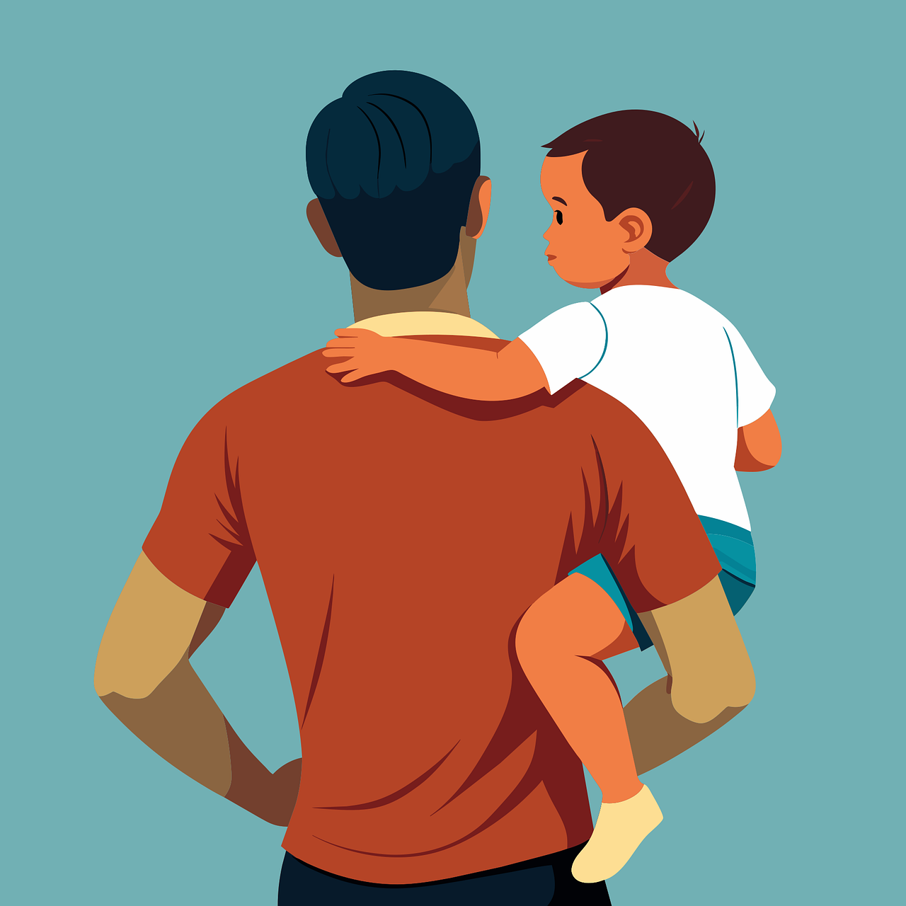
What are Parents’ Responsibilities?
Senior Content | Lesson 1 | Parental Responsibility In the Digital Age/?
Parents hold a central responsibility in shaping not only their child’s physical and academic development, but also their digital environment and habits. In today’s world, children are constantly exposed to content through AI, social media and the internet, much of which they are not mature enough to process or regulate independently.
As such, it is not sufficient to simply provide access to devices; rather, parents must actively guide, monitor and set boundaries around their use.
The digital space is not separate from real life—it directly shapes a child’s thoughts, behaviour and identity. Therefore, a parent must take ownership of what is allowed within the home, ensuring that technology is used in a way that benefits, rather than harms, their child.
Parents are not only responsible for providing for their children physically and academically, but also for safeguarding their moral, spiritual and psychological development. In today’s digital age, this responsibility extends directly into the online world, where children are constantly exposed to content that can shape their beliefs, behaviours and identity. Unlike previous generations, children are now being influenced not only by family and school, but by algorithms, influencers and artificial intelligence systems that operate without moral guidance. This makes the role of the parent even more critical.
Allah (SWT) clearly instructs:
“O ye who believe! save yourselves and your families from a Fire…” (Surah At-Tahrim 66:8)
This verse establishes that parents are responsible not only for their own actions, but also for guiding and protecting their families from harm. In the context of today’s world, this includes protecting children from harmful digital environments. The Holy Prophet (SAW) further stated:
“Each of you is a shepherd and each of you is responsible for his flock” (Sahih Bukhari)
This emphasises that parenting is a position of accountability. Allowing unrestricted access to harmful content is not neutrality — it is neglect of responsibility.

Slide 5
Islamic/ Ahmadiyya Guidance
Islam teaches believers to exercise caution, verification and responsibility when consuming and sharing information. As stated in the Holy Qur’an, “if an unrighteous person brings you any news, ascertain the correctness of the report fully” (49:7), highlighting the importance of not blindly accepting or spreading information.
This is especially relevant in the age of AI, where content can appear convincing yet be inaccurate or entirely false. As highlighted in the programme, AI does not possess true understanding or knowledge, but rather generates responses based on patterns and data, meaning it can produce misleading or fabricated information .
From an Ahmadiyya perspective, this reinforces the principle that truth is not determined by what is most accessible or popular online, but through verified, authentic sources, guided by the Qur’an, the teachings of the Holy Prophet (SAW), and Khilafat.
Therefore, both parents and children must develop a habit of questioning, verifying and thinking critically before accepting or acting upon any digital content.
In Islam, speaking the truth is a key teaching (Sidq), parents are required to verify information before accepting or acting upon it. This is also to be done with children, are you checking your children’s media consumption? Are you having regular talks about common issues ? Only when you take the time to sit with your children and develop a deep bond with them, where they feel comfortable discussions issues with you will you be able to have any positive impact on their habits and behaviours.
This principle is even more critical in the age of artificial intelligence, where information can be generated instantly but is not always accurate or truthful. AI systems do not possess understanding, intention or truth — they produce responses based on patterns and data, meaning they can generate false, misleading or fabricated information.
Allah (SWT) states:
“O ye who believe! if an unrighteous person brings you any news, ascertain the correctness of the report fully…” (Surah Al-Hujurat 49:8)
This verse directly applies to AI and online content today. Not everything seen or heard can be trusted. The Holy Prophet (SAW) also warned:
“It is enough for a man to be considered a liar that he narrates everything he hears” (Sahih Muslim)
From an Ahmadiyya perspective, this reinforces that truth is not taken from random online sources, AI tools or popular opinion, but from:
The Holy Qur’an
The Holy Prophet (SAW)
The Promised Messiah (AS)
Khilafat
Key Point: Parents must therefore teach their children that just because something looks real or sounds convincing, it does not make it true.

Slide 6
What can parents do to safeguard their children?
In order to safeguard their children, parents must adopt a proactive and structured approach to digital usage within the home. This includes setting clear rules regarding screen time, restricting access to inappropriate platforms, and ensuring that devices are used in shared or supervised spaces rather than in isolation.
Regular conversations should take place to understand what children are watching, who they are interacting with, and how digital content is influencing their thoughts and behaviour.
Equally important is leading by example; children are more likely to adopt disciplined habits when they observe the same in their parents.
Safeguarding is not achieved through control alone, but through a balance of supervision, open communication and the development of internal self-discipline, ensuring that children grow into individuals who are not only protected, but capable of making responsible choices independently.
Safeguarding children in the digital age requires more than occasional monitoring — it requires a structured, consistent and intentional approach. Parents must establish clear household systems that regulate how technology is used, ensuring that it remains a tool rather than becoming a source of harm. This includes setting firm boundaries around screen time, restricting access to inappropriate content, and ensuring that devices are used in shared spaces rather than in isolation.
The Holy Prophet (SAW) taught:
“A man is upon the religion of his close companion, so let one of you look at whom he befriends” (Tirmidhi)
In today’s context, “companions” are not only friends in real life, but also:
influencers
content creators
online personalities
Key Point: Parents must therefore be aware of who is influencing their child digitally.

Slide 7
In addition:
Parents must model discipline themselves — children imitate what they see
Regular conversations must take place — not interrogation, but guidance
Children must be taught self-control (Taqwa), not just external rules
Allah (SWT) reminds us:
“Surely Allah does not change the condition of a people until they change what is in themselves” (13:13)
The goal is not just to control children, but to raise individuals who develop internal discipline and conscious awareness, enabling them to make the right choices even when unsupervised.

Slide 8

Understanding the digital world
Senior Content | Lesson 2 | Understanding AI, Social Media and Algorithms
In today’s digital age, the content that children consume online is not random, but carefully selected and personalised through complex algorithms. Social media platforms and online services are designed to maximise engagement by tracking user behaviour, such as what is watched, liked and shared, and then continuously presenting similar content.
This means that over time, children can become immersed in specific types of content that shape their thoughts, attitudes and behaviours without them even realising it.
As a result, the digital environment is highly influential, and without awareness and guidance, children can be subtly directed towards harmful or unproductive habits.
Algorithms do not just decide what children see — they shape how children think over time. By continuously feeding similar types of content, they create a narrowed perspective where certain ideas, behaviours or lifestyles begin to appear normal simply due to repetition. This can gradually influence a child’s beliefs, expectations and even identity, without any conscious decision being made.
This is particularly dangerous because it removes exposure to balanced viewpoints. A child may begin to believe:
“everyone thinks like this”
“this is normal behaviour”
“this is what I should be like”
Allah (SWT) warns:
“And follow not that of which thou hast no knowledge…” (Surah Al-Isra 17:38)
This highlights that blindly following what is repeatedly presented — without understanding or verification — leads to misguidance. Algorithms do not guide towards truth, they guide towards engagement, and this distinction must be understood by parents.

Slide 9
Islamic/ Ahmadiyya Guidance
From an Islamic perspective, this highlights the importance of being conscious of what one allows themselves to see and engage with. Islam teaches that what a person repeatedly observes and listens to has a direct impact on their heart, thoughts and actions.
As emphasised in your programme, individuals must remain aware that technology and algorithms do not distinguish between what is right or wrong, but rather prioritise what is most engaging .
Therefore, a believer must actively exercise control over their choices, ensuring that their consumption aligns with Islamic values such as modesty, discipline and truthfulness. The responsibility lies not with the platform, but with the individual—and for children, this responsibility initially lies with the parent.
Islam places strong emphasis on the environment a person surrounds themselves with, as it directly impacts the condition of the heart and mind. In today’s world, this environment is no longer just physical — it is digital. What a person repeatedly consumes becomes their mental and spiritual environment.
The Holy Prophet (SAW) gave a powerful analogy:
“The example of a good companion and a bad companion is like the seller of musk and the blacksmith…” (Sahih Bukhari)
Just as a person is influenced by their companions, today they are influenced by:
content creators
influencers
algorithm-driven feeds
From an Ahmadiyya perspective, this reinforces that a believer must actively choose environments that strengthen faith, not weaken it. If a child’s digital environment is filled with harmful or empty content, it will inevitably affect their character, regardless of intention.

Slide 10
What Parents Must Do
In response to this reality, parents must take deliberate steps to understand and monitor the digital environments their children are exposed to. This includes becoming familiar with the platforms their children use, recognising how content is recommended, and identifying potential risks associated with prolonged or repeated exposure.
Parents should regularly review their child’s digital activity, have open discussions about what they are seeing online, and guide them in developing awareness of how these platforms influence their behaviour.
By doing so, parents can shift their child from being passively influenced by algorithms to actively making conscious and informed choices about what they engage with.
Parents must move beyond simply limiting screen time and begin actively disrupting harmful algorithm patterns. This requires intentional intervention in what children are exposed to, rather than allowing platforms to dictate their experience.
Practical steps include:
Resetting or reviewing recommended content (e.g. YouTube, TikTok feeds)
Encouraging children to actively choose beneficial content rather than passively scroll
Teaching children to recognise when they are being influenced rather than making independent choices
Introducing alternative sources of engagement (learning, reading, Islamic content)
Allah (SWT) reminds:
“And that man shall have nothing but what he strives for” (Surah An-Najm 53:41)
This teaches that outcomes are a result of conscious effort. If no effort is made to guide a child’s digital environment, then that environment will be shaped by external forces instead.
The goal is not just to reduce exposure, but to ensure that children are actively thinking, choosing and resisting influence, rather than being passively shaped by it.

Slide 11

The Need for Boundaries
Senior Content | Lesson 3 | Control vs Freedom – Setting Boundaries At Home
In many households, children are given access to devices with little to no structure or limitation, often under the assumption that they will regulate their own usage.
However, children lack the maturity and discipline required to manage unrestricted access to technology, particularly when platforms are designed to be highly engaging and addictive.
Without clear boundaries, excessive screen time and exposure to inappropriate content become inevitable. Therefore, it is essential to recognise that freedom without guidance does not lead to independence, but rather to loss of control and potential harm.
What is often presented as “freedom” for children in the digital world is, in reality, a lack of guidance and structure. When children are given unrestricted access to devices, they are not exercising independence — they are being left vulnerable to systems designed to capture their attention and influence their behaviour. True freedom is not the absence of limits, but the ability to operate within boundaries that protect and develop the individual.
Without structure, children begin to:
Prioritise desire over responsibility
Seek constant stimulation
Struggle with discipline and delayed gratification
Allah (SWT) warns:
“And follow not thy low desires, lest they lead thee astray…” (Surah Sad 38:28)
Unrestricted digital access feeds the nafs (desires), not discipline. Therefore, what appears as freedom can in fact become a pathway to loss of control.

Slide 12
Islamic/ Ahmadiyya Guidance
Islam places strong emphasis on discipline, moderation and self-control in all aspects of life. Believers are instructed to avoid excess and to adopt a balanced approach, ensuring that no activity—whether permissible or not—begins to dominate their time or distract them from their duties. This principle applies directly to the use of technology, where unrestricted access can lead to negligence of responsibilities such as Salah, family time and personal development.
From an Ahmadiyya perspective, parents are responsible for instilling these values early, ensuring that children grow up understanding limits, structure and accountability in both their online and offline lives.
Islam does not promote unrestricted freedom, but rather a balanced life built upon discipline, accountability and self-restraint. A believer is not one who follows every desire, but one who controls them. This principle is essential when considering children’s access to technology, where desires are constantly stimulated through entertainment, social validation and instant gratification.
The Holy Prophet (SAW) stated:
“The strong person is not the one who overcomes others, but the one who controls himself when angry” (Bukhari)
This teaches that true strength lies in self-control, not indulgence.
From an Ahmadiyya perspective, parents must understand that children are not born with this discipline — it must be taught, modelled and enforced. If boundaries are not established early, children may grow accustomed to living without limits, making it significantly harder to instil discipline later in life.

Slide 13
What Parents Must Do (Practical Guidance)
To effectively safeguard their children, parents must establish clear and consistent rules regarding device usage within the home. This includes setting specific limits on screen time, ensuring that devices are not used in private spaces such as bedrooms, and monitoring the types of applications and platforms being accessed.
It is also important that these rules are enforced consistently, as inconsistency can lead to confusion and resistance. In addition, parents should involve their children in discussions around these boundaries, helping them understand the reasons behind them.
Through structure, consistency and communication, parents can create an environment where technology is used responsibly, rather than becoming a source of harm.
Parents must establish themselves as clear and consistent authorities within the home when it comes to digital usage. This does not mean being harsh or controlling, but being firm, structured and intentional. Rules must not only be set, but consistently upheld, as inconsistency weakens authority and creates confusion for the child.
Practical implementation includes:
Setting non-negotiable rules (e.g. no devices during certain times)
Ensuring boundaries apply to all children equally
Avoiding giving in to pressure or emotional reactions
Reinforcing expectations calmly but firmly
The Holy Prophet (SAW) said:
“Command your children to pray at seven…” (Abu Dawud)
This shows that structure and discipline are introduced early — not delayed until the child is “ready”.

Slide 14
Similarly, digital discipline must be:
introduced early
reinforced consistently
upheld with clarity
The goal is not control for its own sake, but to raise individuals who understand limits, respect structure, and develop the ability to regulate themselves even when those boundaries are no longer externally enforced.

Slide 15
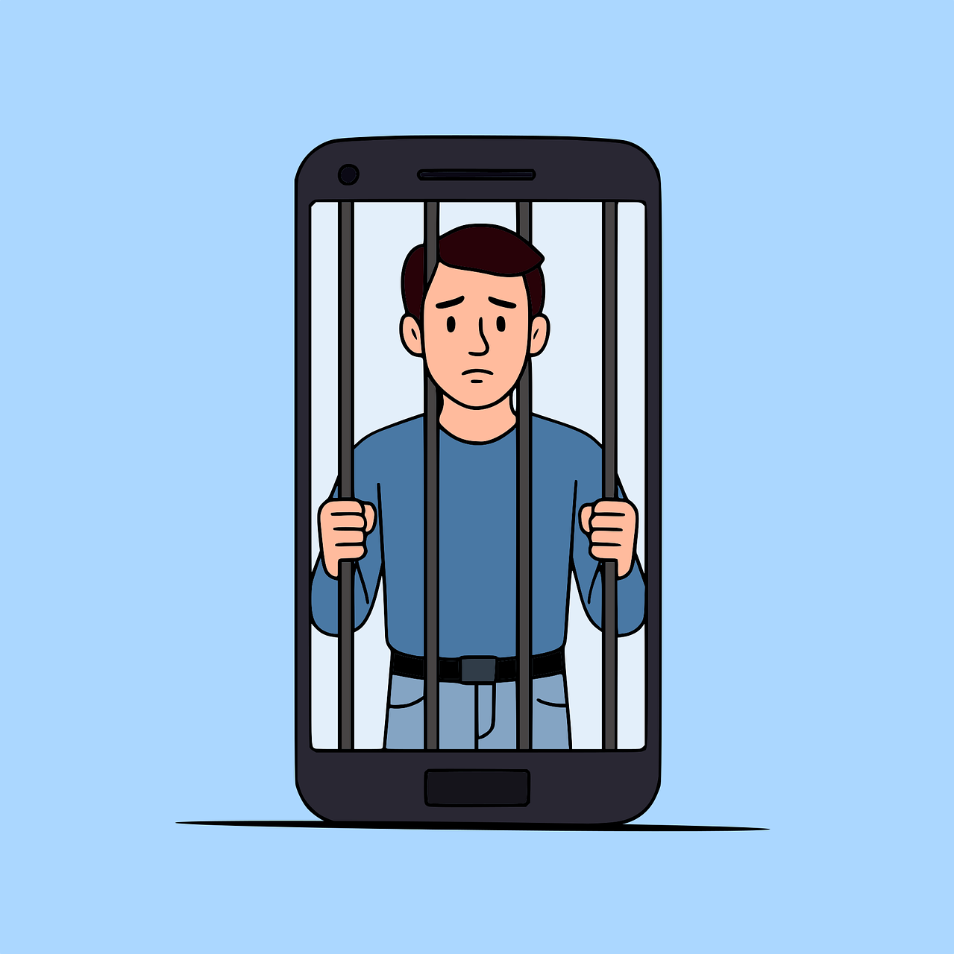
The Reality of Screen Addiction
Senior Content | Lesson 4 | Screen Time, Addiction & Discipline
Excessive screen usage is not simply a matter of habit, but is often the result of platforms being deliberately designed to capture and retain attention. Features such as endless scrolling, notifications and personalised content create a cycle where users feel compelled to continue engaging without conscious control.
For children, whose self-regulation is still developing, this can quickly lead to dependency, reduced attention span and difficulty focusing on tasks such as schoolwork or reading. Over time, this pattern can negatively impact productivity, behaviour and overall wellbeing, making it essential for parents to recognise the seriousness of screen overuse.
Excessive screen usage does not remain a neutral habit — over time, it develops into dependency. What begins as occasional use can gradually become a default behaviour, where children turn to screens for stimulation, comfort or escape. This creates a pattern where the mind becomes accustomed to constant input, reducing the ability to focus, reflect or engage in deeper thinking.
This dependency leads to:
Reduced patience and tolerance for boredom
Constant need for stimulation
Difficulty engaging in tasks that require effort
Allah (SWT) highlights the danger of becoming controlled by desire:
“Hast thou seen him who has taken his desire as his god?” (Surah Al-Jathiyah 45:25)
When screen usage becomes habitual and uncontrolled, it begins to shift from a tool into something that governs behaviour. At this point, the individual is no longer in control — the habit is.

Slide 16
Islamic/ Ahmadiyya Guidance
In Islam, time is regarded as a trust (Amaanah) from Allah, and believers are instructed to use it wisely and avoid excess. Engaging in any activity to the point where it distracts from obligations, such as Salah, family responsibilities or personal development, is strongly discouraged.
The concept of controlling the nafs (inner desires) is central, as true strength lies in the ability to exercise restraint even when something is easily accessible.
As reflected in your programme, excessive screen time not only wastes valuable time but can also weaken discipline and lead to neglect of one’s duties . Therefore, both parents and children must develop conscious control over their usage, ensuring that technology serves a purpose rather than becoming a source of distraction.
In Islam, time is one of the greatest trusts given to a believer, and its misuse carries consequences. A person will be questioned not only about major actions, but about how their time was spent on a daily basis. This is particularly relevant in the context of screen usage, where large amounts of time can be lost without awareness.
The Holy Prophet (SAW) said:
“A person’s feet will not move on the Day of Judgment until he is asked… about his life and how he spent it” (Tirmidhi)
This establishes that time is not insignificant — it is accounted for.
From an Ahmadiyya perspective, this reinforces that excessive engagement in unproductive or harmful content is not simply a lifestyle issue, but a spiritual concern.
When time is consistently diverted away from:
Salah
Family responsibilities
Personal development
it leads to a weakening of discipline and purpose.

Slide 17
What Parents Must Do (Restoring Control & Balance)
To address the issue of screen overuse, parents must actively establish routines and structures that promote balance within the home. This includes setting designated times for device usage, encouraging alternative activities such as reading, physical exercise and family interaction, and ensuring that key responsibilities—such as Salah and schoolwork—are prioritised before screen time.
Parents should also model disciplined behaviour themselves, as children are more likely to adopt habits they observe.
By creating a balanced daily routine and reinforcing the importance of self-control, parents can help their children develop healthier relationships with technology and prevent long-term dependency.
Parents must actively intervene to prevent screen usage from developing into dependency by reintroducing structure, routine and intentional use of time within the home. This requires moving away from reactive control (only stepping in when problems arise) towards proactive planning of how time is spent daily.
Practical steps include:
Establishing fixed daily routines that prioritise key responsibilities
Ensuring screens are not used as a default activity during free time
Encouraging activities that build patience, focus and real-world engagement
Gradually reducing excessive usage rather than allowing patterns to continue
The Holy Prophet (SAW) said:
“Take benefit of five before five… your free time before you become busy” (Al-Hakim)
This highlights the importance of valuing time before it is lost.
The aim is not simply to reduce screen time, but to restore balance, ensuring that children develop the ability to:
Focus
Delay gratification
Engage meaningfully without constant stimulation

Slide 18

The Content Children Watch Can Lead To Spiritual, Moral, Social and Societal Decline
Senior Content | Lesson 5 | X-Rated Content Exposure and Its Impact On Character
Digital content does not simply entertain — it educates, conditions and rewires a child’s understanding of reality. Over time, repeated exposure to certain types of content begins to shape a child’s beliefs about relationships, success, behaviour and even self-worth. This influence is subtle and gradual, making it far more dangerous, as children often do not realise they are being shaped.
This leads to:
Distorted views of relationships and gender roles
Normalisation of behaviour that contradicts Islamic values
Comparison culture, leading to dissatisfaction and low self-worth
Allah (SWT) warns:
“And follow not the footsteps of Satan; surely, he is to you an open enemy” (Surah Al-Baqarah 2:170)
The “footsteps” implies gradual progression — not immediate harm, but small, repeated exposures that lead a person away from truth. Much of modern content operates in this exact way.
Islam tells us to lower our gaze (Ghadd al basr) when faced with inappropriate content and if a non-mahram is passing by/ we encounter a non-mahram
Exposure to inappropriate and explicit content does not remain limited to what is seen in the moment — it creates long-term changes in how a person thinks, perceives and behaves. Such content distorts a child’s understanding of relationships, dignity and human interaction, often presenting unrealistic and harmful expectations. Over time, Rexposure can lead to desensitisation, where behaviour that was once recognised as wrong begins to feel normal or acceptable.
This can result in:
Loss of respect for oneself and others
Distorted understanding of relationships and marriage
Increased curiosity that leads to further exposure

Slide 19
Allah (SWT) warns:
“And come not near unto adultery; surely, it is a foul thing and an evil way” (Surah Al-Isra 17:34)
The command is not just to avoid the act, but to avoid anything that leads towards it — including exposure and pathways that normalise such behaviour.
Islam teaches modesty, dignity, and clear boundaries between non-mahram males and females
Unnecessary private communication, flirting, or emotional attachment outside of halal boundaries is not permitted
Online spaces do not remove these rules—haram remains haram, whether in person or digital
Be mindful of your tone of voice and your topic of conversation when speaking to members of the opposite gender
A believer protects their honour by avoiding inappropriate relationships and conversations
Emotional closeness can develop quickly online and lead to poor decisions
Guarding one’s modesty includes what we say, share, and engage with digitally
It is important to know that Zina is not only physically engaging in impermissible acts with the opposite gender, rather, the Prophet (SAW) stated, ““The two eyes commit adultery, the two hands commit adultery, the two legs commit adultery, and the genitals commit adultery”. (Musnad Aḥmad)

Slide 20
Islamic/ Ahmadiyya Guidance (Lowering the Gaze)
Islam teaches believers to be mindful of what they allow into their eyes, ears and hearts, as these directly influence one’s thoughts and actions. The concept of guarding the gaze highlights that exposure to inappropriate or harmful content can gradually weaken one’s discipline and moral awareness. As emphasised in your programme, what is consumed online does not simply pass time, but shapes behaviour and identity over time .
From an Ahmadiyya perspective, believers are encouraged to engage only in that which is beneficial and aligned with Islamic values, while avoiding content that contradicts modesty, dignity and truth. This reinforces the understanding that even private viewing carries accountability, and that conscious control over content is essential.
As Ahmadis, we are expected to display a high degree of modesty (haya) at all times as well as purity of the heart, and safeguarding one’s inner state.
Exposure to explicit content weakens these qualities and gradually removes the natural sense of shame and moral awareness that protects a believer from wrongdoing.
Allah (SWT) commands:
“Tell the believing men to lower their gaze and guard their private parts…” (Surah An-Nur 24:32)
This instruction applies directly to digital environments today.
The Holy Prophet (SAW) said:
“Modesty is part of faith” (Sahih Bukhari)
And also:
“The eyes commit adultery…” (Musnad Ahmad)
From an Ahmadiyya perspective, this highlights that even viewing such content is not harmless — it affects the heart, weakens discipline, and can lead a person towards further harmful behaviour. A believer is expected to actively protect their purity, both in public and in private.

Slide 21
What Parents Can Do
To safeguard their children, parents must take an active and consistent role in monitoring and guiding content consumption within the home.
This involves being aware of what their children are watching, understanding the nature of the platforms and influencers they engage with, and setting clear boundaries around inappropriate material.
Open and regular conversations should be encouraged, allowing children to reflect on what they are exposed to and seek guidance when needed. In addition, parents should actively direct their children towards content that is beneficial, educational and aligned with Islamic values.
Through awareness, supervision and guidance, parents can ensure that content becomes a source of growth rather than harm.
Parents must approach this issue with seriousness, awareness and wisdom, recognising that exposure is increasingly common and often occurs unintentionally. Safeguarding requires both prevention and guidance, ensuring that children are protected while also being educated on why such content is harmful.
Practical steps include:
Restricting access through filters, controls and supervision
Ensuring devices are not used in isolation or private spaces
Addressing the topic openly and appropriately, without embarrassment or avoidance
Teaching children the concept of dignity, modesty and accountability
The Holy Prophet (SAW) said:
“Each of you is a shepherd, and each of you will be questioned about his flock” (Bukhari)
Parents must understand that silence or avoidance does not protect children — guidance does.
The aim is to raise individuals who:
Recognise harm before it takes root
Value modesty and self-respect
actively choose purity over exposure

Slide 22

| Lesson 6 | AI, Deepfakes and Misinformation
The Hidden Reality of the Online World
The online world presents risks that are often not immediately visible, particularly to children who may lack the experience and awareness to identify them.
Individuals online can easily conceal their true identity, intentions and background, making it difficult to distinguish between what is genuine and what is deceptive. Harmful interactions often begin in a subtle and gradual manner, appearing friendly or harmless at first before developing into more serious situations.
Children may not recognise these warning signs and, in many cases, may feel unable or unwilling to speak up. This highlights the importance of understanding that the digital world is not inherently safe and requires active supervision.
We are now living in a time where seeing is no longer believing. With the advancement of artificial intelligence, images, videos and voices can be created or altered to appear completely real, even when they are entirely false. This means that children — and even adults — can be exposed to content that looks authentic but is in fact fabricated. Over time, this blurs the line between truth and falsehood, creating confusion and uncertainty.
This leads to:
False accusations and reputational harm
Inability to distinguish truth from deception
Normalisation of sharing unverified content
Allah (SWT) warns:
“And mix not truth with falsehood, nor hide the truth knowingly” (Surah Al-Baqarah 2:44)
When false content is accepted or spread, it contributes to the corruption of truth within society.

Slide 23
Islamic/ Ahmadiyya Guidance
Islam emphasises the protection of one’s dignity, safety and wellbeing, and instructs believers to avoid situations that may lead to harm. A believer is encouraged to act with caution, awareness and responsibility, particularly in environments where intentions are unclear.
As reflected in your programme, not everyone online has good intentions, and individuals must be careful about who they interact with and what they share .
From an Ahmadiyya perspective, safeguarding oneself and one’s family is a responsibility, and seeking help when faced with discomfort or danger is a sign of strength, not weakness.
This reinforces the importance of remaining vigilant and proactive in protecting both oneself and others.
Islam places absolute importance on truthfulness and strongly condemns spreading information without verification. In an age where misinformation can spread instantly, this teaching becomes even more critical.
Allah (SWT) commands:
“And follow not that of which thou hast no knowledge…” (Surah Al-Isra 17:38)
And:
“If an unrighteous person brings you any news, ascertain the correctness…” (49:8)
The Holy Prophet (SAW) said:
“It is enough for a man to be considered a liar that he narrates everything he hears” (Sahih Muslim)
From an Ahmadiyya perspective, this reinforces that:
Truth must always be verified
Information must not be blindly accepted
Responsibility lies with the individual before sharing anything
AI does not understand truth — it generates content based on data. Therefore, reliance on it without verification contradicts Islamic principles of honesty and accountability.

Slide 24
What Parents Can Do (Protection & Awareness)
Parents must take a proactive role in safeguarding their children from online risks by maintaining awareness of their digital interactions and environments.
This includes regularly checking devices, monitoring communication platforms and ensuring that children understand the importance of not engaging with unknown individuals online. It is equally important to create an environment where children feel comfortable speaking openly about their experiences without fear of punishment or judgement.
Parents should educate their children on recognising warning signs and encourage them to seek help immediately if something feels wrong.
Through vigilance, open communication and consistent guidance, parents can significantly reduce the risks their children face online.
Parents should teach their children the following points/ actions if they encounter a deepfake or any such situation involving such content being generated:
The Holy Prophet (SAW) said:
“Whoever believes in Allah and the Last Day should speak good or remain silent” (Bukhari)
In today’s context, this applies directly to:
Posting
Sharing
Forwarding content
The aim is to raise individuals who:
Value truth over convenience
Think before they act
Understand the weight of their digital actions
Do not share, forward or engage with the content
Block and report the account or source immediately
Inform a trusted adult (teacher, parent, safeguarding lead)
Remove yourself from the group in which it is being shared
Do not attempt to handle it alone
Do not comment under such a post

Slide 25
Scheme of Work Concluded
Please Note: All Images Sourced From Pixabay (Free-use Licence)

Slide 26
“O ye who believe! if an unrighteous person brings you any news, ascertain the correctness of the report fully, lest you harm a people in ignorance, and then become repentant for what you have done” (Al Hujuraat 49:7)

