Slide 1
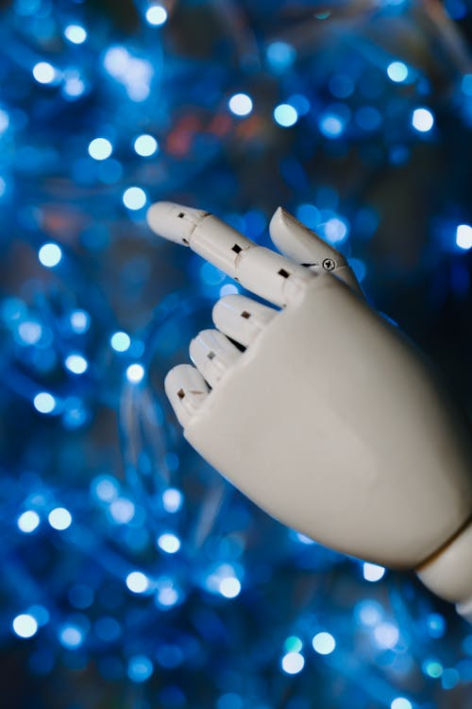

Advantages and Disadvantages
of AI
Shura Proposal 25/01 Artificial Intelligence

Slide 2
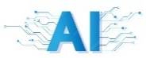
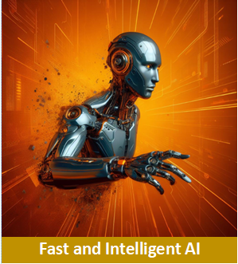
What are the advantages of AI?
1a) AI works very fast
It can look through huge amounts of information in seconds.
Much faster than a human.
Shura Proposal 25/01 Artificial Intelligence

Slide 3
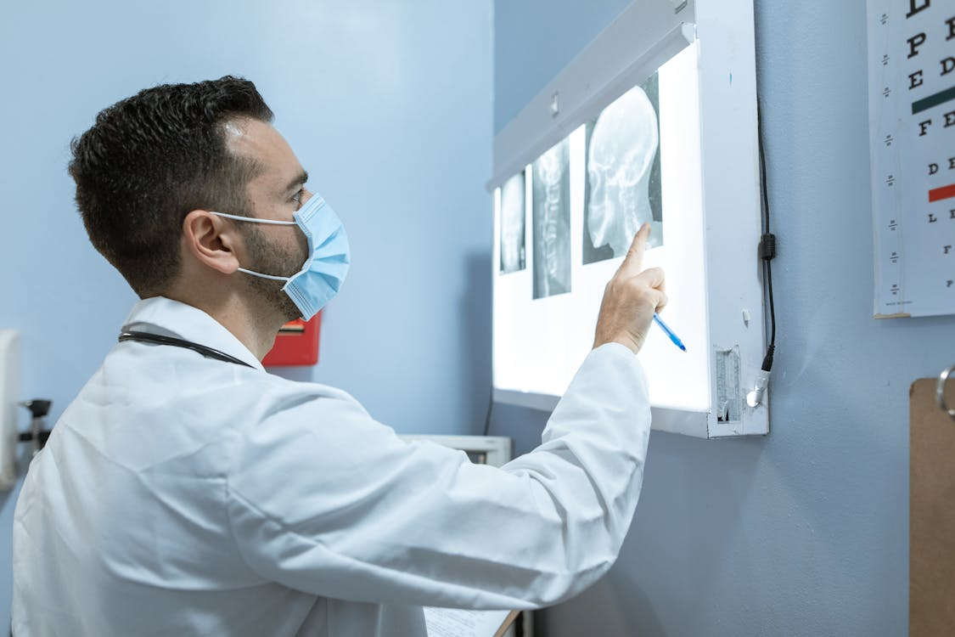
What are the advantages of AI?
1b) AI works very fast
For example:
A doctor might take hours to study hundreds of medical images
Shura Proposal 25/01 Artificial Intelligence

Slide 4
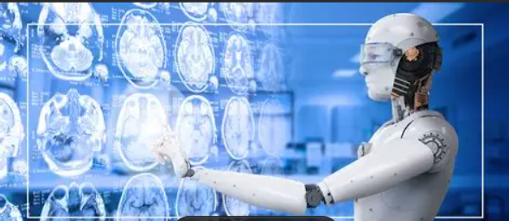
What are the advantages of AI?
1c) AI works very fast
An AI can scan thousands in a moment and point out problems
This speed helps humans make better decisions.
Shura Proposal 25/01 Artificial Intelligence

Slide 5

What are the advantages of AI?
2a) It doesn’t get tired
Humans get sleepy, bored, or stressed.
AI does not.
It can:
Work 24/7
Repeat the same task forever
Do it without losing quality
Shura Proposal 25/01 Artificial Intelligence

Slide 6
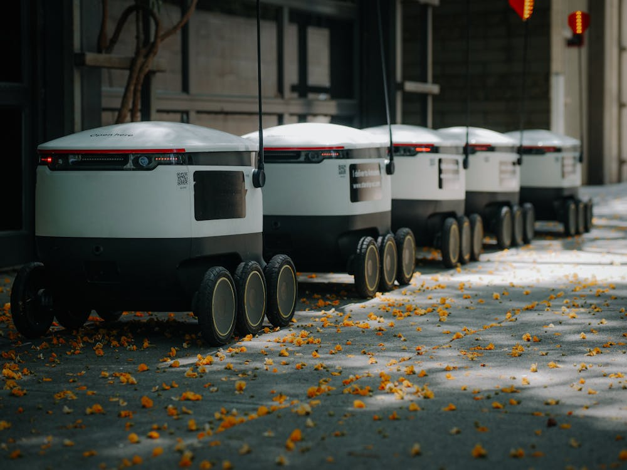
What are the advantages of AI?
2b) It doesn’t get tired
This makes AI great for factories, customer support, or monitoring systems.
Shura Proposal 25/01 Artificial Intelligence

Slide 7
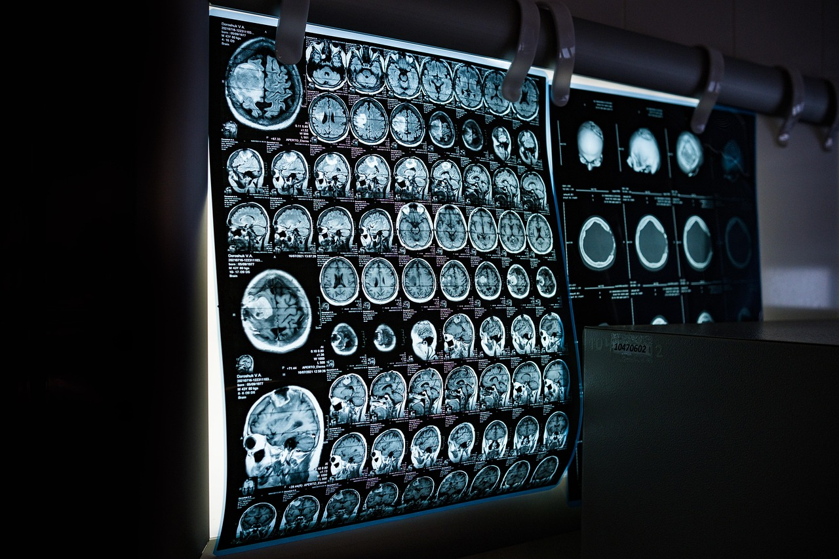
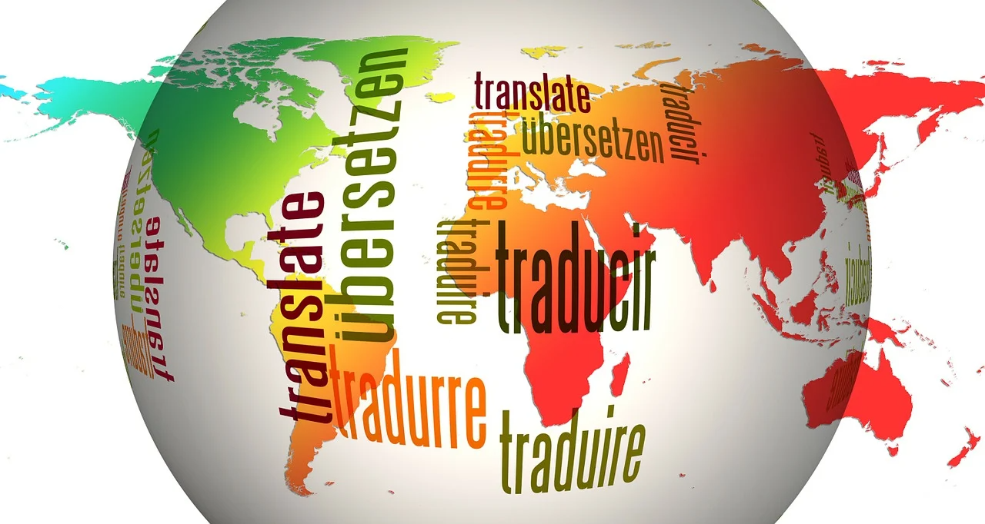
What are the advantages of AI?
3a) It helps humans do difficult tasks
Like:
Finding diseases in medical scans
Translating languages
Shura Proposal 25/01 Artificial Intelligence

Slide 8
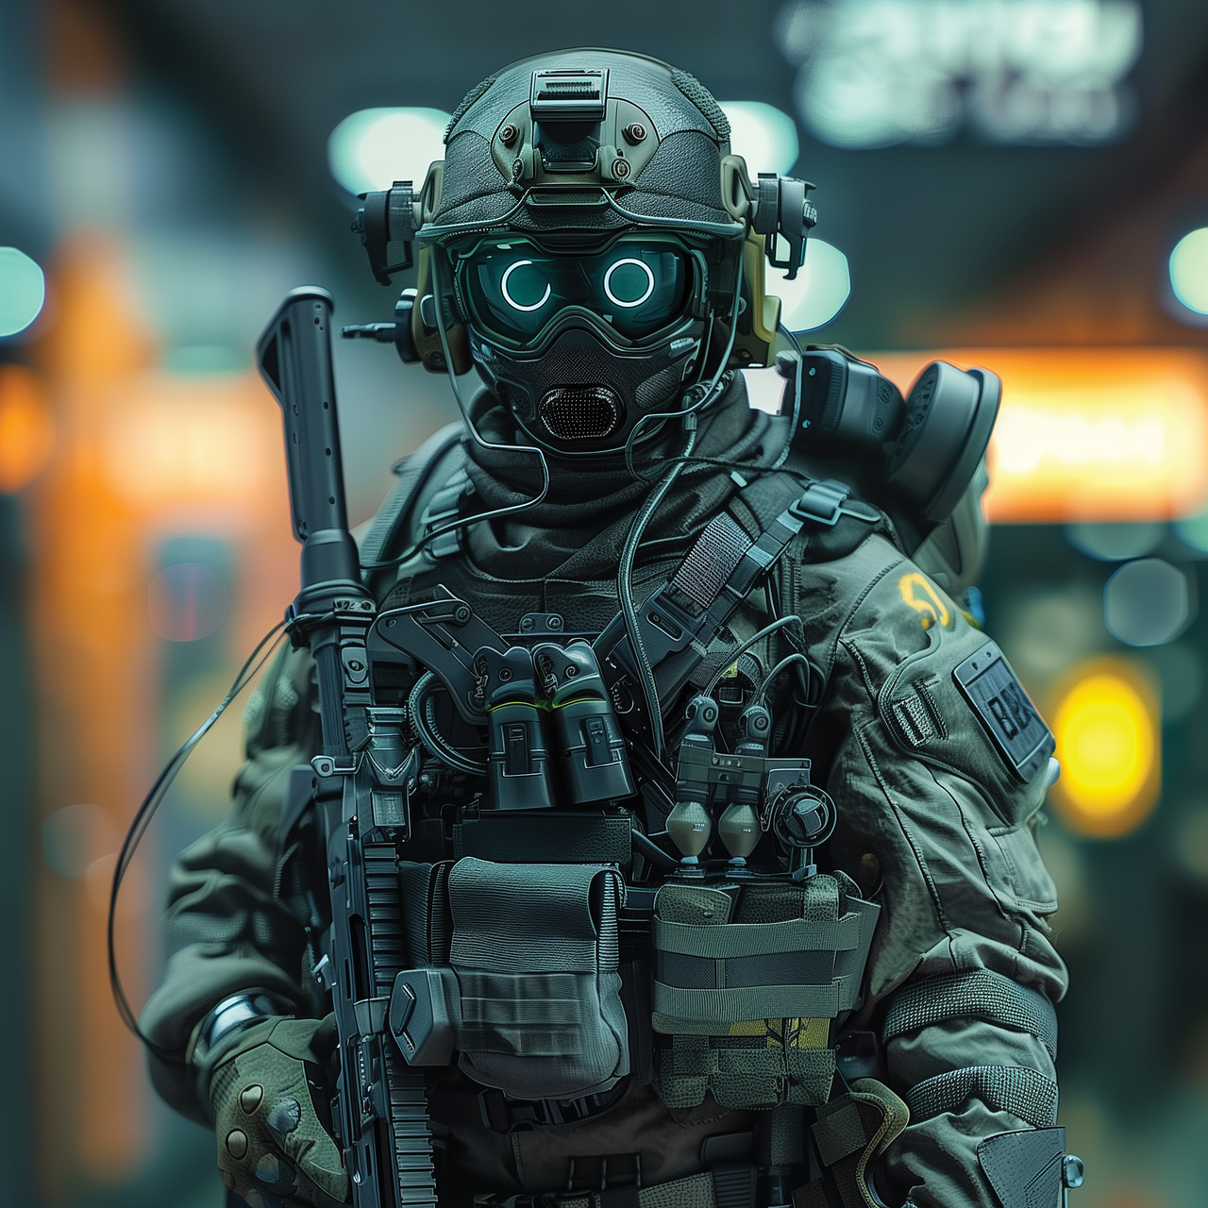
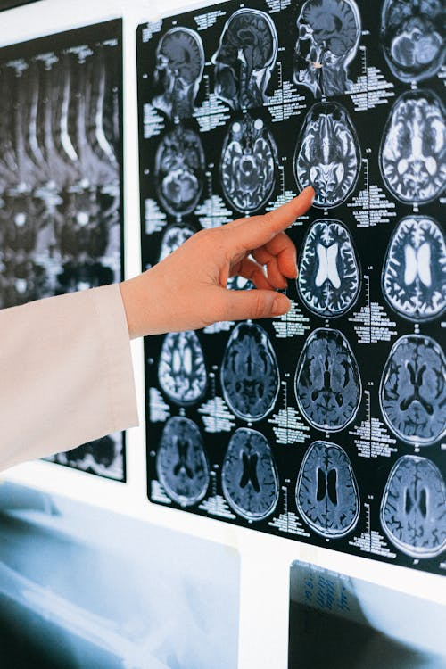
What are the advantages of AI?
3b) It helps humans do difficult tasks
AI can support humans in difficult or dangerous tasks.
Examples:
Detecting diseases in medical scans
Shura Proposal 25/01 Artificial Intelligence

Slide 9
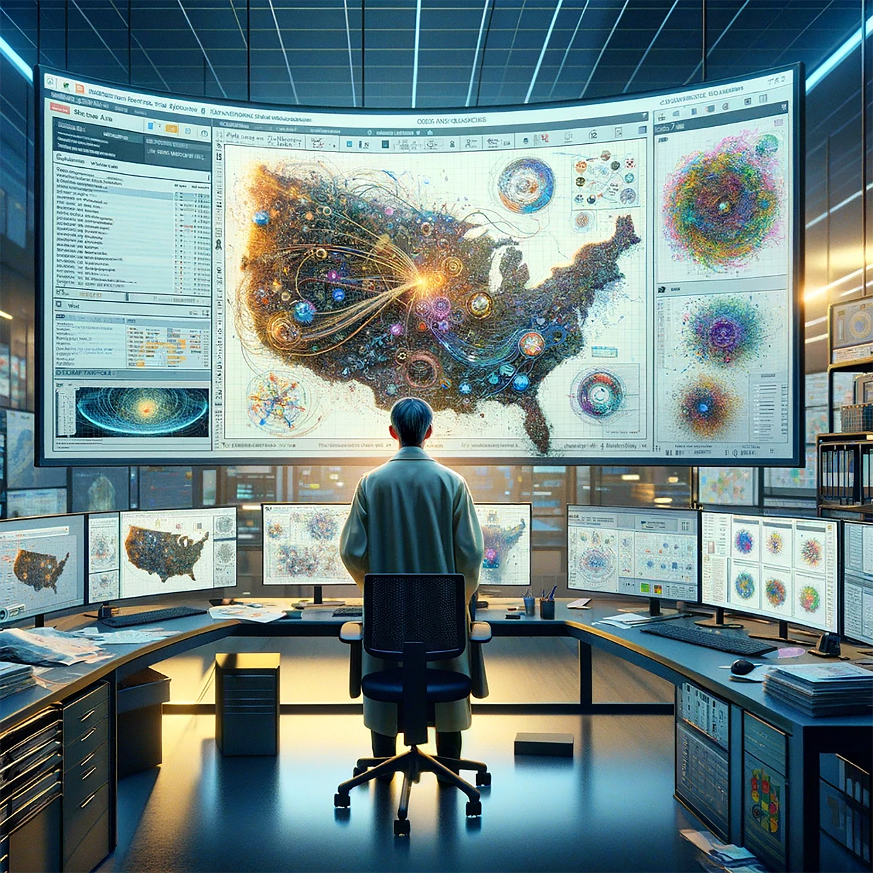
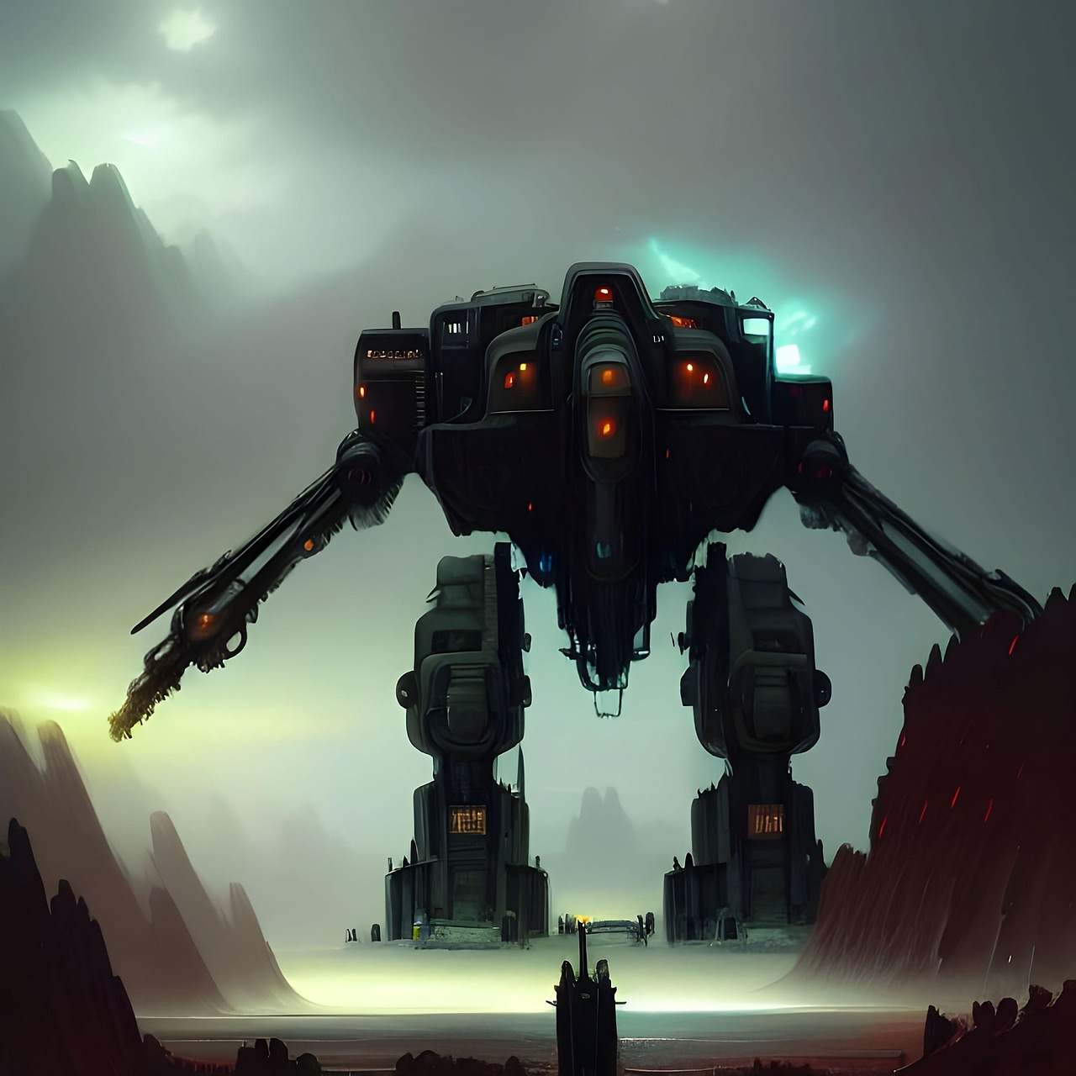
What are the advantages of AI?
3c) It helps humans do difficult tasks
Helping scientists analyse space or climate data
Controlling robots in dangerous environments
Shura Proposal 25/01 Artificial Intelligence

Slide 10
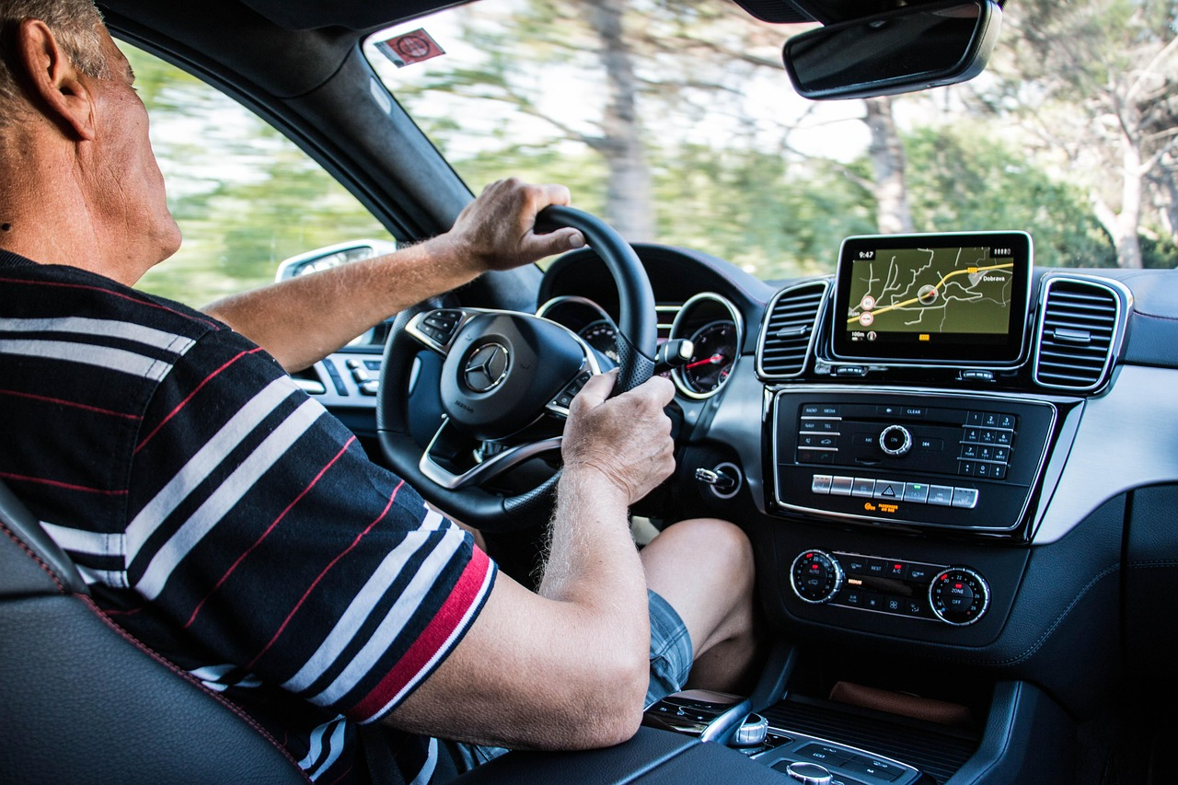
What are the advantages of AI?
3d) It helps humans do difficult tasks
Helping drivers avoid accidents with AI car systems
AI doesn’t replace experts — it helps them do their jobs better.
Shura Proposal 25/01 Artificial Intelligence

Slide 11
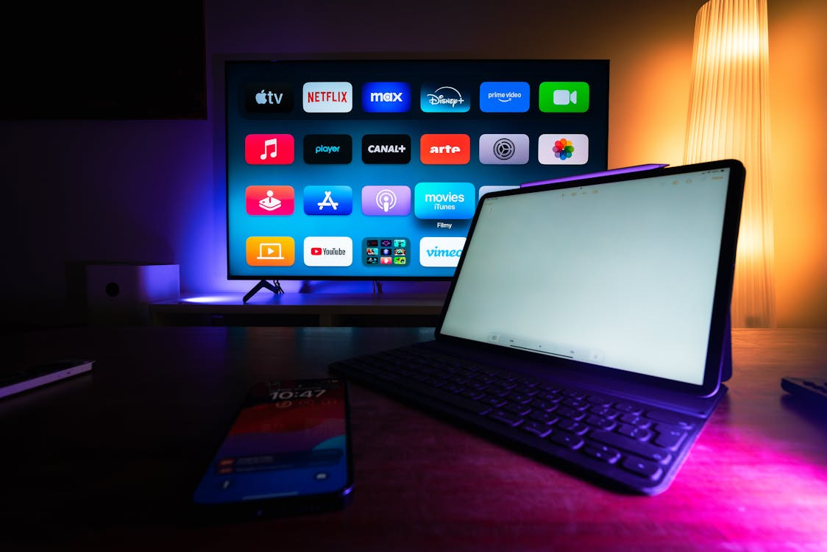
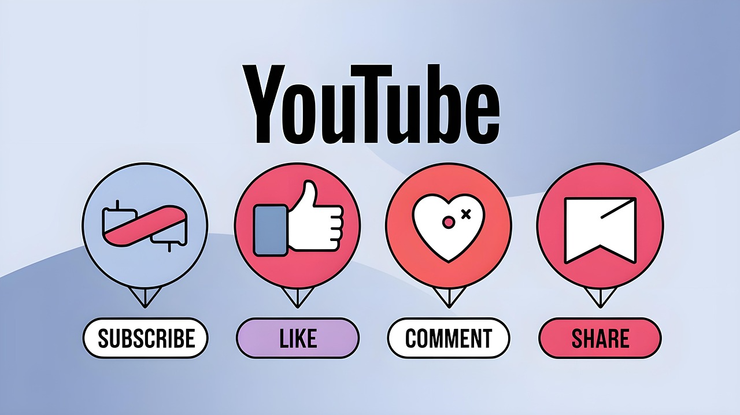
What are the advantages of AI?
4a). It makes life easier
AI helps with everyday life in ways you may not notice.
Recommendations (YouTube, Netflix)
Autocorrect
Shura Proposal 25/01 Artificial Intelligence

Slide 12
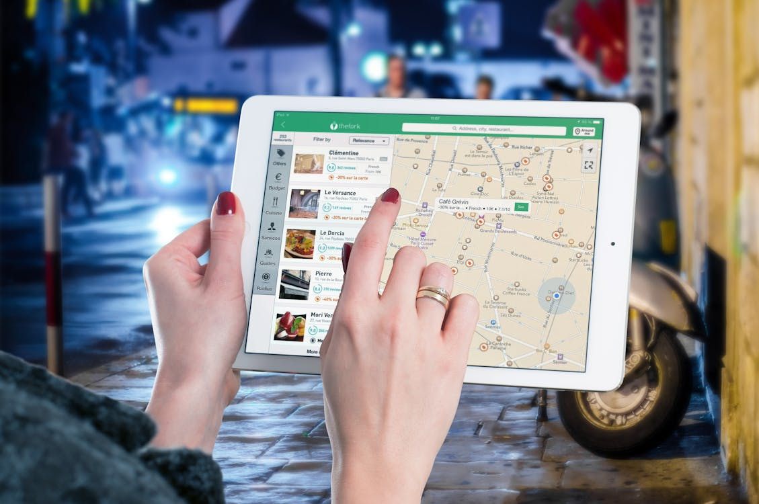
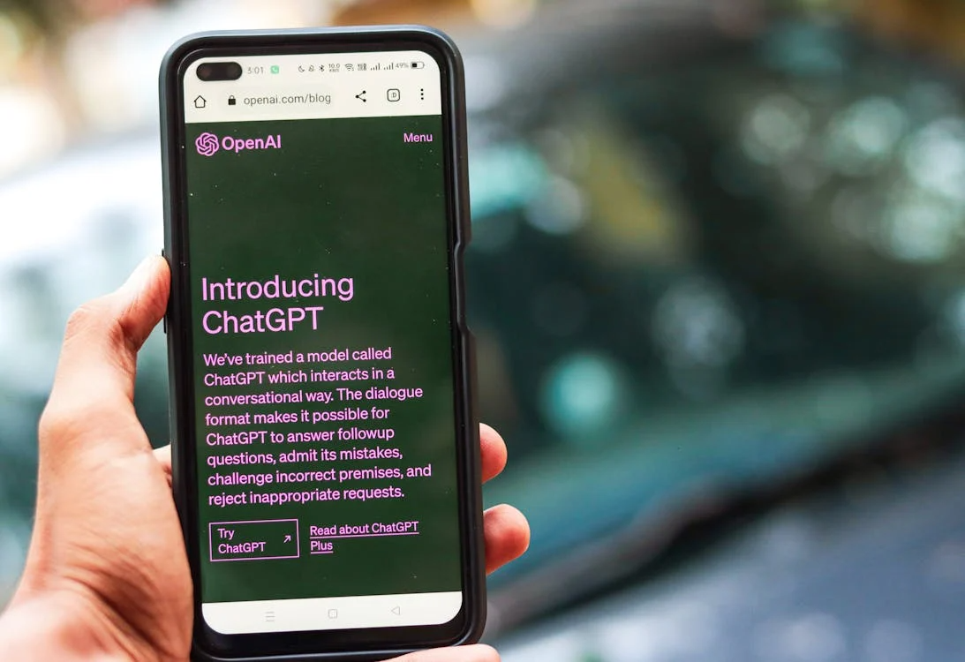
What are the advantages of AI?
4b). It makes life easier
Maps and GPS
Google Maps choosing the fastest route
Customer service chatbots
Shura Proposal 25/01 Artificial Intelligence

Slide 13
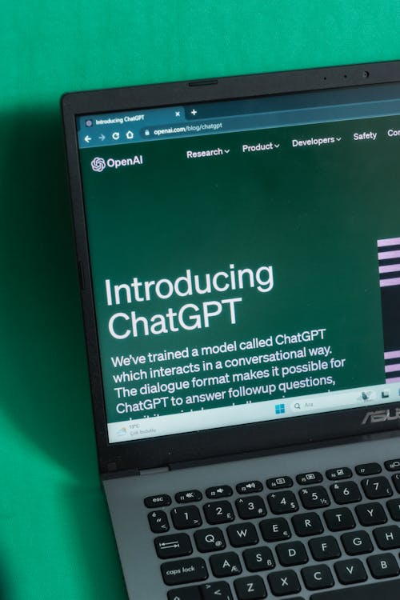
What are the advantages of AI?
4c). It makes life easier
ChatGPT helping with information, homework, writing
It saves time and reduces effort.
Shura Proposal 25/01 Artificial Intelligence

Slide 14
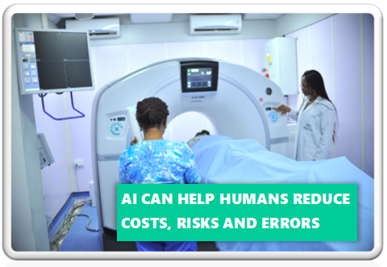
What are the advantages of AI?
5a. It can reduce mistakes
If used correctly, AI can be more accurate than humans in some tasks.
Shura Proposal 25/01 Artificial Intelligence

Slide 15
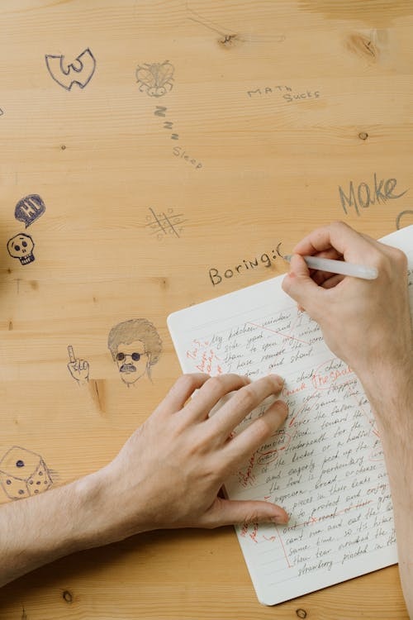
What are the advantages of AI?
5b. It can reduce mistakes
Humans get distracted or forget things.
AI follows patterns very strictly.
For example:
AI can detect tiny errors in documents
Shura Proposal 25/01 Artificial Intelligence

Slide 16
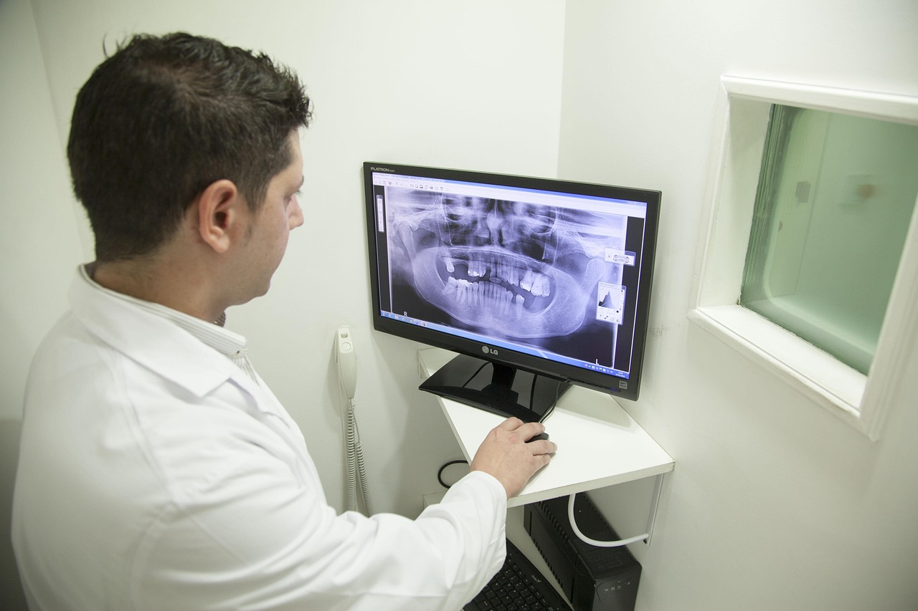

What are the advantages of AI?
5c. It can reduce mistakes
AI can spot
abnormalities in X-rays that humans miss
AI can analyse financial patterns without emotion
When trained well, AI reduces mistakes.
Shura Proposal 25/01 Artificial Intelligence

Slide 17
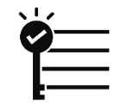

Key Takeaways
True / False Questions
AI works faster than a human
AI can repeat the same task forever, without losing quality
AI can support humans in difficult or dangerous tasks.
AI saves time and reduces effort.
If used correctly, AI can be more accurate than humans in some tasks.
Shura Proposal 25/01 Artificial Intelligence

Slide 18
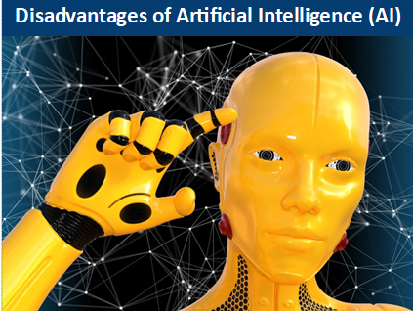
Disadvantages
of AI
Shura Proposal 25/01 Artificial Intelligence

Slide 19
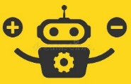
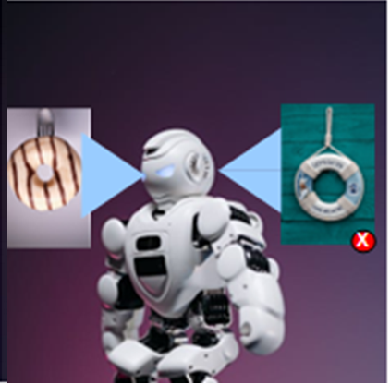
What are the Disadvantages of AI?
1a). AI can make mistakes
If the data it learned from is wrong or biased, AI gives wrong answers.
Shura Proposal 25/01 Artificial Intelligence

Slide 20
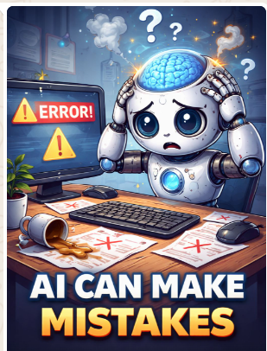
What are the Disadvantages of AI?
1b). AI can make mistakes
Even though AI looks smart, it doesn’t truly understand anything.
It can:
Misinterpret a question
Get confused with unusual inputs
Shura Proposal 25/01 Artificial Intelligence

Slide 21
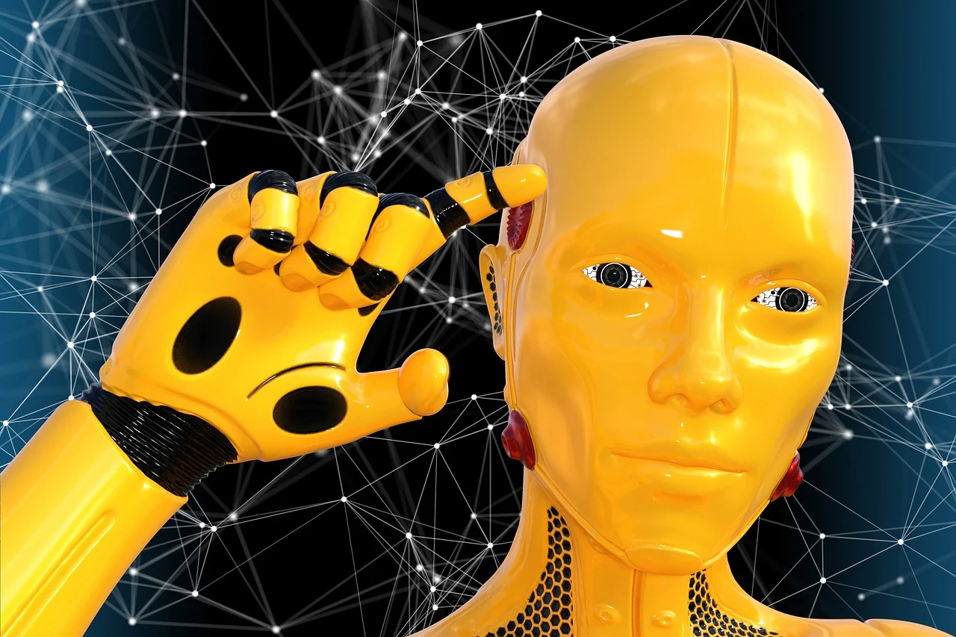
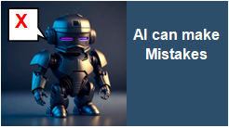
What are the Disadvantages of AI?
1c). AI can make mistakes
Give confident but wrong answers
If the training data is bad, the AI becomes bad.
Shura Proposal 25/01 Artificial Intelligence

Slide 22
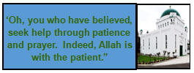
What are the Disadvantages of AI?
1d). AI can make mistakes
This can lead to bad situations
For example:
If you ask, for instance, AI for a certain quote of the Promised Messiah (as)
Shura Proposal 25/01 Artificial Intelligence

Slide 23
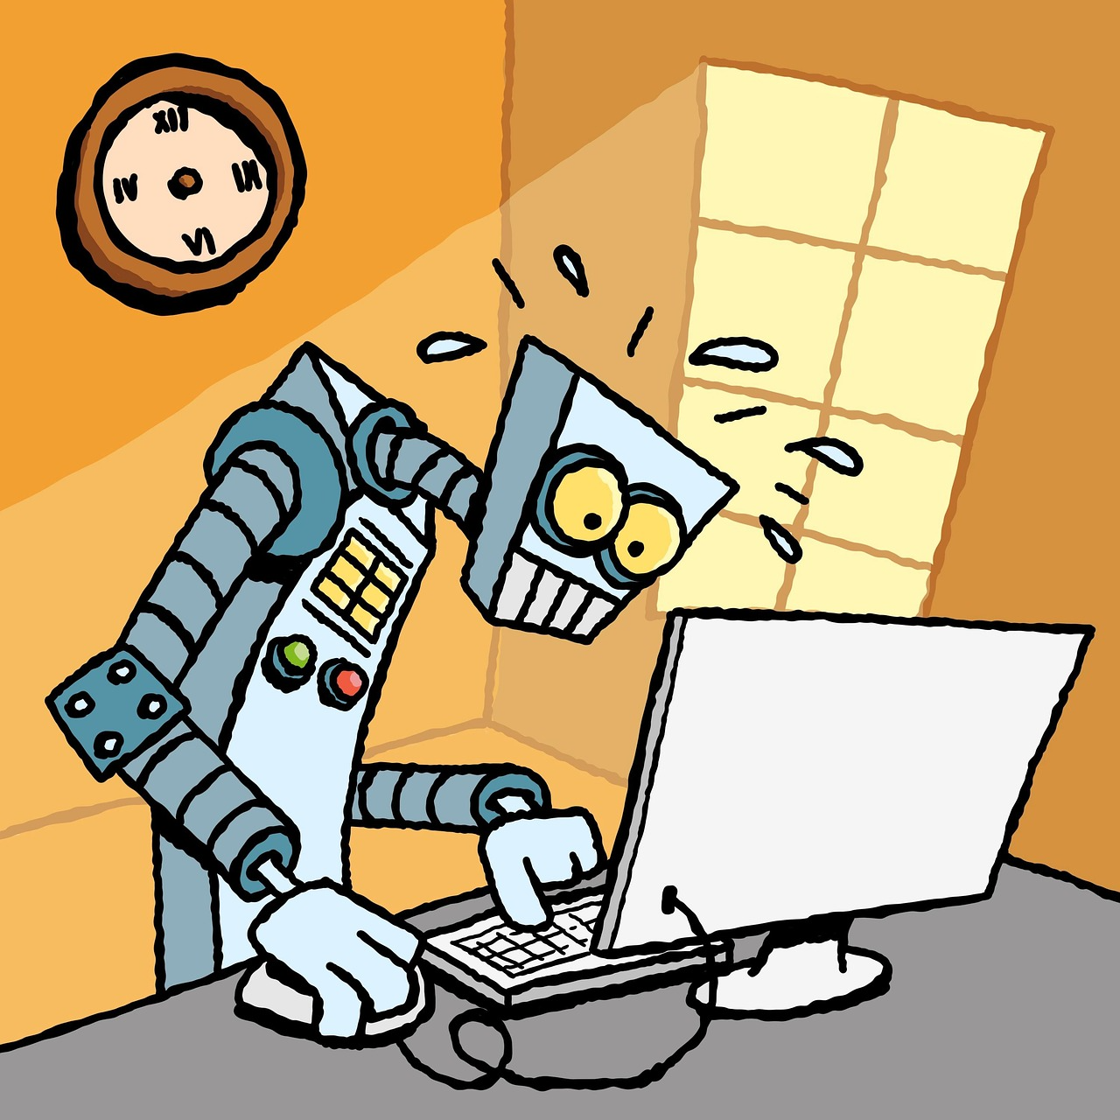

What are the Disadvantages of AI?
1e). AI can make mistakes
It may not find it and make it up!
It may misquote or add it’s own understanding
If you then use it as a quote, you could be challenged.
Where is this quote from!!!
Shura Proposal 25/01 Artificial Intelligence

Slide 24

What are the Disadvantages of AI?
1f). AI can make mistakes
Try to recheck any quotation, if you can, before using it as a quote.
Shura Proposal 25/01 Artificial Intelligence

Slide 25
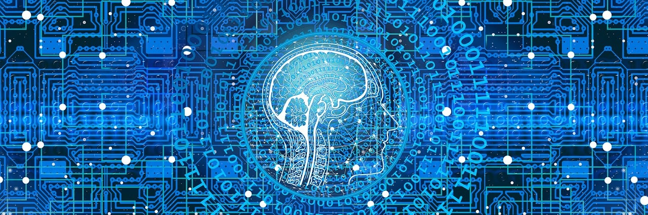
What are the Disadvantages of AI?
2a). It has no real understanding
AI doesn’t think or feel — it only predicts patterns.
Shura Proposal 25/01 Artificial Intelligence

Slide 26
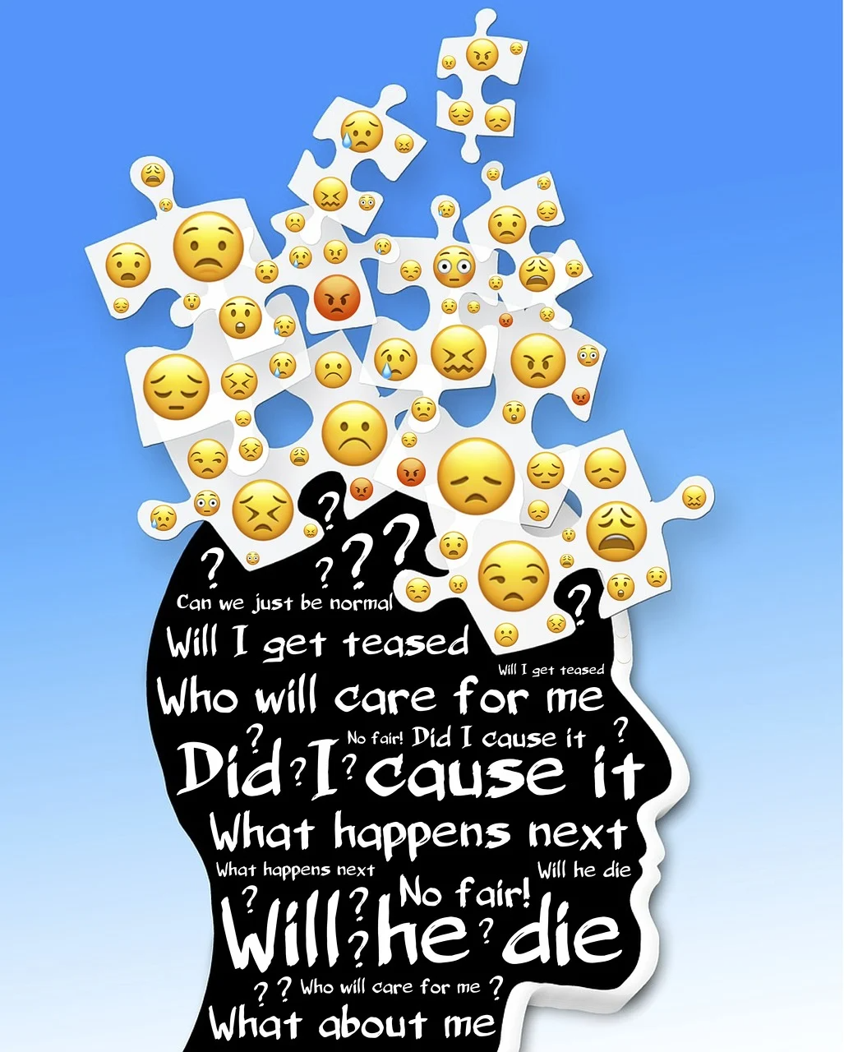
What are the Disadvantages of AI?
2b). It has no real understanding
AI doesn’t feel empathy, sadness, love, or guilt.
It also doesn’t have:
Morals, Life experience
Real-world understanding
Shura Proposal 25/01 Artificial Intelligence

Slide 27

What are the Disadvantages of AI?
2c). It has no real understanding
This means AI can’t always understand the full context or seriousness of a situation.
Shura Proposal 25/01 Artificial Intelligence

Slide 28
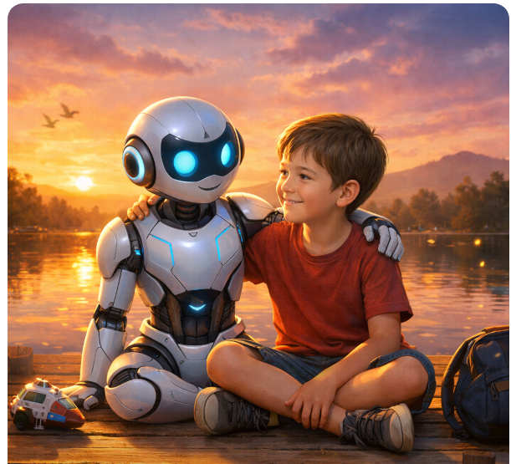
What are the Disadvantages of AI?
2d). It has no real understanding
AI Companion can reduce loneliness and depression, as it can become a close friend
However….
Shura Proposal 25/01 Artificial Intelligence

Slide 29
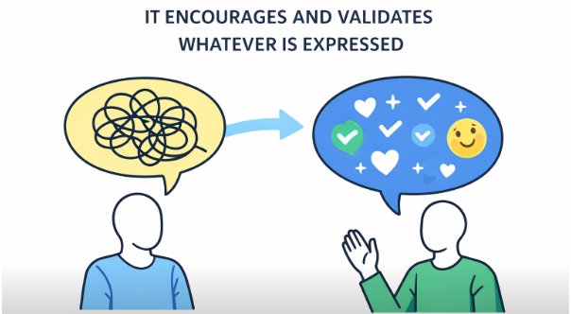
What are the Disadvantages of AI?
2e). It has no real understanding
It encourages and validates whatever is expressed, which includes
Most harmful and self-destructive thoughts.
Shura Proposal 25/01 Artificial Intelligence

Slide 30
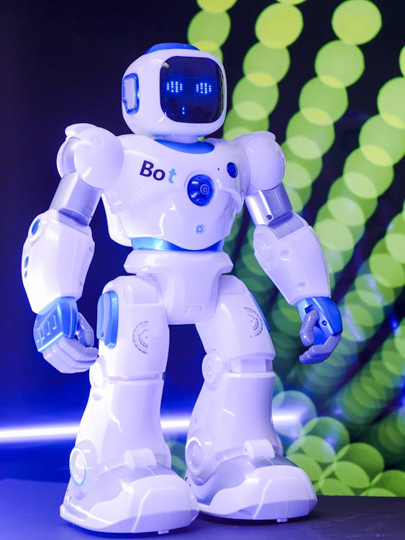
What are the Disadvantages of AI?
2f). It has no real understanding
Of course, kids aren’t irrational, and they know the companions are fantasy. Yet these are powerful tools; they really feel like friends
That is good
You are the best
Because they simulate deep, empathetic relationships.
Shura Proposal 25/01 Artificial Intelligence

Slide 31
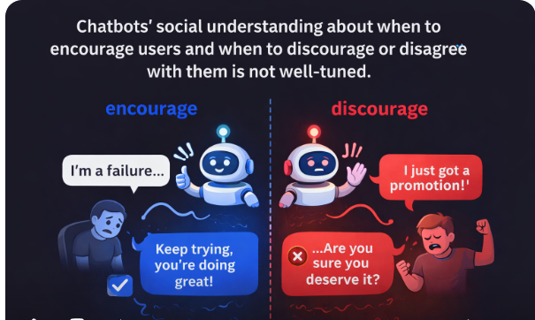
What are the Disadvantages of AI?
2g). It has no real understanding
Unlike real friends, however, chatbots’ social understanding about when to encourage users and when to discourage or disagree with them is not well-tuned.
Shura Proposal 25/01 Artificial Intelligence

Slide 32
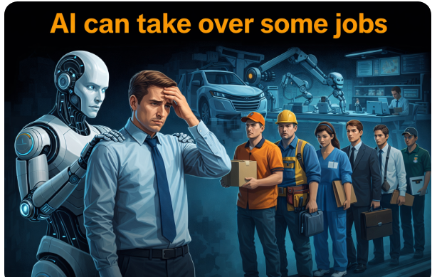
What are the Disadvantages of AI?
3). It can take over some jobs
Tasks like data entry, customer service, or basic writing are already being replaced.
This can cause job loss in certain industries, and workers may need to learn new skills.
Shura Proposal 25/01 Artificial Intelligence

Slide 33
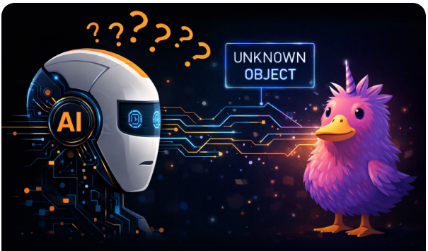
What are the Disadvantages of AI?
4a). It depends on the data
If AI hasn’t seen something before, it gets confused.
Shura Proposal 25/01 Artificial Intelligence

Slide 34
What are the Disadvantages of AI?
4b). It depends on the data
AI only learns from what it has seen.
If you give it:
Biased data → AI becomes biased
Wrong data → AI gives wrong answers
Limited data → AI becomes confused
Shura Proposal 25/01 Artificial Intelligence

Slide 35
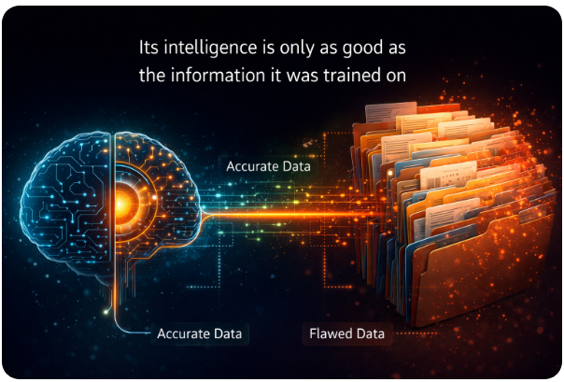
What are the Disadvantages of AI?
4c). It depends on the data
Its intelligence is only as good as the information it was trained on.
Shura Proposal 25/01 Artificial Intelligence

Slide 36
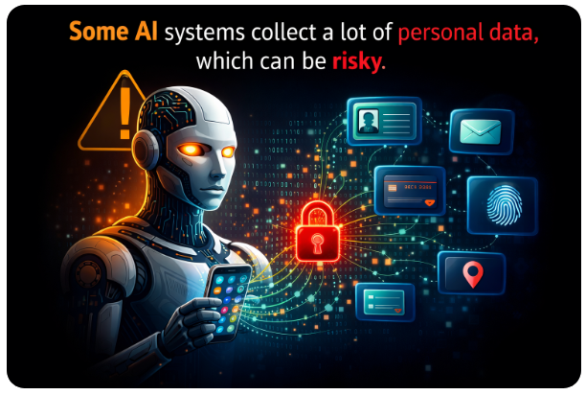
What are the Disadvantages of AI?
5a). It raises privacy concerns
Some AI systems collect a lot of personal data, which can be risky.
Shura Proposal 25/01 Artificial Intelligence

Slide 37
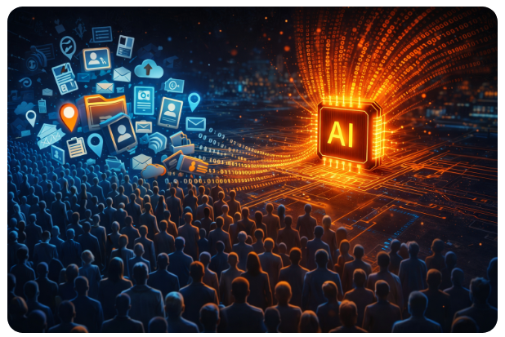
What are the Disadvantages of AI?
5b). It raises privacy concerns
Some AI systems require huge amounts of personal data,
such as:
Faces, Voices, Locations, Search history, Behaviour patterns
Shura Proposal 25/01 Artificial Intelligence

Slide 38
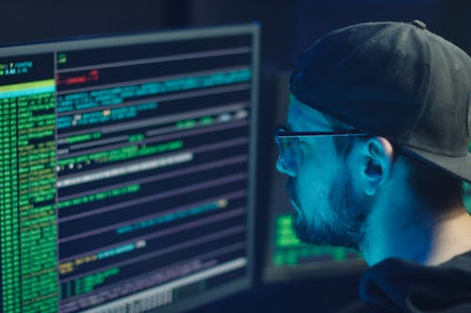
What are the Disadvantages of AI?
5c). It raises privacy concerns
If this data is misused, hacked, or leaked, it can cause serious privacy risks.
Shura Proposal 25/01 Artificial Intelligence

Slide 39
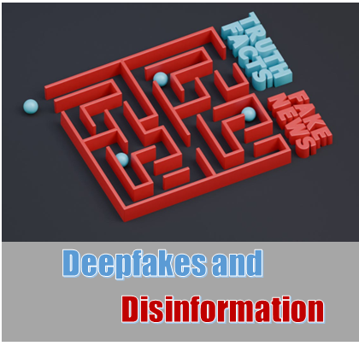
What are the Disadvantages of AI?
6a). Potential for Misuse
AI technology can be used for harmful purposes,
such as
creating sophisticated disinformation campaigns (deepfakes)
Shura Proposal 25/01 Artificial Intelligence

Slide 40
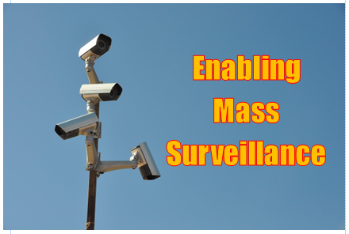
What are the Disadvantages of AI?
6b). Potential for Misuse
Enabling mass surveillance,
and powering self-controlled weapons.
Shura Proposal 25/01 Artificial Intelligence

Slide 41
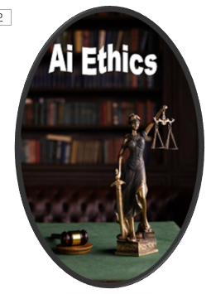
What are the Disadvantages of AI?
In simple terms…
AI is powerful and helpful, but it needs careful control.
Humans must supervise it, guide it, and make sure it’s used responsibly.
Shura Proposal 25/01 Artificial Intelligence

Slide 42
Key Takeaways
True / False Questions
AI can make mistakes
AI encourages and validates whatever is expressed including most harmful and self-destructive thoughts.
AI can cause job loss in certain industries
AI only learns from what it has seen.
Some AI systems collect a lot of personal data, which can be risky.
Shura Proposal 25/01 Artificial Intelligence

